Slide 1
DICOM Educational Conference Chennai, India
October 9-11, 2023
Large-scale Implementation of DICOM
Mayo Clinic
Nick Charboneau
Enterprise IT Architect

Slide 2
Agenda
Mayo Clinic overview
Baselining a vender neutral archive and enterprise imaging
Practical considerations before implementing a VNA
Emerging areas of enterprise imaging
Cloud Integrations
Digital Pathology
Longitudinal Patient Record
Conclusions

Slide 3
Mayo Clinic Overview

Slide 4
Who We Are and What We’re About
Mayo Clinic
Nonprofit organization committed to clinical practice, education and research.
Primary Value
The needs of the patient come first.
Mission
Inspiring hope and promoting health through integrated clinical practice, education and research.
Vision
Transforming medicine to connect and cure as the global authority in the care of serious or complex disease.
Notes:
Mayo Clinic is committed to clinical practice, education and research.
Primary value is that the needs of the patient come first—this is an important part of the work that we do
Medical Institutions across the world have a strong desire for:
Patient-centric management
Efficiency in workflow
Seamless integration between applications
Strive for the best tools and technology to improve patient care.
Standards and Industry have been great partners with Medical Institutions by:
Bringing advances in technology to healthcare
Striving for well-defined and adopted standards
Enabling interoperability using these standards and best practices
A crown jewel example of this partnership is the growth of the Vendor Neutral Archive and adoption of Enterprise Imaging

Slide 5
Baselining a Vender Neutral Archive and Enterprise Imaging
Notes:
Let’s baseline a Vendor Neutral Archive and Enterprise Imaging to see how it enables interoperable clinical imaging for healthcare facilities.

Slide 6
What is a VNA Anyway?
Vendor Neutral Archive
An Archive for Medical Images
Notes:
A Vendor Neutral Archive or VNA consists of three primary characteristics
1) An Archive for Medical Images
2) Based on Medical Imaging Standards
3) Vendor Neutral - Interoperable with “Standards-based” Systems from Other Vendors

Slide 7
What is a VNA Anyway?
Vendor Neutral Archive
An Archive for Medical Images • Based on Medical Imaging Standards
Notes:
A Vendor Neutral Archive or VNA consists of three primary characteristics
1) An Archive for Medical Images
2) Based on Medical Imaging Standards
3) Vendor Neutral - Interoperable with “Standards-based” Systems from Other Vendors

Slide 8
What is a VNA Anyway?
Vendor Neutral Archive
Radiology PACS
Cardiology PACS
Other Dep’t PACS
Procedural Photos/Video
Medical Photos
etc.
An Archive for Medical Images • Based on Medical Imaging Standards
Notes:
A Vendor Neutral Archive or VNA consists of three primary characteristics
1) An Archive for Medical Images
2) Based on Medical Imaging Standards
3) Vendor Neutral - Interoperable with “Standards-based” Systems from Other Vendors

Slide 9
VNA: Not All the Same
Quality Assurance
Validation
IOCM
Reporting
Recycle Bin
EMR Integration
Notification Services
PIX
Image Viewers
Image Exchange
Logical Data Handling
Data Pooling
Access Management
Data Privacy Services
Lifecycle Management
Data Format Support
Non-DICOM objects
Documents
Videos
Migration Services
Notes:
But, Not all VNAs are the same!
While VNAs at the core provide these foundational capabilities VNAs are not all built the same or provide the same services.
VNA vendors can differentiate themselves in the market to support a number of additional important requirements and use cases throughout the healthcare environment.
Examples of this include:

Slide 10
Revolutionary Milestones in Medical Imaging
1895
1971
1990s/2000s
2000s
2010s
2020s - 2030s
First X-ray
CT (Computed Tomography) Scanner Invention
Growth of PACs for departmental workflows and specialities
Vendor Neutral Archive (VNA) Emergence
Enterprise Medical Imaging Ubiquity
Cloud integrations
Growth of Digital Pathology
Maturation of the Longitudinal Patient Record
AI
Notes:
Looking back on the major milestones in medical imaging we see an incredible amount of innovation and growth of an industry.
1990s
2000s
2010s
2019 was the last time the DICOM standard meeting was held, and VNAs and Enterprise Imaging platforms were becoming more common and mature.
Four years later we see a number of emerging areas that will play a key role in transformative care using medical imaging technologies.

Slide 11
VNA: In an Imaging Ecosystem
VNA In an Imaging Ecosystem
Electronic Health Record
AI
Research
Post
Processing
Health Data
Exchange
Vendor Neutral Archive
Radiology PACS
Cardiology PACS
Other Dep’t PACS
Procedural Photos/Video
Medical Photos
etc.
Notes:
Note: This slide has animation
The Vendor Neutral Archive is the central role in an imaging ecosystem.
It supports image creators ranging from well established image producing departments such as Radiology and Cardiology
To more recent medical imaging producers such as GI department Procedural Photos/Video, and Dermatology’s use of Medical Photos
The VNA connects the imaging world to other parts of the ecosystem.
AI applications, research groups, and post-processing applications use the VNA as the primary system to access medical imaging data.
The Electronic Health Record can become “image enabled” by interacting with the VNA to become aware of imaging data for patients and linking the related metadata with the rest of the patient record.
The VNA also has connections outside of the primary healthcare facility through Health Data Exchanges and more recently specialized cloud integrations.
This imaging ecosystem would not be possible without the participants adhering to a common way to interact with each other.

Slide 12
VNA: In an Imaging Ecosystem
VNA In an Imaging Ecosystem
Electronic Health Record
AI
Research
Post
Processing
Health Data
Exchange
Vendor Neutral Archive
Radiology PACS
Cardiology PACS
Other Dep’t PACS
Procedural Photos/Video
Medical Photos
etc.
Notes:
The enabling factor allowing all these participants to work with the VNA is the use of standards.
Rich adoption of standards like DICOM and HL7 greatly improves the use of imaging as a major institutional platform to provide the necessary information and data to individuals and applications.

Slide 13
Practical Considerations Before Implementing a VNA
Notes:
Let’s look at some practical considerations

Slide 14
VNA and Enterprise Imaging
Define Enterprise Imaging Strategy and Core Services to Provide
Establish Effective Governance for Strategy Implementation
Create an Enterprise Imaging Platform to Provide the Core Services
Work with Departments to Integrate their Devices and Applications
Foundations for Success
Image Archival, Viewing, and Exchange
EMR Integration
Outside Image Management
Image Access Controls and Auditing
Policies
Prioritization
Planning
Approval
Oversight
The Platform Itself
Standards-based integrations
Order-Based Workflows
Encounters-Based Workflows
Outside Images
Medical and Surgical Photos and Video
Notes:
Organizations can use four foundations for success as guiding principles to support launching their first Enterprise Imaging environment as well as adapting to advances in technology and standards.
Defying enterprise imaging strategy and core services provide
Establish effective governance for strategy implementation
Create an enterprise imaging platform to provide the core services
Work with departments to integrate their devices and applications
Group into patterns

Slide 15
VNA: In an Imaging Ecosystem
VNA In an Imaging Ecosystem
Electronic Health Record
AI
Research
Post
Processing
Health Data
Exchange
Vendor Neutral Archive
Radiology PACS
Cardiology PACS
Other Dep’t PACS
Procedural Photos/Video
Medical Photos
etc.
15
Notes:
Applying the foundations for success and deciding on the VNA architecture provides the necessary information to successfully implement a VNA and Enterprise Imaging Platform for your organization.
Morph transition
Here is the VNA Implementation jointly developed by Mayo and our VNA vendor.

Slide 16
Enterprise Imaging
EXAMPLE: MATURE VNA IMPLEMENTATION
Electronic Health Record
Registration
Master Data
Orders Results Management
Worklist
Services
Acquire/Store
Photos/Videos
EHR
Desktop
EHR
Mobile
Patient
Portal
DICOM, HL7 and Web Services
Vendor Neutral Archive
DICOM Digital
Capture Devices
DICOM Wrap
Import Services
Outside Images
Import
Service
Mayo
Images
Export
Service
Orders-based
Encounters-based
Image Exchange
Figure based on: Roth, C.J., Lannum, L.M. & Persons, K.R. A Foundation for Enterprise Imaging: HIMSS-SIIM Collaborative White Paper. J Digit Imaging 29, 530–538 (2016). https://doi.org/10.1007/s10278-016-9882-0
Notes:
Note; This slide has animation
Here is the VNA Implementation jointly developed by Mayo and our VNA vendor.
It has grown from one department in 2003 into an enterprise-wide platform used by all of our facilities and over 80 individual departments.
Mayo has evolved this architecture over the years to respond to growing business requirements and improvements in technology and the DICOM standard.
We are now seeing emerging areas of enterprise imaging that require some adjustments to our architecture to fully support the demand and advancing technologies.

Slide 17
Emerging Areas of Enterprise Imaging
Notes:
We will now take a closer look at these emerging areas and explore the changes to our architecture.

Slide 18
Emerging Areas of Enterprise Imaging
FHIR Analytics
Cloud Integrations
Digital Pathology
Longitudinal Patient Record
Supporting advancing technologies
Notes:
These include:
Cloud Integrations
Moving beyond applications running in the cloud
Integrated into workflow and optimizing performance and costs
Digital Pathology
A brand new department to clinical digital imaging
Enormous storage requirements
Less standardization among vendors
Longitudinal Patient Record (LPR)
The LPR is a single complete patient record that combines data from a variety of sources throughout the healthcare system. This includes text and clinical media data such as images, audio, and video.
Opportunities for applications to see the whole story of a patient through one pane of glass

Slide 19
Cloud Integrations
Notes:
Cloud technologies provide tremendous opportunities for enterprise imaging

Slide 20
Extending to a Hybrid Cloud Architecture
AI
Research
Post
Processing
Electronic Health Record
Vendor Neutral Archive
Radiology PACS
Cardiology PACS
Other Dep’t PACS
Procedural Photos/Video
Medical Photos
etc.
Notes:
So far, we’ve discussed the importance of the VNA and its role in the enterprise
This architecture is based on on-premises implementations and workflows.
The model is highly mature and continues to be essential to the enterprise imaging ecosystem.
We are now starting to see use cases requiring a presence in the cloud.
These use cases cover requirements such as:
reducing on-premises infrastructure capital costs
scaling to increased demand
increased integrations with Software as a Service products
Most importantly anticipating future technological advances around AI

Slide 21
Extending to a Hybrid Cloud Architecture
+
AI
Research
Post
Processing
AI
Research
Post
Processing
Vendor Neutral Archive
PACS
Procedural Photos/Video
Medical Photos
Cloud PACS
Cloud SaaS
apps
etc.
Notes:
Note: Slide has animation
Institutions will need to consider how to continue to support the established enterprise imaging architecture and extend the clinical imaging capabilities to the cloud environment.
This provides an on-ramp for cloud-based image producers and consumers.
Early adopters of cloud imaging include AI products, Research projects, and automated post-processing applications.
These categories are a natural fit for cloud imaging as they align with other industry patterns using computational cloud power and storage flexibility to process clinical images.
Cloud SaaS applications are also becoming more prevalent to incorporate into workflows
There are many SaaS imaging products being introduced into the market to do very specific tasks
Healthcare organizations leveraging these products can implement them more rapidly than on-premises
Major departmental PACS applications are starting to offer their solutions within the cloud.
This is attractive to support healthcare organizational-level desires to reduce capital and ongoing expenses on infrastructure where it makes sense
It also provides a cloud point-of-presence for other applications and use cases to draw from

Slide 22
Enabling Cloud Extensions
Data Transmission
DIMSE DICOM
VPNs to other sites
Workflows around C-MOVE
Performance
Local latencies (1-5ms)
Heavy traffic loads
Workflows around instant data accessibility and viewing
Enabling “Best of Breed”
Mature Enterprise Imaging Architecture
“De-constructed” PACS models
On-Premises
Optimizing for the Cloud
DICOMWeb
HTTPS to other sites
Feature parity for C-MOVE via DICOMWeb
Regional latencies (40-50ms)
Shared backbone to provider
Need optimized hybrid architectures
New Enterprise Imaging Architectures
Stress vendor commitment to interoperability and VNA core services
Cloud Enablement
Notes:
These cloud extensions require adjustments to the established architectures.
Three areas of optimization that are key to Cloud adoption include.
Data Transmission
Language of the cloud is HTTP
Products should look to a richer adoption of DICOMweb
Look to working with the DICOM WG27 for guidance on use cases that are difficult to achieve through existing DICOMweb features such as C-MOVE concepts using real-time web technologies.
Performance
Distributed networks with greater latency and associated egress costs
Optimized hybrid architectures to support use cases in an efficient and cost-effective way
Enabling “Best of Breed”
Common model of enterprise imaging with best of breed
Continue to stress an interoperable model and enterprise imaging architecture principles

Slide 23
Digital Pathology
Notes:
Pivoting digital pathology we are taking the current process and making data more easily accessible

Slide 24
Case Study: Digital Pathology
Problem
Digitize and access pathology data to provide the best possible care for patients
Solution
Leverage Artificial Intelligence and Machine Learning Technologies to develop new diagnostic tests
Increase pathologist efficiency
Minimize turnaround time and reduce potential for error and lower costs
Outcome
Increasing the value of pathology services to Mayo Clinic, clients and patients
Notes:
Problem
How do we digitize and access pathology data to provide the best possible care for patients?
Solution
Leveraging AI and ML to develop new diagnostic tests
Increase pathologist efficiency
Minimize turnaround time, reduce potential for error and lower costs
Outcome: increasing the value of pathology services to Mayo Clinic, Clients and patients

Slide 25
Applied “Foundations for Success” to Digital Pathology
Define Enterprise Imaging Strategy and Core Services to Provide
Establish Effective Governance for Strategy Implementation
Create an Enterprise Imaging Platform to Provide the Core Services
Work with Departments to Integrate their Devices and Applications
Digital Pathology
Image Archival, Viewing, and Exchange
Outside Image Management
Image Access Controls and Auditing
Policies
Prioritization
Planning
Approval
Oversight
The Platform Itself
Standards-based integrations
Order-Based Workflows
Outside Images
25
Notes:
We used the same Foundations for Success framework to apply to Digital Pathology to ensure a consistent Enterprise Imaging experience for Mayo Clinic.
These greatly helped us steer in the right direction to support a prominent new digital department contributing to the imaging platform.

Slide 26
Our Digital Pathology Approach Mirrors Traditional Clinical Imaging
AI
Cloud Apps
Cloud Viewers
Digital Pathology Vendor Neutral Archive
DICOM conversion (SVS, NDPI, etc.)
Future
PACS
Tissue Registry
Other
Slide formats
DICOM
Applications
26
Notes:
Our Digital Pathology approach mirrors that of traditional clinical imaging.
Due to several factors including:
- Large storage requirements
- And the use of cloud-based AI analytics
Mayo chose to archive the digital pathology data into a cloud-based VNA.
Mayo worked very hard to cast the vision of a digital pathology archive based on the DICOM standard.
We engaged Dr. David Clunie - one of the world’s experts in DICOM and Digital Pathology - for guidance in properly converting proprietary data formats into DICOM Whole Slide Images.
We continue to work with vendors to improve their conformance to DICOM
We anticipate a time when digital pathology vendors will have more complete support for DICOM and can begin to retire the conversion layer sitting between the product and the VNA.

Slide 27
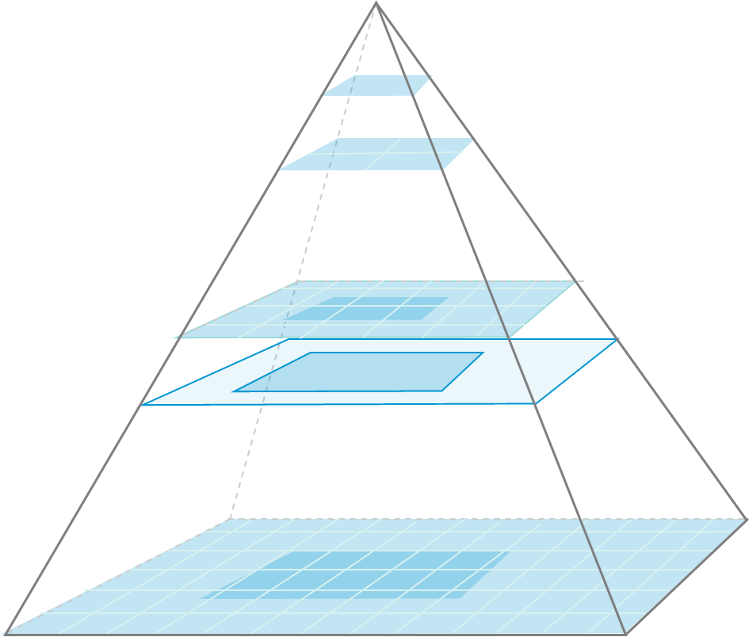
Working Towards Standardization
Problem
What’s the best way to represent sparse slide imagery with z-stacking?
Approaches to Date
Engaging DICOM WG 26 for guidance
Reviewing proposals with vendors
Processing vendor feedback
Notes:
Some acquisition techniques are more complex to map into the DICOM specification.
In this example, we see the Whole Slide Imaging pyramid of the different levels of magnification.
One of our pathology Digital FISH workflows is to scan slides at multiple depth levels across several fields of view.
This is a complex technique to understand how to properly encode into DICOM
And we’re reviewing proposals and feedback with the vendors to work toward a consistent and proper way to handle this.
We’ve also engaged DICOM WG 26 for guidance and look forward to more discussions to ensure we are working in accordance with the standard.
Other use cases are likely to come up in this growing space, and we look forward to working with the DICOM community to identify the right way to encode the metadata.

Slide 28
Longitudinal Patient Record
Notes:
The LPR is our final emerging area of Enterprise Imaging

Slide 29
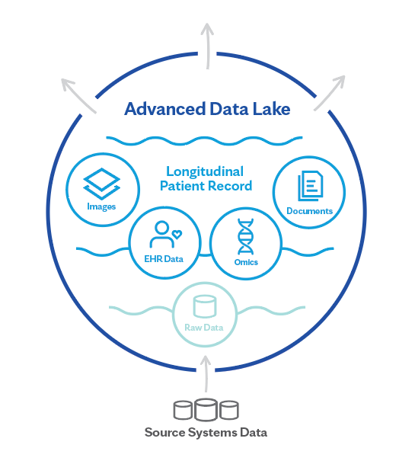
THE PATIENT’S HEALTH JOURNEY
Application Development
Clinical Consumption
AI and Analytics
Notes:
We talked about the Longitudinal Patient Record (LPR) earlier in this presentation.
It’s a single complete patient record that combines data from a variety of sources throughout the healthcare system
Our goal is to provide an LPR that is trusted, secured, and usable for clinical consumption, application development, and AI/Analytic consumers.
Let’s keep going and learn more

Slide 30
Providing Context to Consumers
Longitudinal
Patient Record
Patient Care
Teaching
AI/Research
Sensitive/Restricted Imaging
Departments
Training
Clinical
Clinical
External
Labeling
Patient
Other
Development
Notes:
Soon after a facility has adopted an enterprise imaging strategy, use cases arise which require custom management strategies to distinguish the context of the imaging data.
A key example today is the ability to define a DICOM study containing sensitive or restricted information.
This is most often seen in visible light photographs from areas such as plastic surgery or graphical content.
Policies will differ by facility, but as the data becomes more available to a different consumer types, the need to identify these in an interoperable way becomes more important.
In this example sensitive images are available in patient care settings and clinical AI/Research settings.
It is unavailable for teaching or other development and labeling workflows.
The DICOM Standard is working on an approach to help address this in an interoperable way through a Change Proposal, and we look forward to it being adopted in products in the future.

Slide 31
Providing Context to Consumers
Longitudinal
Patient Record
Patient Care
Teaching
AI/Research
Contextual Intent
Departments
Training
Clinical
Cardiology
IRB Study
Clinical
External
Labeling
Patient
Other
Development
Notes:
Similarly, we are seeing use cases where user and data context are necessary to comply to a variety of organizational policies.
This is achieved today through specific product features and configurations, but we are seeing user role-level access management becoming more important especially as the data consumption models grow.
In this example we see the context of a Cardiology IRB Study.
The access policy makes the content available for:
users within the Cardiology Department
Clinical and Research tools for AI
And development projects related to the IRB
The DICOM Standard provides ways to mark context of a DICOM instances through KOS, but some types of contexts are not easy to reflect within the existing terms.
And the DICOM Standard has ways to supply and use user identity, but this is not often implemented in products.
This is an evolving space for Mayo and we hope to work with the DICOM working groups to better define this growing need in practice and see if there are ways to improve the adoption of user and role-level data access management.

Slide 32
Conclusions
Foundations for a successful VNA and Enterprise Imaging Platform are essential to prepare for the next milestones of digital imaging
Medical Institutions partnered with Standards and Industry continue to innovate
Emerging “areas” will stress the need to adhere to standards and interoperability
Partner with DICOM, IHE, HL7/FHIR
Notes:
Mayo Clinic’s Large-scale Implementation of DICOM continues to grow
We’ve found that the
Foundations for a successful VNA and Enterprise Imaging Platform are essential to prepare for the next milestones of digital imaging
Medical Institutions partnered with Standards and Industry continue to innovate and deliver even more groundbreaking solutions to enhance patient care
There are several emerging areas that stress the need to adhere to standards and interoperability
And finally, working closely with the standards bodies to thoughtfully incorporate these new innovations and technologies will help ensure they properly fit into the well-established medical imaging frameworks.

Slide 33
DICOM Educational Conference Chennai, India
October 9-11, 2023
Large-scale Implementation of DICOM
Mayo Clinic
Nick Charboneau
Enterprise IT Architect

