Slide 1
DICOM Educational Conference Chennai, India
OCTOBER 9-11, 2023

Slide 2
Introduction
Anand Jahagirdar
Principal Software Architect @ Karkinos Healthcare
Over 20 years of experience with medical imaging and clinical data
Worked in Siemens Healthineers to build enterprise systems like PACS/VNA and CDSS, using DICOM, FHIR
Currently building a technology led purpose driven oncology platform at Karkinos to enable care continuum using OpenEHR, DICOM, FHIR standards
Anand.Jahagirdar@karkinos.in

Slide 3
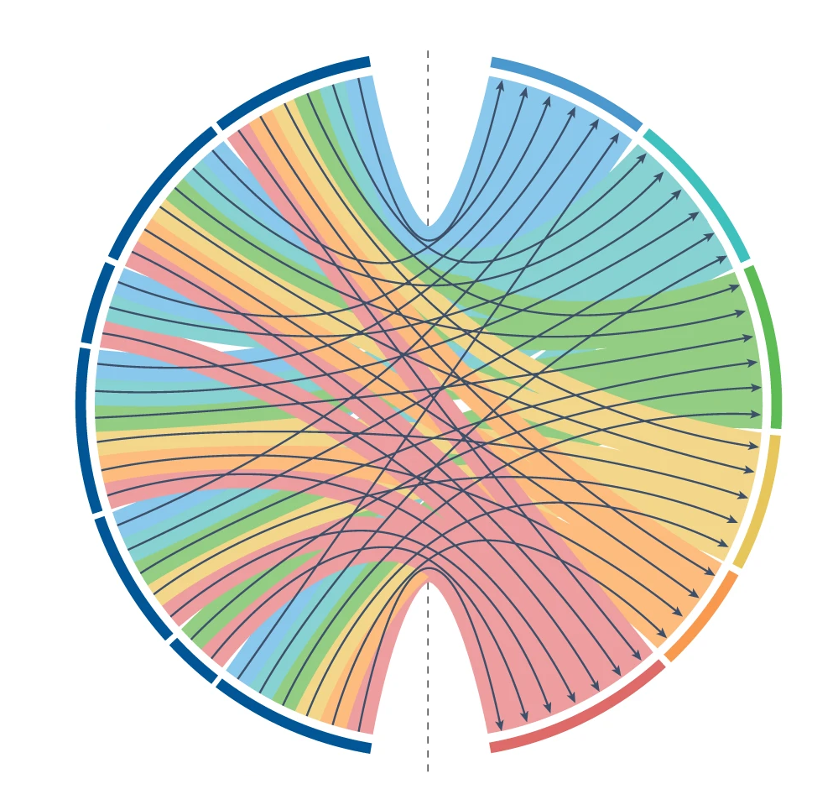
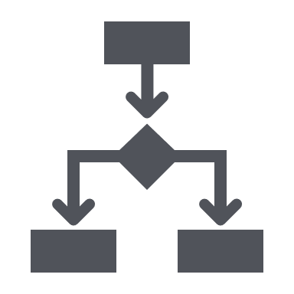
Multi-modal clinical data repository
Data modalities
Opportunities
A secure, integrated infrastructure to a fragmented and difficult to access clinical-lab-imaging-genomics data ecosystem enabling discovery
Enabling data to be more easily shared and combined to drive scientific discoveries and healthcare innovation
Longitudinal Clinical Data
Population health management
`
Distributed care management
Citizen and Patient self-service
Imaging Data
Personalized
treatment
recommendation
Histopathology Data
Formalized clinical guidelines
Intelligent care navigation
Sequencing Data
Connected knowledge network

Slide 4
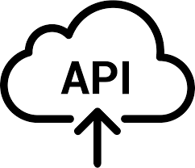
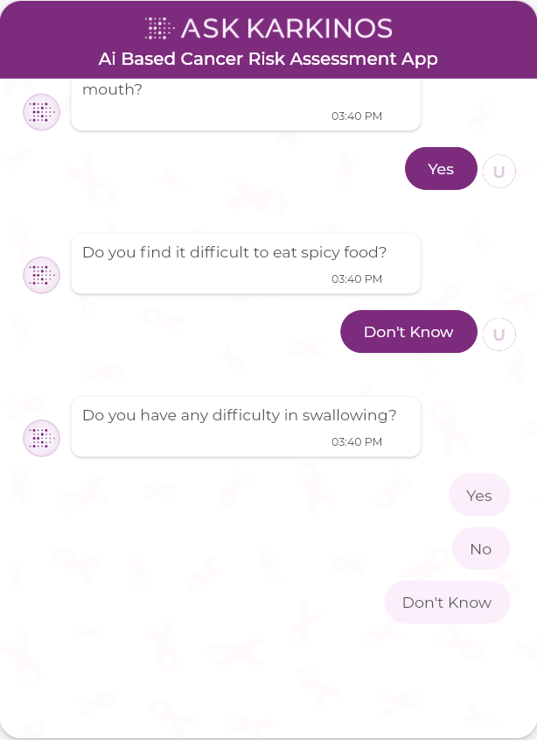
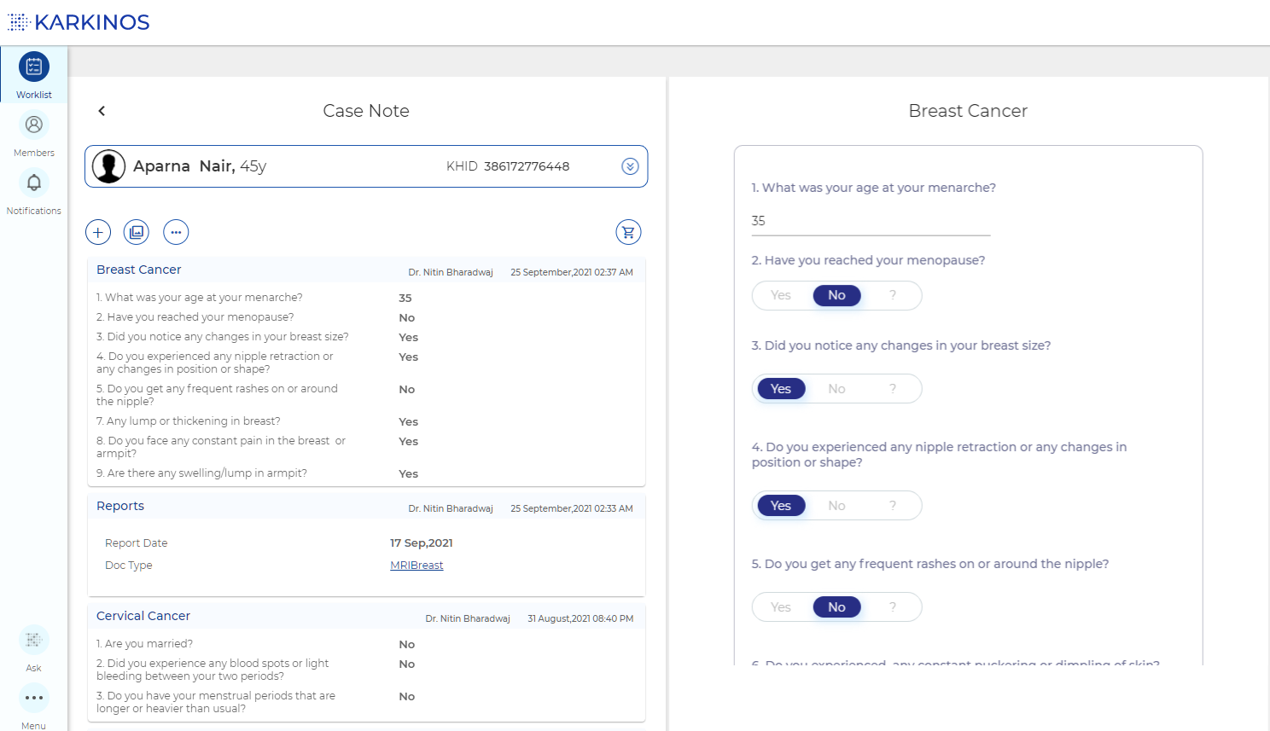
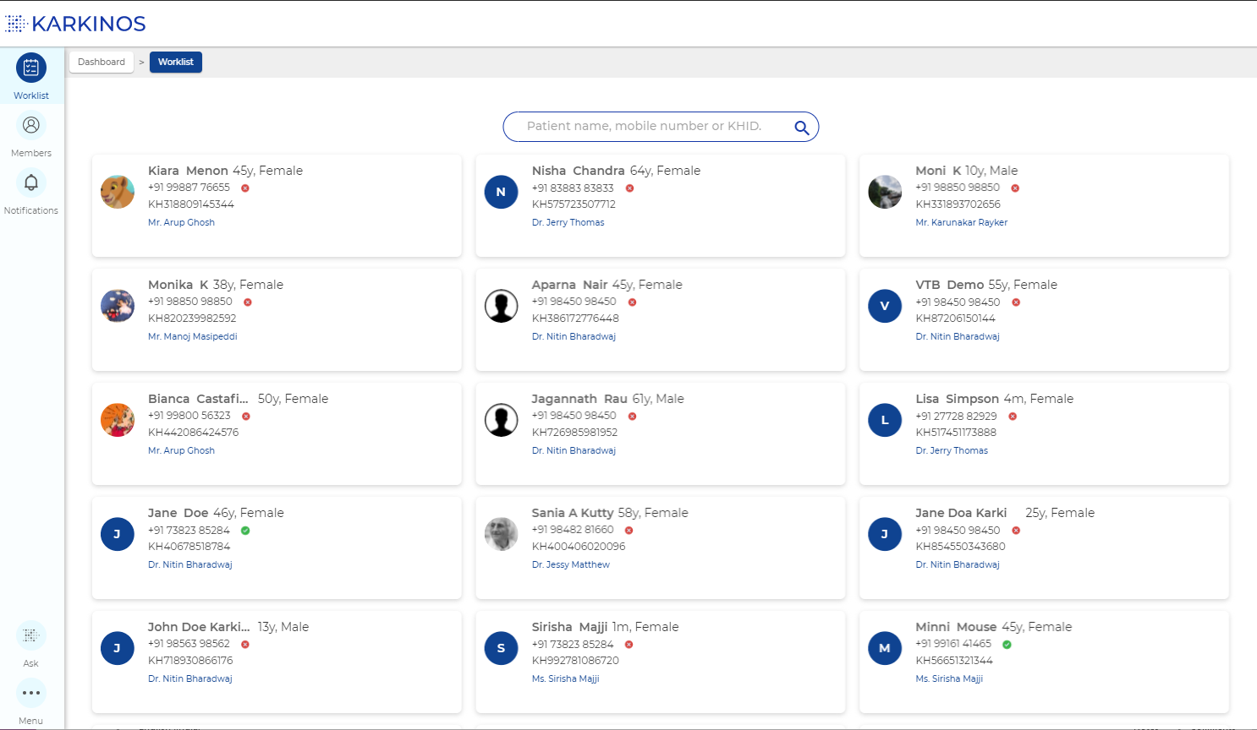
Technology powering information integration across care continuum
Heterogenous Input
Processing and Interoperability Layer
Data Access Layer
Partner Systems
Multi Modal Data Ingestion
Data Insights
Clinical Decision Support
Apps
Longitudinal Clinical Data
Patient data
OncoKEEN - AI/ML based analytics
Clinical data
Histopathology Data
Data Studio –patient cohorts
Lab data
Data lake Processing Engine
Imaging Data
Sequencing Data
Data Access
Radiology data
Terminology
Cancer Registry
Digital Pathology
Genomics data
Data model & persistency
Bioinformatics
Cloud Infrastructure (Autoscaling, On-demand)
Longitudinal Clinical Data
Imaging Data
Histopathology Data
Sequencing Data
Patient identifiers,
Demographics,
Diagnoses,
Medications,
Procedures,
Vital signs, and Utilization events
X Ray Imaging,
Ultrasound (USG),
Mammogram,
CECT,
PET CT
Bone scan
Digital rendition in real time on VTB
Cytology,
Molecular pathology, Liquid biopsy,
Clinico pathology
Cytopathology, Histopathology, IHC
Whole Genome Sequencing based on presence of Germline variants sequencing
Whole Genome Sequencing analysis and anomaly identification

Slide 5
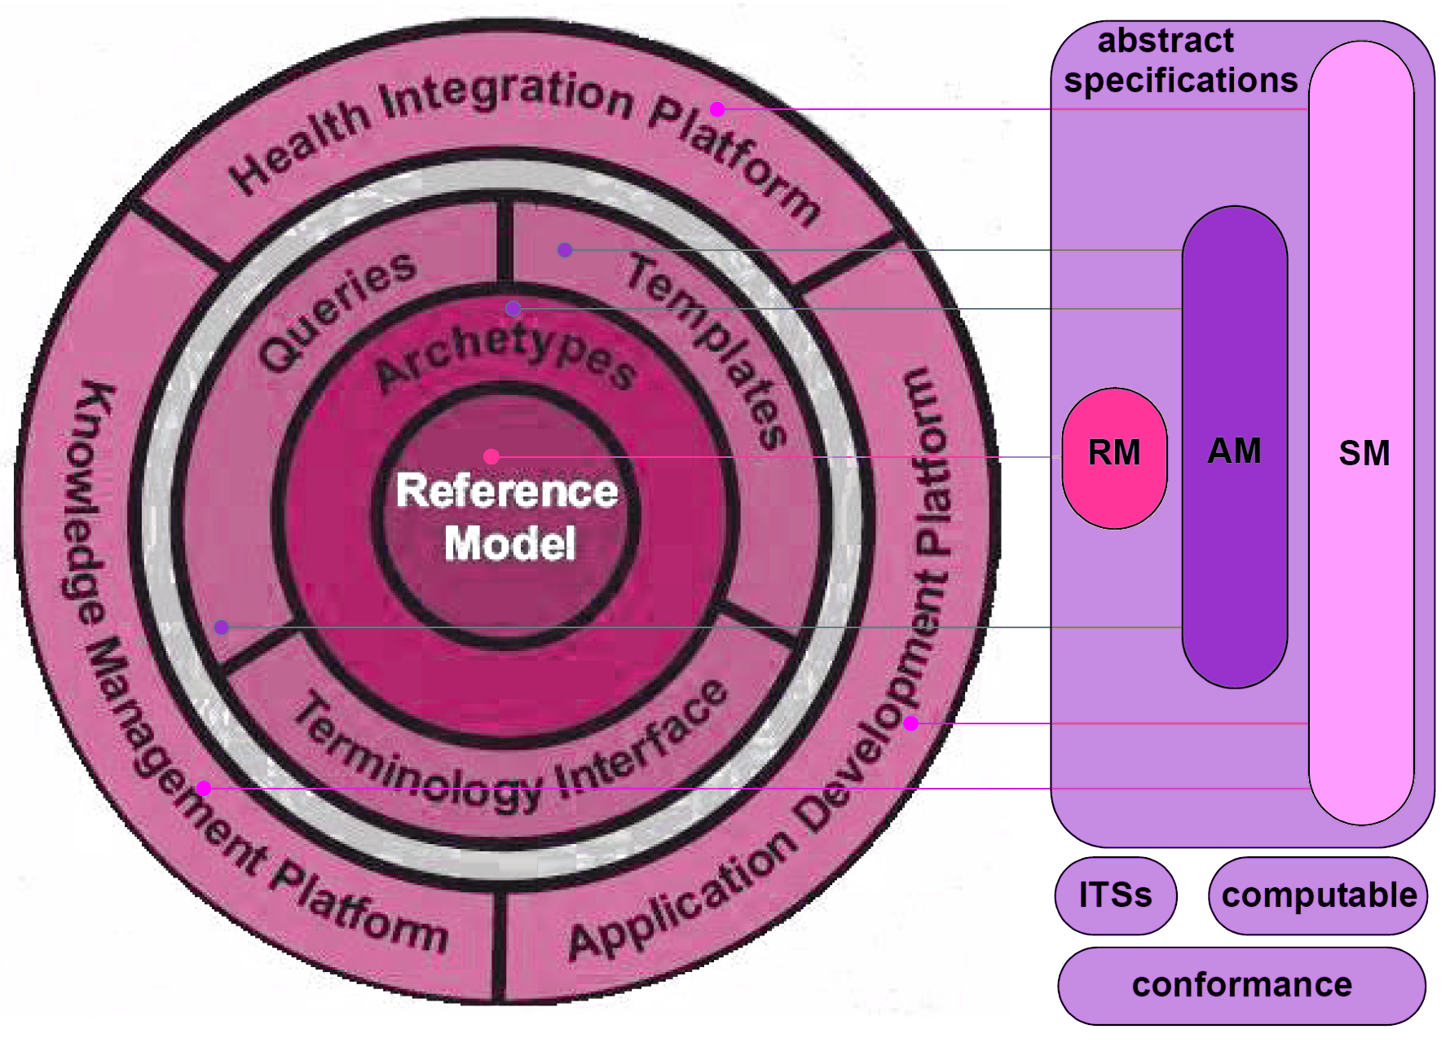
openEHR - A semantically-enabled, vendor-independent, health computing platform
The comprehensive semantic framework available in e-health, combining formal clinical modelling, terminology, and a services infrastructure
Semantic scalability - handling complex and constantly changing information and clinical workflows, forever
Prevents vendor lock-in on the basis of data format, or any other technical element
Empowers the clinical experts to be involved in the specification and steady state development of the system into the future
RM
Reference: https://specifications.openehr.org/releases/RM/latest/ehr.html#_the_ehr_information_model

Slide 6
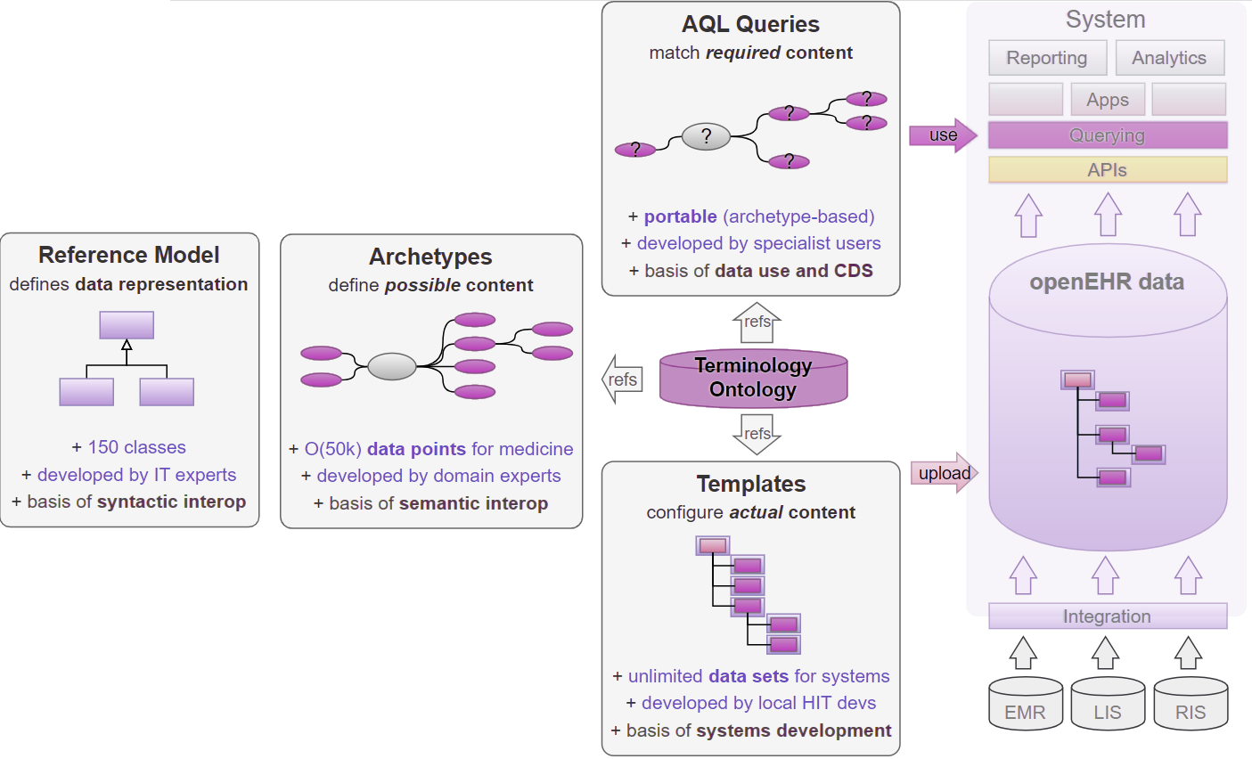
The semantic framework of openEHR
Reference model: Information model defining data types, structures, semantics, versioning, security
Archetype: A computable specification of the data points and groups of a specific clinical factor, such as Tumor size', ‘BP'
Template: Use case specific clinical dataset composed of elements from one or more Archetypes, e.g. ‘Pathology report’, ‘Discharge Summary’
CKM - Clinical Knowledge Manager: Online library of clinical knowledge artifacts
Reference: https://specifications.openehr.org/releases/RM/latest/ehr.html#_the_ehr_information_model
reference: https://specifications.openehr.org/releases/RM/latest/ehr.html#_the_ehr_information_model

Slide 7
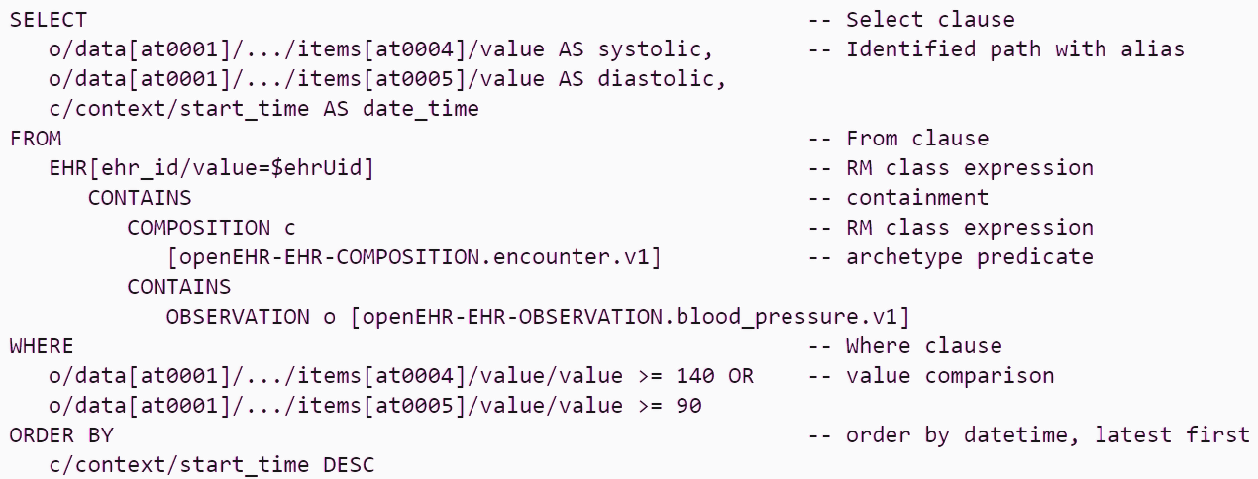
openEHR - Archetype query language(AQL)
AQL – Archetype Query Language Vendor neutral query language to search and retrieve clinical data in archetype-based repositories
Uses openEHR path syntax to locate clinical statements and data values within them using archetypes
Model-neutral syntax: AQL does not have any dependency on a Reference Model; it is also neutral to system implementation and environment;

Slide 8
Clinical modeling in openEHR
CKM Archetype
Knowledge mapping and encoding process
Applicability
Cardinality
Archetype
Definition
SNOMED CT
Internal Coding
Clinician
Coding
Clinical Information Requirements
Archetype 1
t.Json
Archetype 2
Business Analyst
Info Model Implementation
.opt file
Templates
Archetype … n
Clinician
Developer

Slide 9
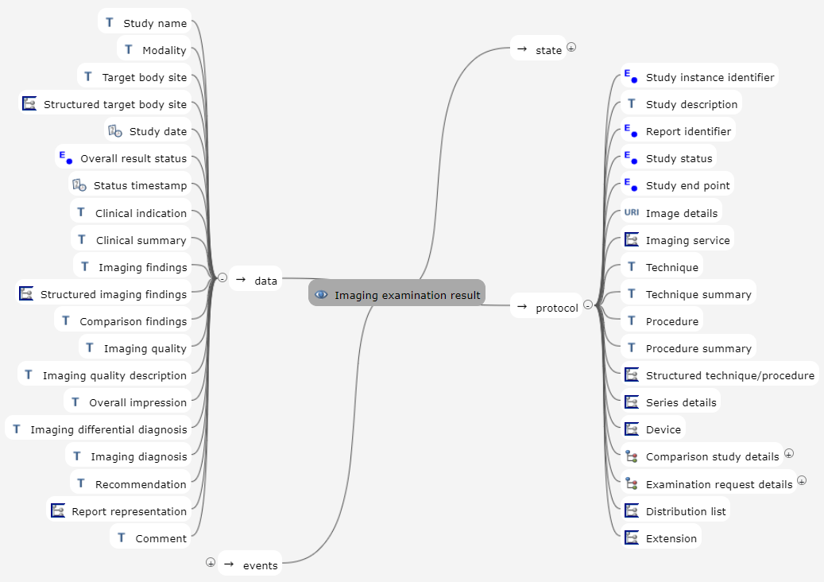
Imaging data using openEHR + DICOMWeb
Archetype : Imaging examination result
To record the findings on imaging examination of a specified body structure or region and their interpretation, using radiological techniques
Models DICOM study details
Study, series, image level information
Models the report - findings and interpretation
Stores the DICOMWeb study access endpoint

Slide 10
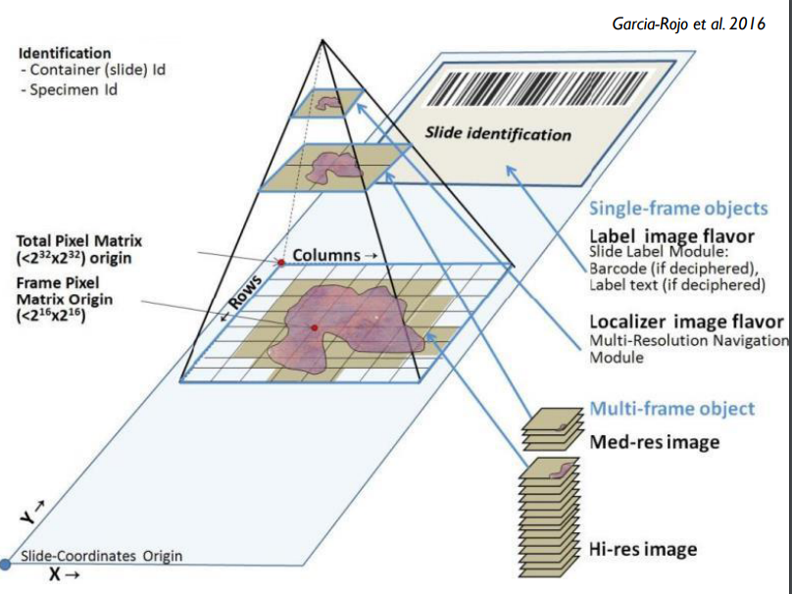
Digital pathology: DICOM encoding of WSI (Whole slide image)
A digital slide is typically represented as a multiresolution image pyramid
Each resolution level is a separate instance of the VL Whole Slide Microscopy Image IOD
Encoded as a separate DICOM data set - a multiframe image instance with encapsulated Pixel Data element
Information of patient, study, series, specimen, and container mapped to openEHR archetype : Laboratory test results
https://journals.plos.org/plosone/article?id=10.1371/journal.pone.0030783
https://www.dclunie.com/papers/FDA_WSI_2020_Clunie.pdf

Slide 11
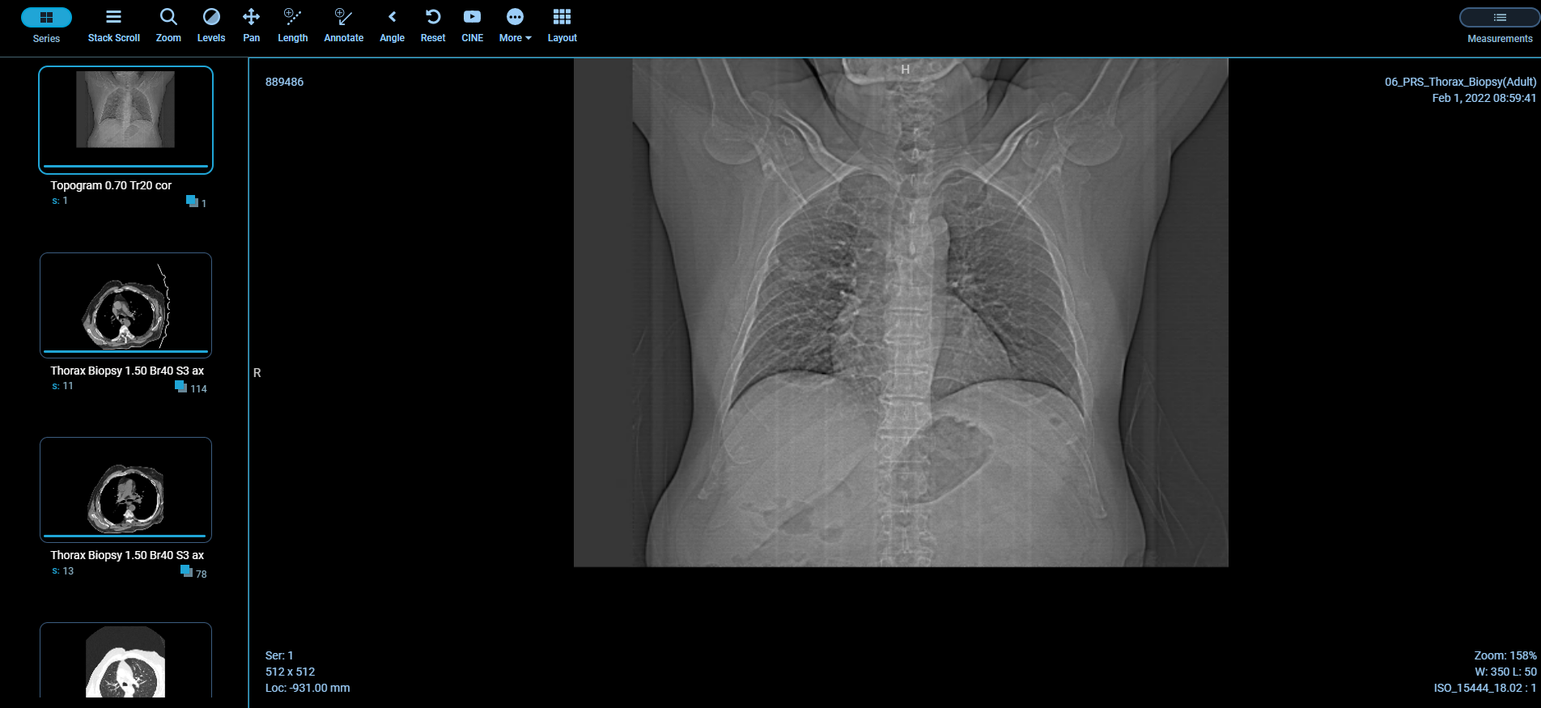
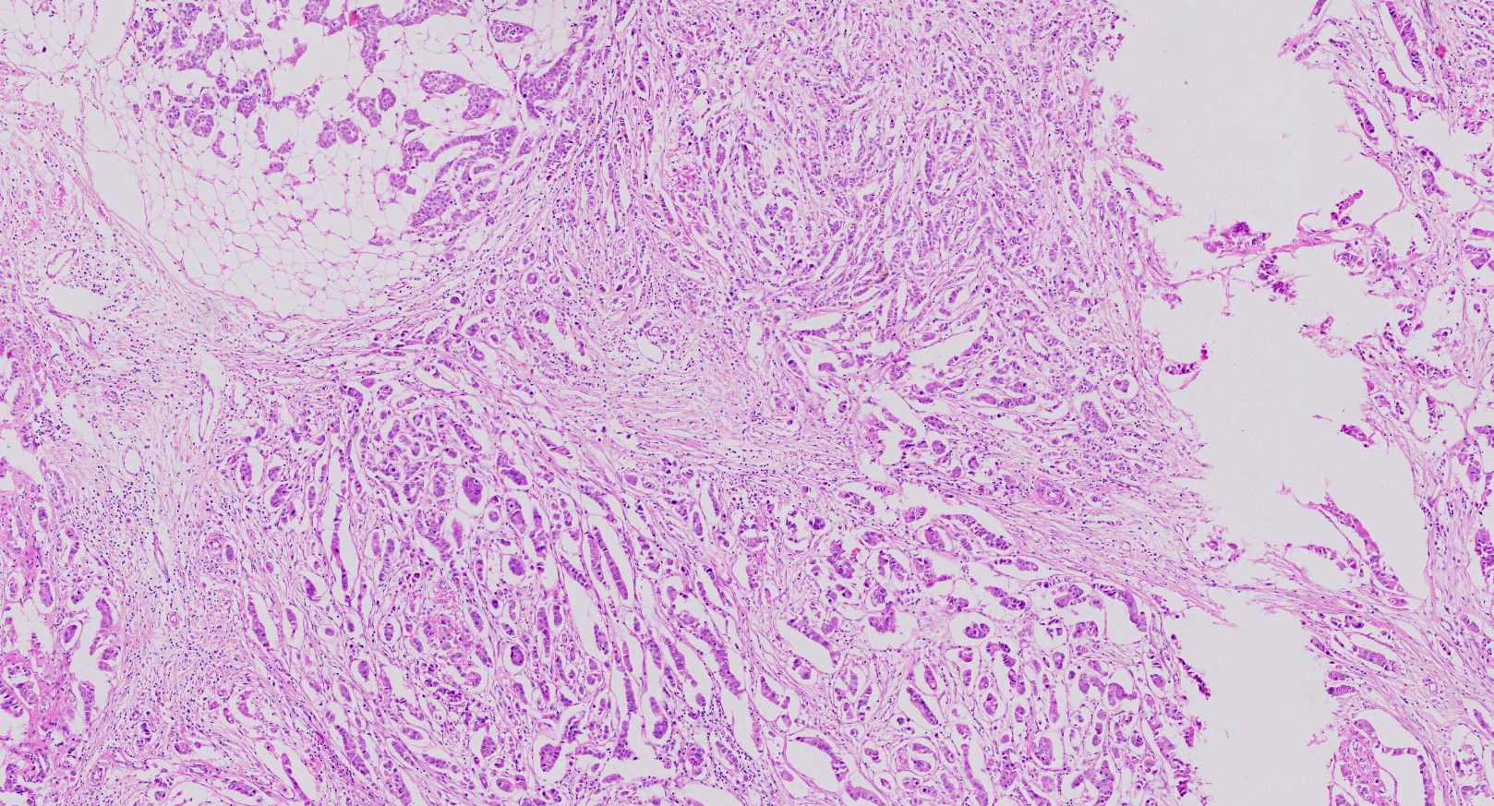
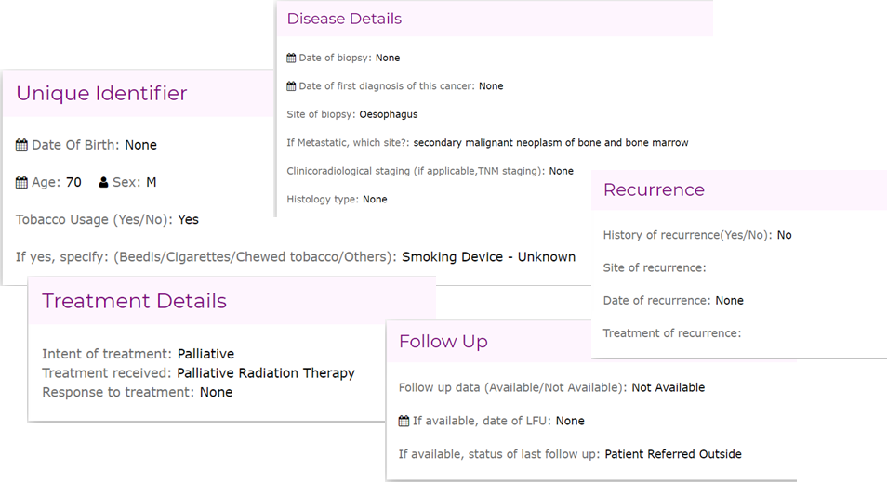
Applications of multi-modal CDR
Patient longitudinal data viewer

Slide 12
Multi-modal CDR - Driving innovation in disease Discovery, Diagnosis, Prognosis, Treatment and Prevention
Key Challenges / Considerations
Richer image analytics for triage/detection
Seamless integration of clinical workflow
Heterogeneity of data
Complexity of data integration
The clinical data repository built using openEHR+DICOM enables AI/ML to improve patient outcomes, streamline healthcare processes and informed decision-making process
Notes:
The clinical data repository built using openEHR+DICOM enables Artificial intelligence, machine learning, to improve patient outcomes and streamline healthcare processes
Driving innovation across biomedical discovery, diagnosis, prognosis, treatment and prevention
Additionally, by utilizing big data and predictive analytics, now it is feasible to gain new insights into patient health and inform decision-making processes

Slide 13
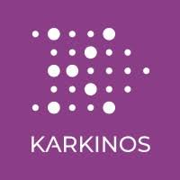
Thank you
Anand Jahagirdar
Principal Software Architect
+91-9900145772 | anand.jahagirdar@karkinos.in
www.karkinos.in
A purpose-driven technology-led oncology platform

Slide 14
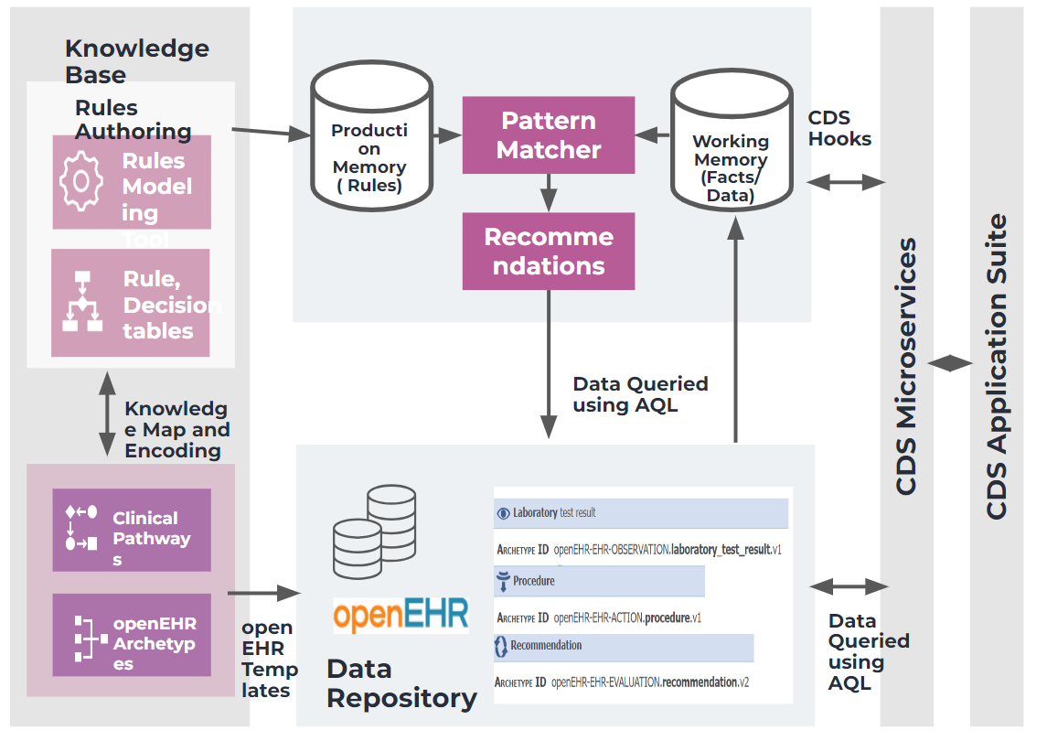
Application of multi-modal CDR
Clinical decision support system (CDS)
GDL(Guideline Definition language): Language to express clinical logic as production rules to drive at-point-of-care decision support
Provide treatment recommendations based on the patient data at run-time by invoking the rules specified in the standard guidelines like NCCN guidelines
Implementation of the CDS by using openEHR Archetypes, terminology bindings and the rules connects openEHR, SNOMED-CT and the Computer Interpretable Guidelines (CIGs)
Ref: https://nccn.org

