Slide 1
DICOM Educational Conference Chennai, India
October 9-11, 2023
Perspective on DICOM in Diagnostic Center
Dr Arunkumar Govindarajan
Executive Director & Radiologist
Aarthi Scans and Labs

Slide 2
Overview
About Aarthi Scans and Labs
The work we do
DICOM from a Dr’s perspective
DICOM from an Administrator’s perspective
How DICOM standardization and automation helped us offer affordable diagnostics

Slide 3
Aarthi Scans & Labs – An Overview
Started in 1988
Run by a family of 7 Radiologists
Present in 11 States. 58 Branches
56 MRI & 58 CT scanners.
230+ Radiologists. 2000+ Staff.

Slide 4
Making Diagnostics Affordable !
MRI Scan @ 30 USD
CT Scan @ 13 USD
PET CT @ 140 USD

Slide 5
Daily We Do..
800+
1300+
MRI Scans
Ultrasound Scans
Honest & Transparent Pricing.
Quality & Quick Reporting.
650+
91.4%
CT Scans
Scans reported within TAT

Slide 6
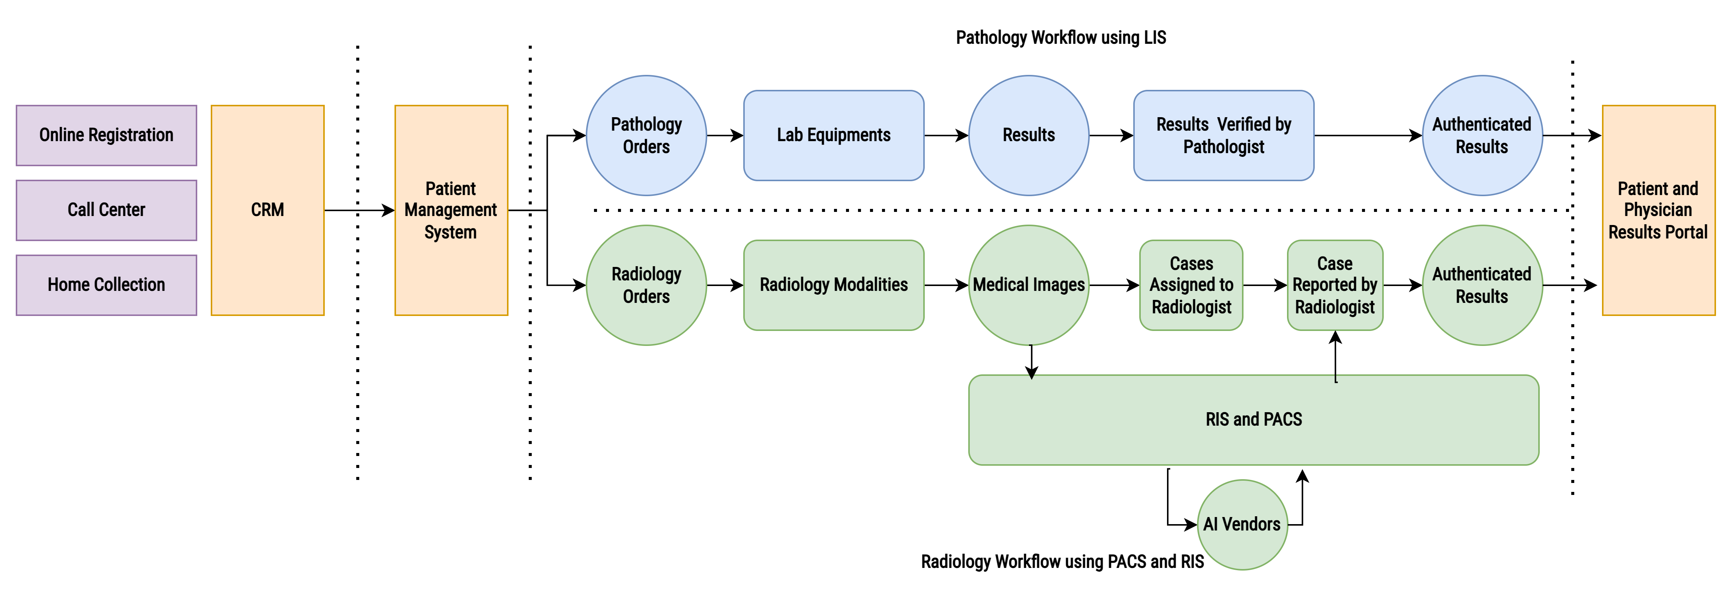
Overall core diagnostic IT Systems @ Aarthi Scans
Notes:
LIS – not standardised. Vendor support needed.
DICOM – Vendor independent, open source tools and knowledge. More room for automation. Easy to collaborate with 3rd party companies

Slide 7
To Modalities
From Modalities
Curation Engine to Map Billing Codes to Radiology procedures
Modality Worklist Data Generation
Modality Worklist and Modality Performed Procedure Step
To Local Archive
Invoke an IAN Message to Start the Reading workflow
Case Assigned to TWC
Clinical Document Documentation
Case Assigned to Radiologist
Default (Auto) / Manual
TAT Tracking
Notes:
No Snomed or Loinc codes yet. We would like to go there.
MPPS – knowing when machine is free – no return cases and non peak hour rates
SDWAN – private network

Slide 8
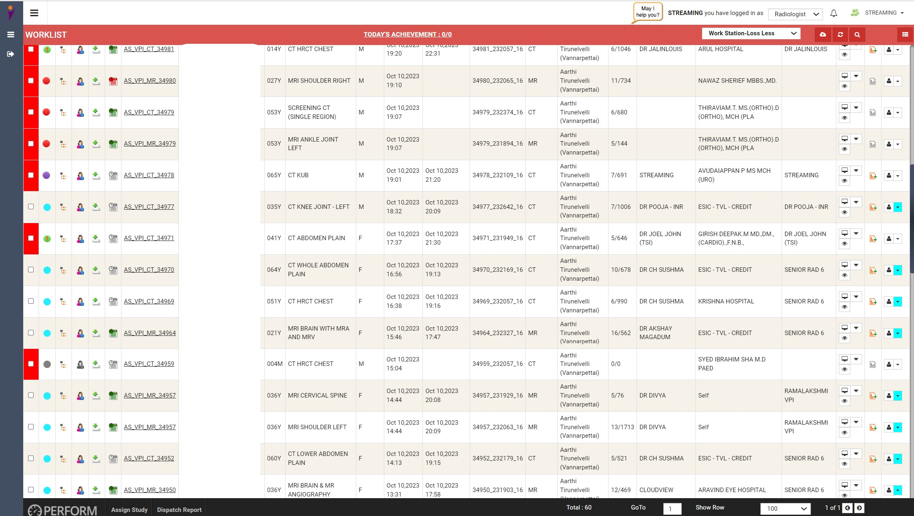

Slide 9
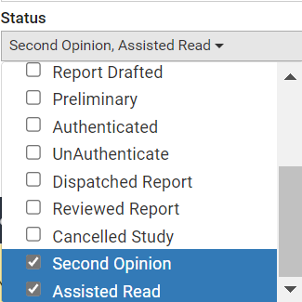
Prelim Reporting - All Reports double checked for Typing & Measuring errors!
Mentoring - Second Opinion by Senior Radiologists !
Peer review – Assisted Read for all anomaly USG scans viewed & guided by fetal medicine consultant for clarifications.

Slide 10
To AI Engine
To Radiologist
Curation Engine to identify Cases to AI Engine
Clinical Information verification
Upload Studies to AI Engine
Wait for Results from the AI Engine
Create Prim Reports
Push Key Image Objects to PACS
Case Availably Notification via Worklist
View Clinical Documents
View images Local or Remote
View images
Workstation (Clearcanvas, Weasis, Osirix)
Modality Workstations (Syngo, Centricity)
View Prim Reports / AI Artifacts
Finalize Reports

Slide 11
Radiology AI – Empowering Radiologists
CXR – Qure
CT Chest – Siemens
MRI Brain – Neuro shield
CT Brain Triaging – Qure
CT KUB - Biocliq

Slide 12
To Patient
To Physician / Clients
Printout Reports
Films / Soft Copy online
Notification to view Reports, Images and other artifacts online
Patient Health Portal for Permanent access of Reports and Printed Softcopy of Radiology images.
Thank you note for referral
Notification to view Reports, Images and other artifacts online
Physician Health Portal for Permanent access of Reports and Printed Softcopy of Radiology images.

Slide 13
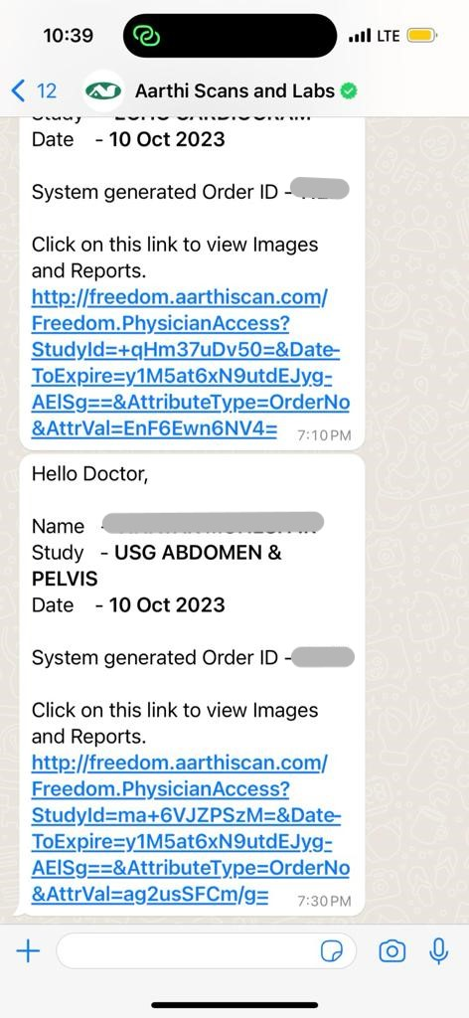
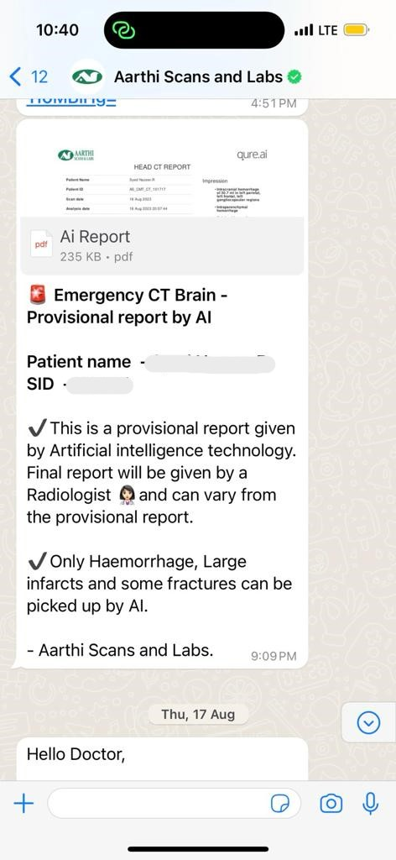

Slide 14
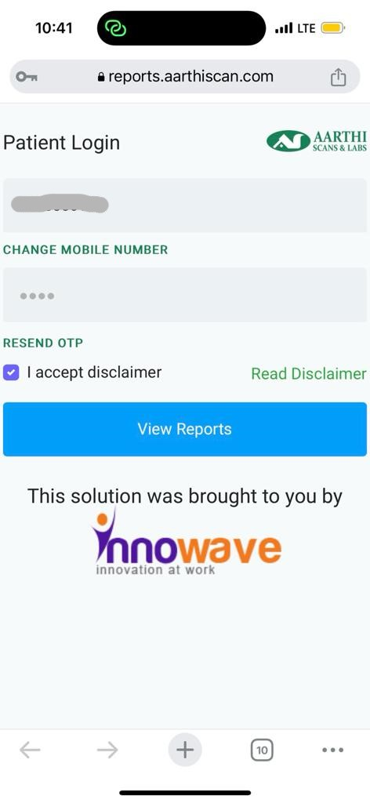
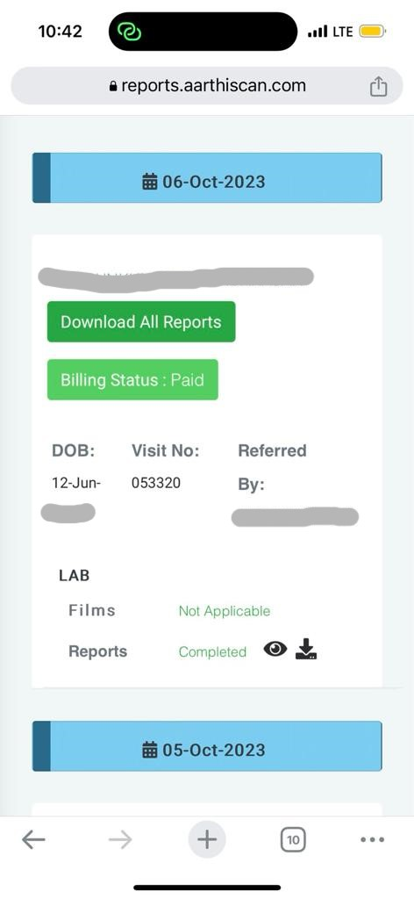

Slide 15
DICOM Services Used
Modality Worklist (Registration)
Modality Performed Procedure Step (TAT)
DICOM Store (DIMSE)
DICOM Query / Retrieve (pull Primary and Priors)
DICOM Print (Hard / Soft copy)
DICOM DIR (CD / DVD Writing)
IAN Message Notification
DICOM Compression
Lossless – Archive
Lossy – Remote Reading
DICOM Web
QIDO-RS, WADO-RS
DICOM SR (Ultrasound Measurement into Reports)
DICOM Encapsulated PDF
DICOM Key Objects

Slide 16
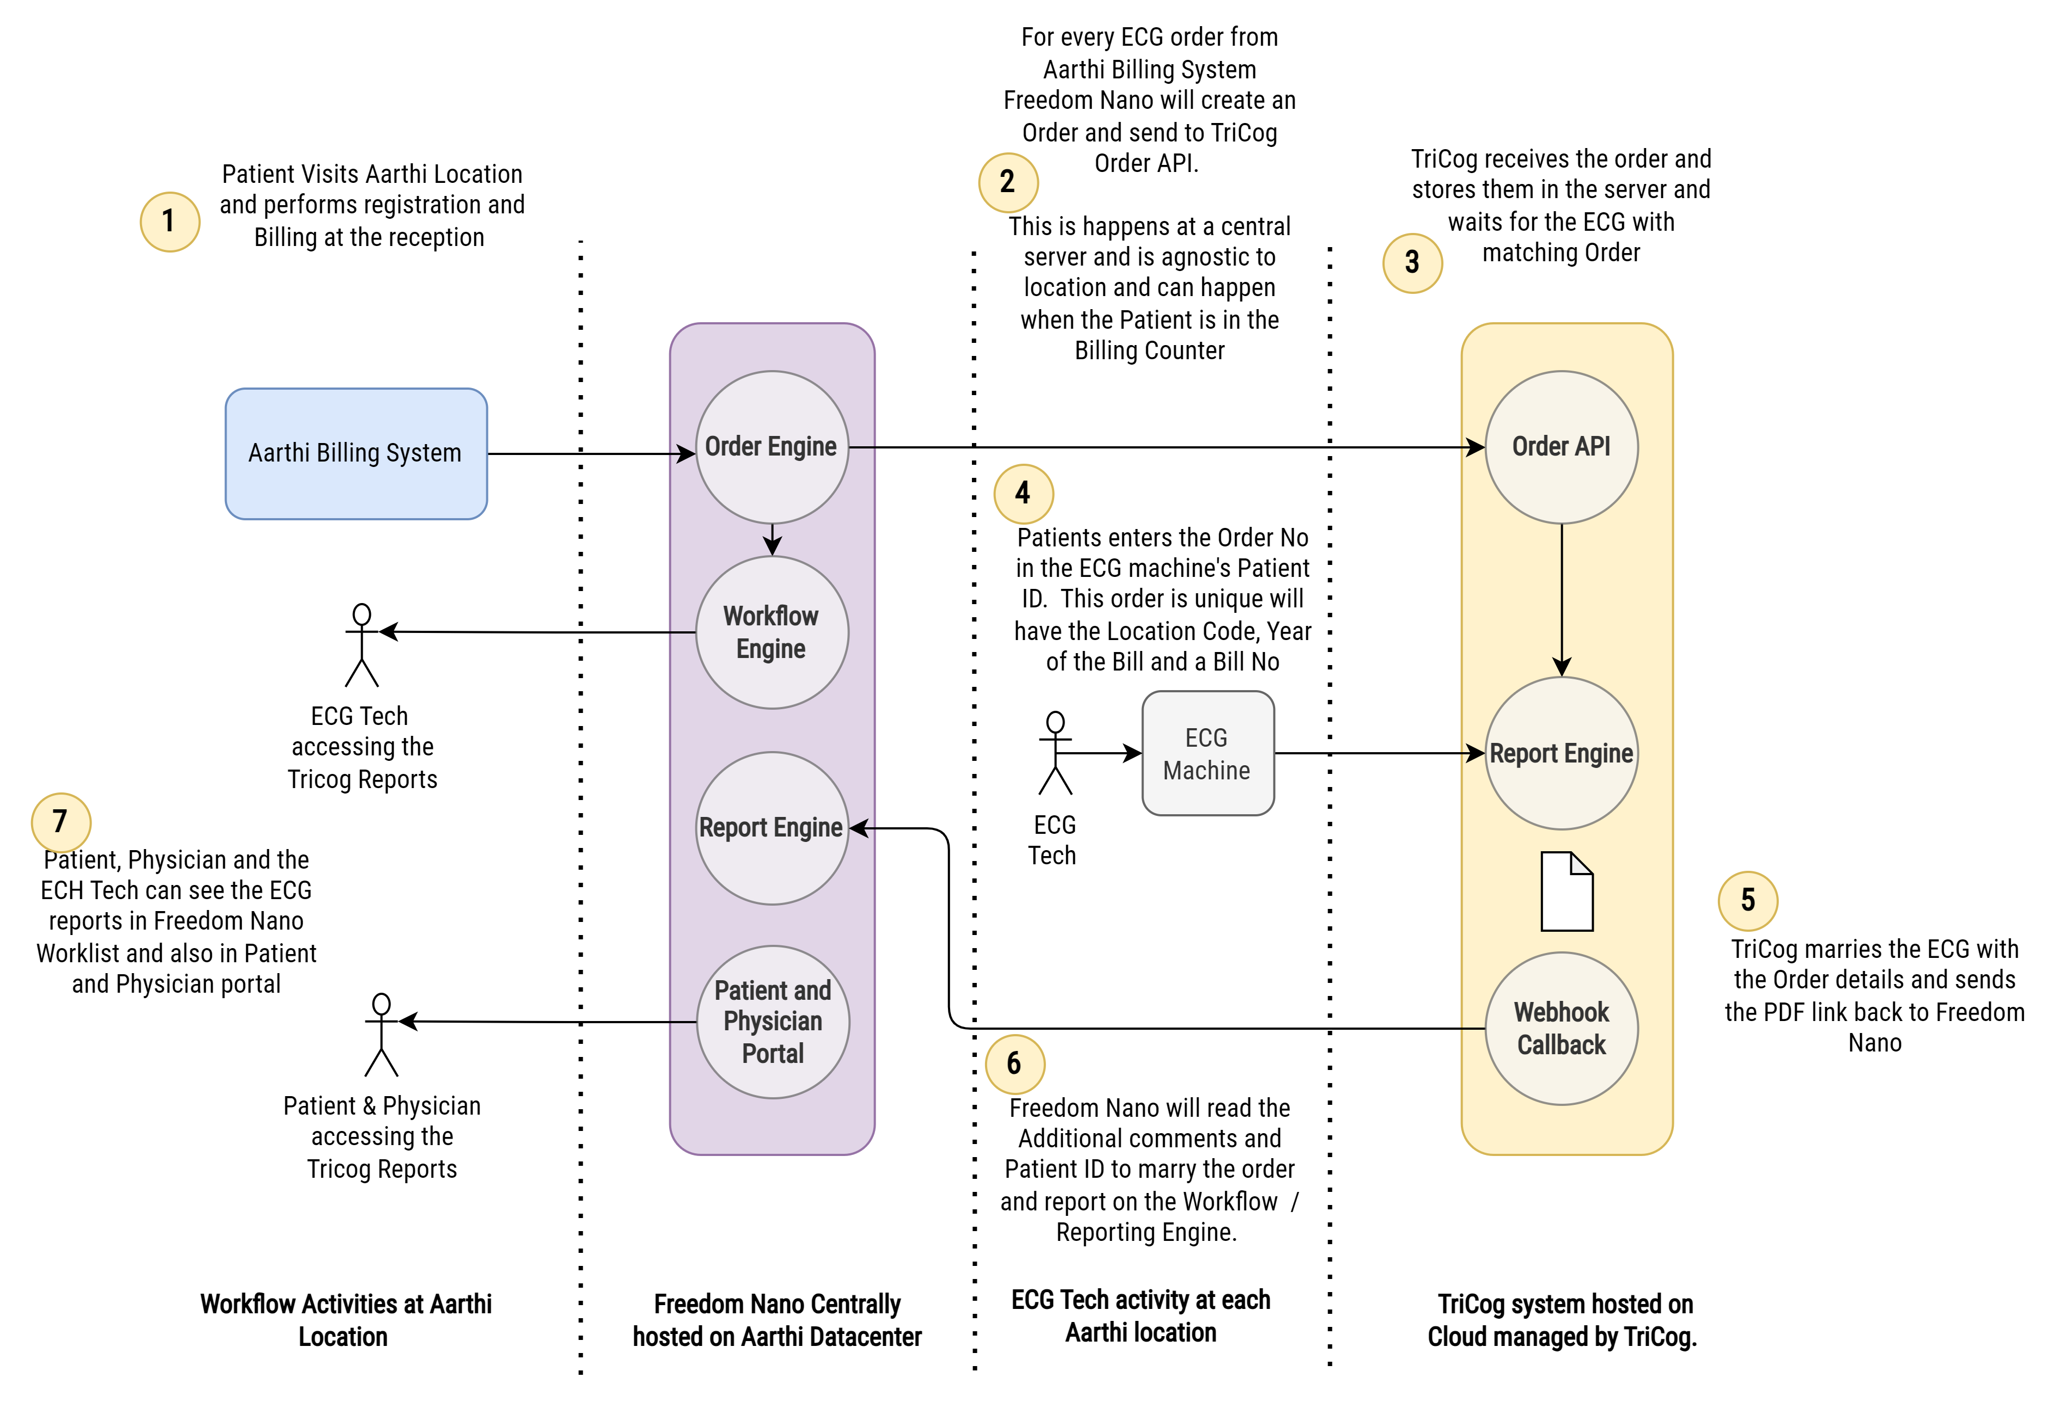
ECG Workflow Integration @ Aarthi Scans

Slide 18
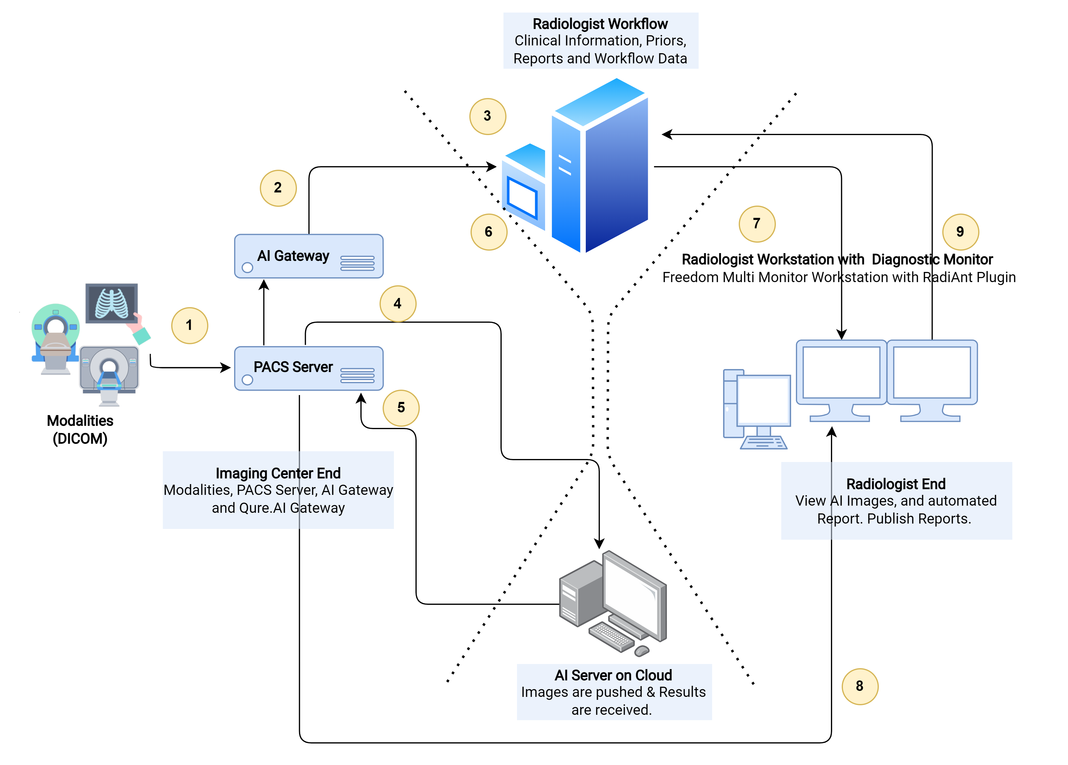
AI Workflow Integration @ Aarthi Scans
Notes:
Used core principles of DICOM standards and automation in radiology in ECG reporting.
The final output is actually a DICOM encap PDF

Slide 19
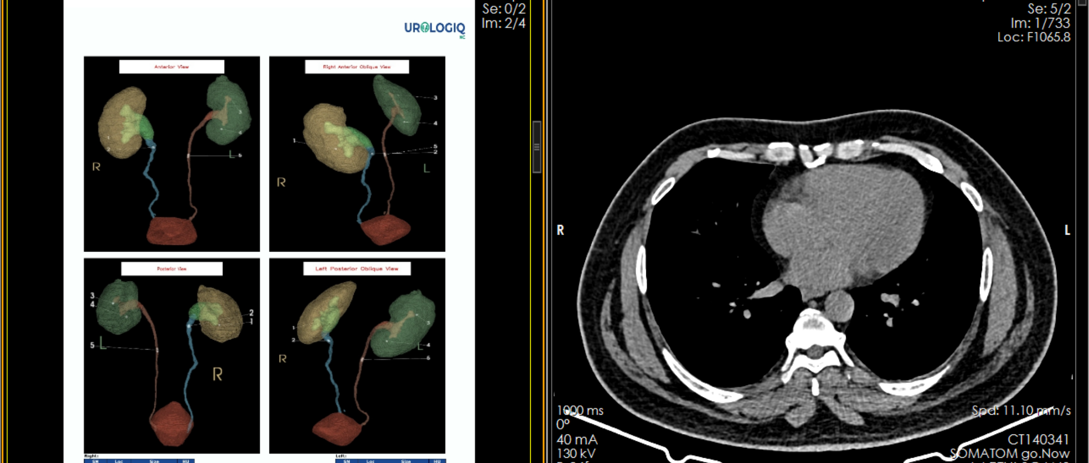

Slide 20
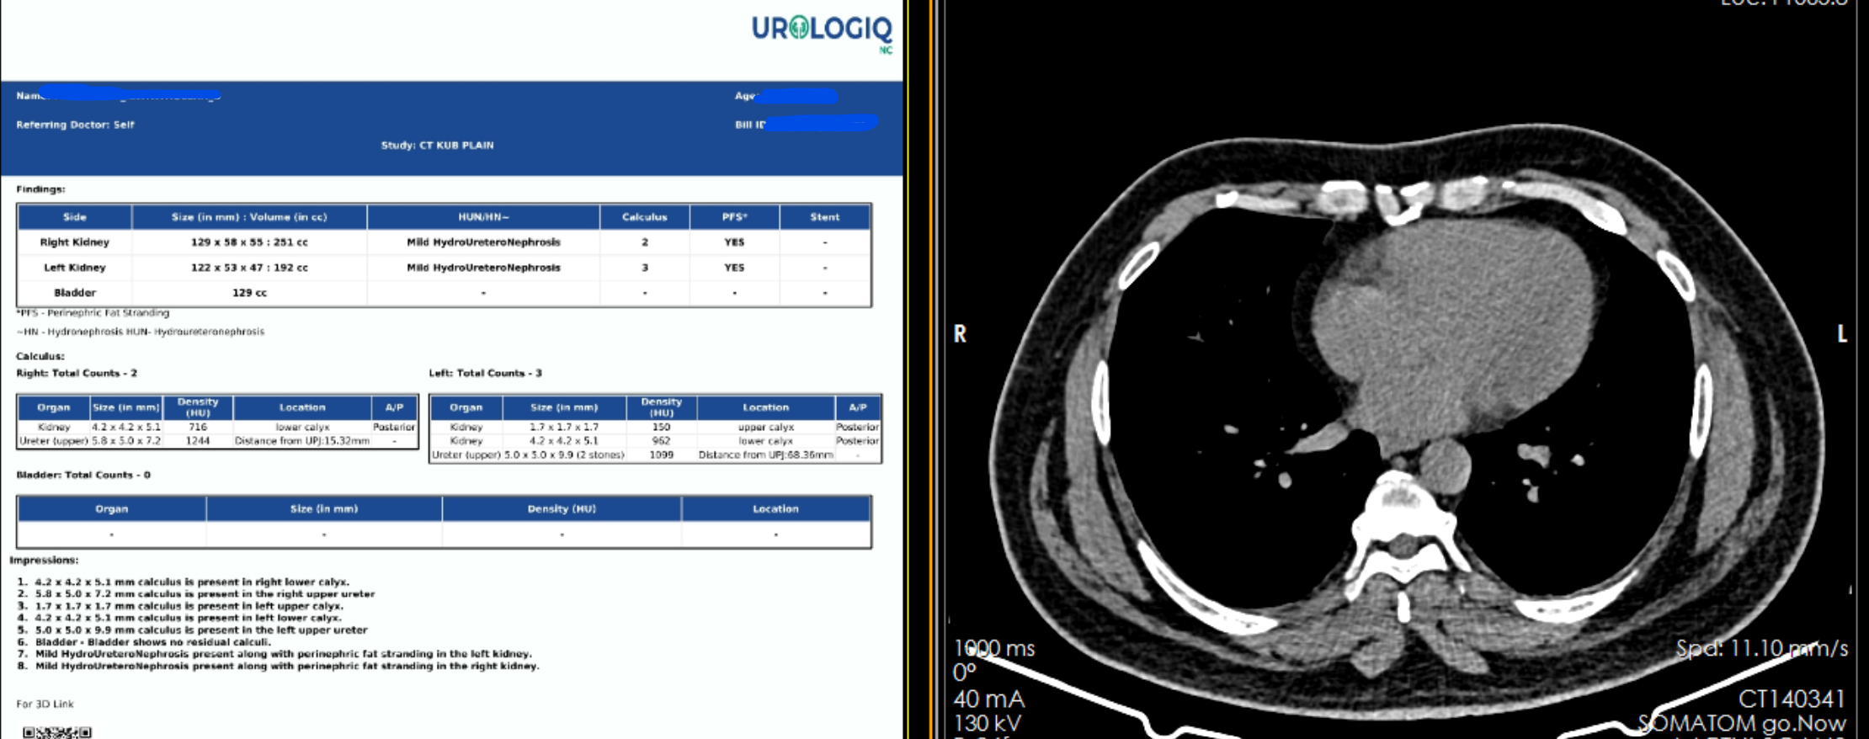

Slide 21
Q & A

