Slide 1
DICOM Educational Conference
Bangkok, Thailand
October 3-4, 2019
Trends and future directions in DICOM
Kevin O’Donnell
Canon Medical Research USA
Co-Chair DICOM WG-10 (Strategy)
Past-Chair DICOM Standards Committee
Notes:
30 Min (90 min with Fundamentals, Secretariat, Trends)

Slide 2

The Future
  “Making predictions is hard, especially about the future”
  – Yogi Berra

Slide 3

The Future
  “The best way to predict the future is to invent it”
  – Alan Kay

Slide 4
Working Groups
Modality, clinical domain, or function specific teams,
assigned to develop Supplements or Change Proposals
WG-01: Cardiac and Vascular Information | WG-17: 3D
WG-02: Projection Radiography/Angiography | WG-18: Clinical Trials and Education
WG-03: Nuclear Medicine | WG-19: Dermatology
WG-04: Compression | WG-20: Integration of Imaging and Info Systems
WG-05: Exchange Media | WG-21: Computed Tomography
WG-06: Base Standard | WG-22: Dentistry
WG-07: Radiotherapy | WG-23: Application Hosting
WG-08: Structured Reporting | WG-24: Surgery
WG-09: Ophthalmology | WG-25: Veterinary Medicine
WG-10: Strategic Advisory | WG-26: Pathology
WG-11: Display Function Standard | WG-27: Web Technology for DICOM
WG-12: Ultrasound | WG-28: Physics
WG-13: Visible Light | WG-29: Education, Communication & Outreach
WG-14: Security WG-15: Digital Mammography and CAD | WG-30: Small Animal Imaging WG-31: Conformance
WG-16: Magnetic Resonance | WG-32: Neurophysiology Data
Notes:
DICOM direction as an exercise in crowd-sourcing

Slide 5
The Common Thread
DICOM Mission
Create & maintain an international standard for the communication of biomedical, diagnostic, and therapeutic information in medical disciplines that use digital images and associated data.
DICOM Strengths
Sustainable standard (stable & evolving)
  we don’t break it; it’s a safe investment
Semantic interoperability with stable information model
Mature development and maintenance process
Notes:
Before we talk about trends, recall the Common Thread that doesn’t change
You can still read a CT image from the 1990s

Slide 6

DICOM Trends
(Themes of
Recent Work)

Slide 7
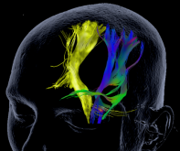
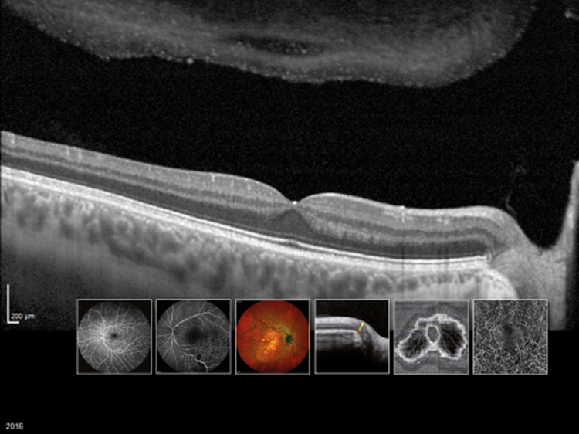

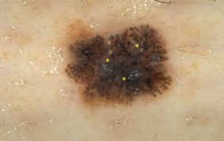
Theme: Modalities
As vendors continue developing digital modalities, the data must be stored…
Multi-Energy CT Sup 188
MR Tractography Sup 181
Wide Field Ophthalmic Photography Sup 173
Ophthalmic OCT Angiography Sup 197
Whole Slide Imaging (recent uptake) Sup 145
Neurophysiology Waveforms Sup 217
Dermoscopy Sup TBA
* Further reinforced by trend toward Enterprise Imaging solutions
Notes:
Dermatology Photos already covered along with new anatomy codes
Breast Tomosynthesis – Sup 125 from 10 years ago.

Slide 8
Multi-Energy CT
4 families
Multi Energy Imaging
Standard CT Image
Objective Image
Family
Material Quantification
Family
Material Labeling
Family
Material Visualization
Family
many flavors
Virtual Mono-energetic Image (VMI)
Material-Specific Image
Discrete Labeling
Image
CT IOD
Other IOD
Iodine Map;
Bone Density
Material-Modified Image
Color Overlay Image
Effective Atomic Number (Z) Image
Probability Map Image
Material-Removed Image
Highlighted;
Partially-Suppressed
Color Blending Image
Electron Density Image
Value-based Map
Image
Virt. Non Contrast;
Virt. Non-Ca;
Color Map Image
Proportional Map
Image
Gout crystals
Notes:
Note new display requirements the new IODs/specialties bring along (but DICOM doesn’t mandate display behaviors)

Slide 9
Theme: DICOMweb
RESTful services for modern architectures and programmers
STOW-RS (Store) Sup 163
QIDO-RS (Query) Sup 166
WADO-RS (Retrieve) Sup 161
RESTful Rendering Sup 174
UPS-RS (Worklists) Sup 171
Server Options (Capabilities) Sup 170
Thumbnail Service Sup 203
Non-Patient Instances Sup 194
Web Services Re-documentation Sup 183 (dicomstandard.org/current Part 18)
…
* DIMSE & RESTful service symmetry -> Bi-directional Proxies
Notes:
I guess you’ve heard about the Web. It’s been all over the news…
Sup 198 Retire WADO-WS

Slide 10



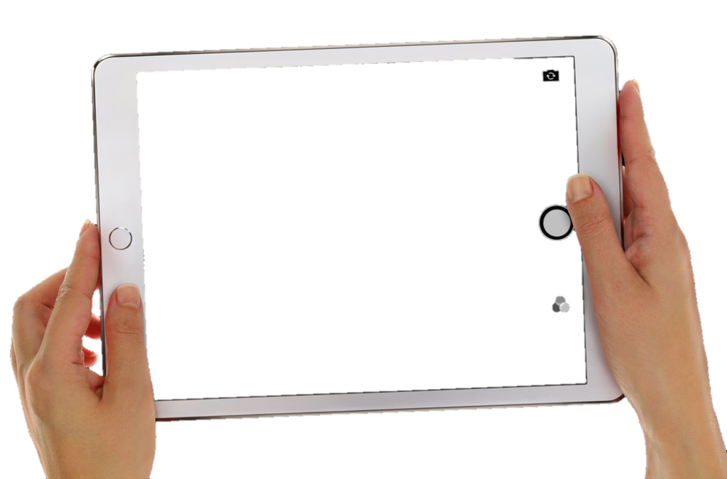
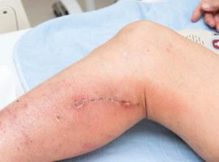

DICOMweb example
http://encountermanager.here.org/workitems?AdmissionID=987654
&ScheduledProcedureStepSequence.ScheduledStationAETitle=DermTab1
[ {
“PatientName”: {"vr": "PN", "Value": [{"Alphabetic": "SMITH^JOHN"}]},
“PatientID”: {"vr": "LO", "Value": ["66437748"]},
“IssuerOfPatientID”: {"vr": "LO", "Value": ["MyHospital"]},
“PatientBirthDate”: {"vr": "DT", "Value": ["19670701"]},
“PatientSex”: {"vr": "CS", "Value": ["M"]},
“InstitutionName”: {"vr": "LO", "Value": ["Metrocity General Hospital"]},
“InstitutionalDepartmentName”: {"vr": “LO", "Value": [“Dermatology"]},
…
Encounter Manager
Get
Imaging Context
http://mypacs.here.org/studies
Content-Type: application/dicom+json
[ {
“PatientName”: {"vr": "PN", "Value": [{"Alphabetic": "SMITH^JOHN"}]},
“PatientID”: {"vr": "LO", "Value": ["66437748"]},
“IssuerOfPatientID”: {"vr": "LO", "Value": ["MyHospital"]},
“PatientBirthDate”: {"vr": "DT", "Value": ["19670701"]},
…
“BodyPartExamined”: {"vr": "CS", "Value": [“CALF"]},
“Laterality”: {"vr": "CS", "Value": [“R"]},
…
Content-Type: image/jpeg
<the image>
Store Images
Image Manager/ Archive
Notes:
Kevin

Slide 11

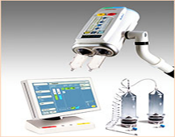
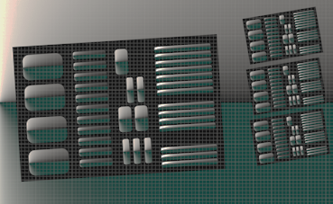
Theme: Quality Assurance
Managing and monitoring Imaging Procedures
CT Radiation Dose SR Sup 127
Radiopharmaceutical Administration SR Sup 159
Patient Dose SR Sup 191
Contrast Agent Administration SR Sup 164
Cone-beam CT Radiation Dose SR Sup 214
CT Protocol Storage Sup 121
Protocol Approval Sup 192
XA Protocol Storage Sup 212
MR Protocol Storage Sup TBA
fMRI Acquisition Paradigms Sup 210
Notes:
Note Sup127 built on the work of Heinz Blendinger in Sup94
Sup 201 Retire Radiation Dose from MPPS

Slide 12
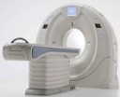
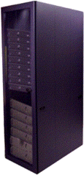
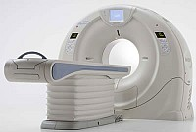



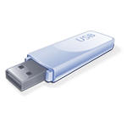
Protocol Storage
SOURCES
Defined Protocol
APPLICATIONS
Device=Scanomatic Series
…
Pat. Pos. : Feet First / Supine
Pat. Instruct : Single Breath Hold
/ Full Inspiration
…
kVp : 80~140
Slice Thickness : 1.0~2.5mm
Recon. Kernel : Std.
…
Semi-auto Scan Setup
Prior Scan
Prior Comparability
Modality
Protocol Library
Patient Positioning
Vendor
Sharing
Best Practice
Clinical Trial Protocol
Clinical Trial
or
Performed Protocol
Protocol Backups
Local Standard
Device=Scanomatic Delta
Version=3.0.4
…
Pat. Pos=Feet First / Supine
Pat. Instruct=Given
…
kVp=120
Slice Thickness=1.0mm
Recon. Kernel=FC12
…
Hospital
Acquisition Validation
Best Practice
Scan QA / Troubleshooting
ACR / RSNA
AAPM
Notes:
12

Slide 13

Contrast Administration SR
Performed Administration
Contains
Programmed at injector device
Actually delivered by injector device
1
1
Programmed Plan
Delivered
Plan
1-n
1-n
Steps
Steps
Pressure
Vs. Time Graphs
Flow Rate
Vs. Time Graphs
1-n
1-n
Phases
Phases
* Courtesy WG-6
Notes:
Set up a quality program for contrast similar to radiation dose.
Also potential for clinical applications to use the detailed flow information to refine analysis.

Slide 14
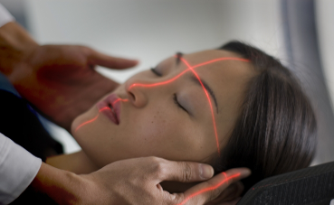
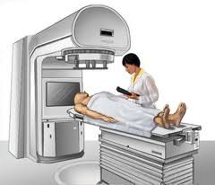
Theme: Radiotherapy (2nd Generation)
Prescribing, planning, verifying, and delivering radiotherapy treatments
RT Prescription & Segment Annotation Sup 147
RT C-Arm Radiations Sup 175
RT New Radiations Sup 176
RT Patient Positioning and Workflow Sup 160
RT Dose Objects Sup 177
RT Course Sup 178
RT Radiation Records Sup 199
RT Ion Radiation Objects Sup 215
RT Brachytherapy Objects Sup 216
Notes:
Note the portion of supplements done to finished belies the portion of the work completed.

Slide 15
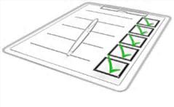
Theme: Conformance
Increasing formalization of conformance assessment and communication (WG-31)
Revised DICOM Conformance Statement Sup 209
  Address needs identified in user survey
  Consider Machine-readable for inter-system distribution and analysis
Conformity Assessment Sup 207
  Define hierarchy of conformance clauses and assessment procedures

Slide 16
A Few Other Topics

Slide 17

Security
Providing and maintaining security mechanisms used within the protocol
TLS Security Profiles Sup 204
Extended BCP195 TLS Profile Sup 206
* Variety of features added circa 1999-2001
Notes:
204 = (mostly) Use TLS 1.2, originally added TLS around 2001

Slide 18
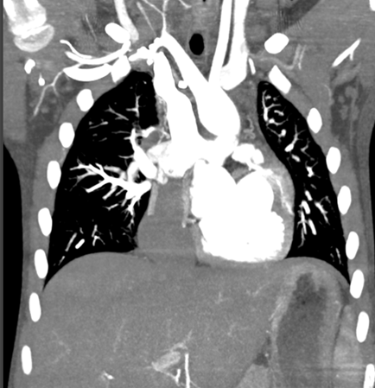
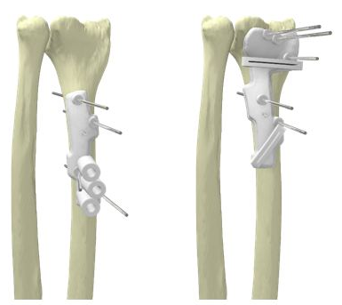
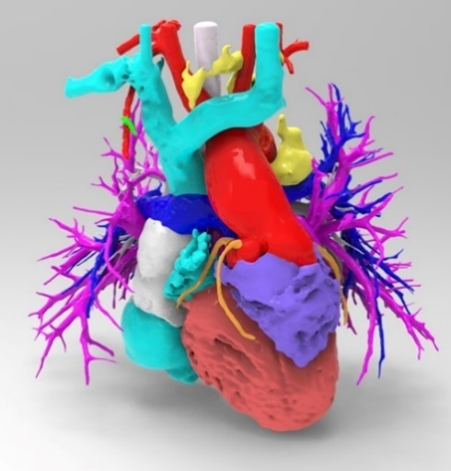
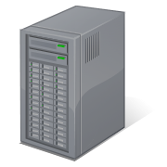
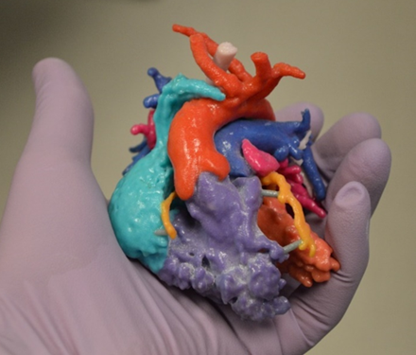
3D Manufacturing
Manage 3D files together with the imaging study used to generate them
STL Encapsulation for 3D Manufacturing Sup 205
OBJ Encapsulation for AR/VR/3D Manufacturing Sup 208
Notes:
A form of physical visualization. For specialists, referring, patient.
Surgical guides can significantly reduce the length of the procedure.
OR Time does not come cheap.

Slide 19
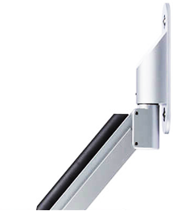
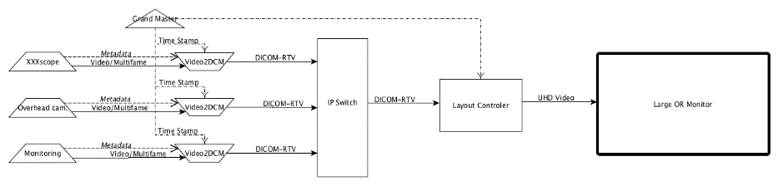
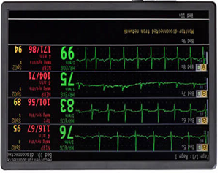

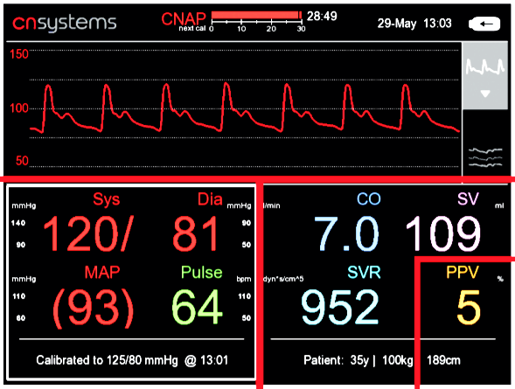
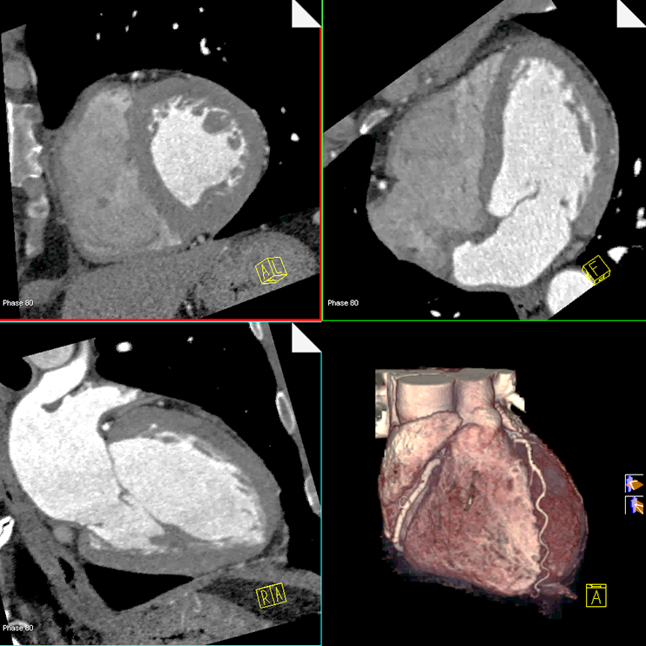

Video
Increasing use of video; stored and streaming
HEVC/H.265 Transfer Syntax Sup 195
Real-Time Video Sup 202 (New!)
Compression ratio to MPEG-2
4
2
1
MPEG-2
AVC
HEVC
Notes:
Sample Use Case: Automated OR “Multi-display”
Layout (“hanging protocol”) depends on procedure, metadata

Slide 20
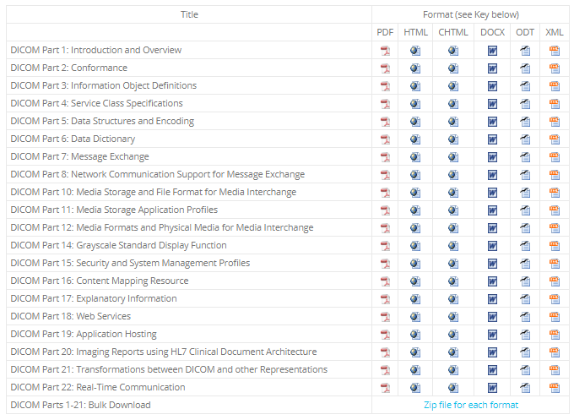
DICOM Standard in HTML / XML
dicomstandard.org/current

Slide 21

AI / Machine Intelligence
Enormous interest in applying AI to medical imaging
Transform NCI AIM & DICOM SR Measures Sup 200
Simplified SR in JSON for AI Sup 219
WG-23 Artificial Intelligence / Application Hosting
  AI Results: Display Primitives, “AI Ready”
  AI Operational Workflow: Image Generation,
  Processing, Display, Reporting
  AI Development Workflow: Data Annotation,
  Management, Research, Algorithm Training,
  Distribution
WG-08 Structured Reporting and Common Data Elements (CDE)
  Radelement.org
  Prostate SR
  ACR DSI Collaborations – Certify-AI, Assess-AI
Notes:
Analyzing and annotating imaging

Slide 22

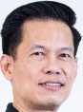
The Future
You tell us…
… seek out new modalities & new technology
… find new applications & new efficiencies
… boldly solve problems we have
never solved before.
Notes:
The Future? You know what you can do and what you need to do but can’t.
Bring your problems and insights to DICOM and help us invent the future.
All the supplements you saw above have something in common. Someone saw a need and volunteered to help meet the need.

Slide 23

Participate !
DICOM invites new members
& contributors
  Application process
  Patent disclosure policy
  dicomstandard.org
  dicom@dicomstandard.org
    Great opportunity to learn
    Great opportunity to contribute

Slide 24


Presenter’s contact information
Kevin O’Donnell, MASc.
kodonnell@mru.medical.canon
Pacifica, California, USA
https://global.medical.canon/
Thank you
For
Your Attention!

