Slide 1
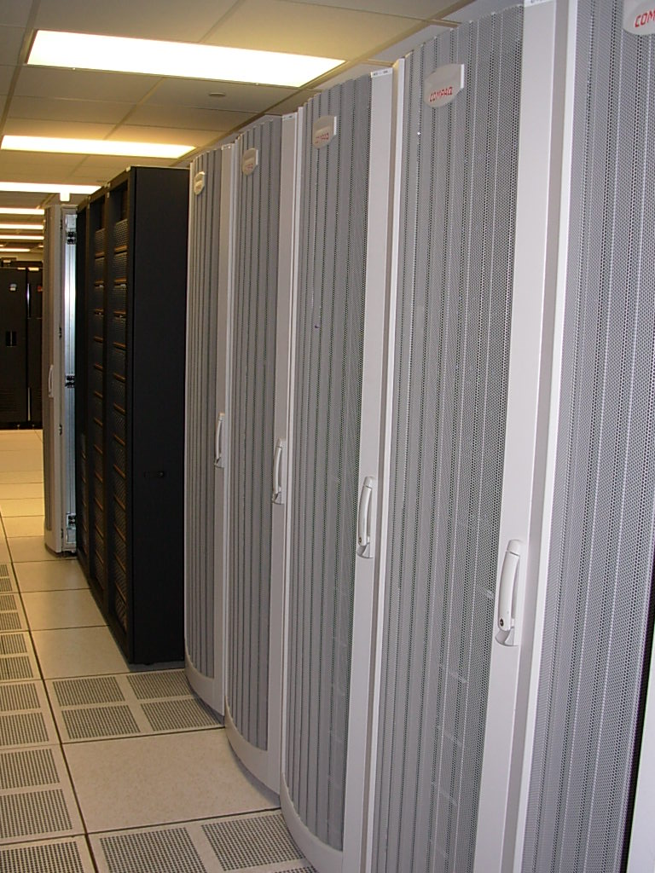
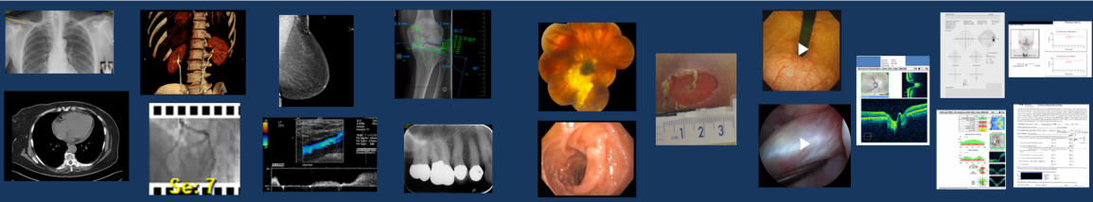
DICOM Educational Conference
Bangkok, Thailand
3-4 October 2019
VNA
mayo Clinic
Ken Persons
Copyright DICOM® 2019 www.dicomstandard.org #DICOMConference2019 #DICOM @DICOMstandard

Slide 2
VNA
Topics:
What is a VNA Anyway ?
History and Evolution of the VNA
Practical Considerations Before Implementing a VNA
Example: A Mature Enterprise Imaging VNA Implementation
Planning for A Successful Implementation

Slide 3
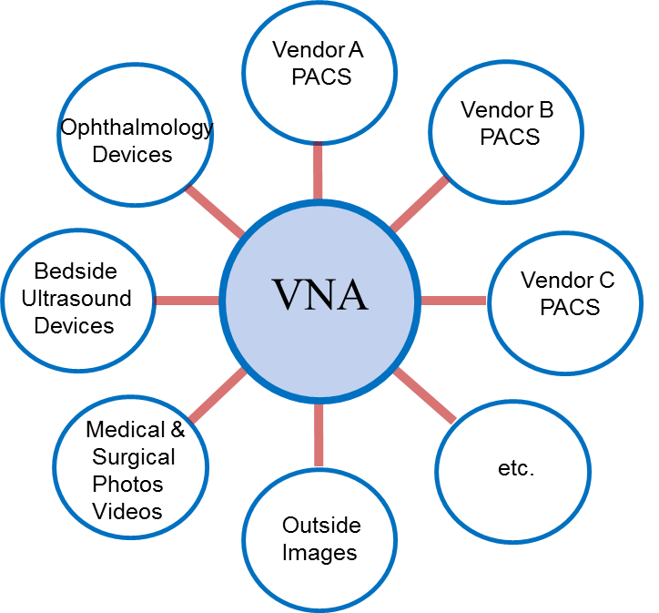
VNA
What is a VNA Anyway ?
    An Archive for Medical Images
    Based on Medical Imaging Standards
    Vendor Neutral
      Interoperable with “Standards-based” Systems from Other Vendors

Slide 4
VNA
What is a VNA Anyway ?
VNA’s are not all the Same
  They may include a variety of other image management functions or services
    Quality Assurance, Validation, and Notification Services
    Image Viewer
    EMR Integration
    Image Exchange Services
    Data Privacy Management Services with Auditing and Reporting
    Support for Multiple Patient ID’s per Patient with Cross-Matching Lookup
    Image Life Cycle Management
    Support for non-DICOM images (proprietary or standard)
    Data Migration Tools
    Administration Tools
    Dash Board
    Analytics Reporting Tools
    Etc.

Slide 5
VNA
Topics:
What is a VNA Anyway ?
History and Evolution of the VNA
Practical Considerations Before Implementing a VNA
Example: A Mature Enterprise Imaging VNA Implementation
Planning for A Successful Implementation

Slide 6
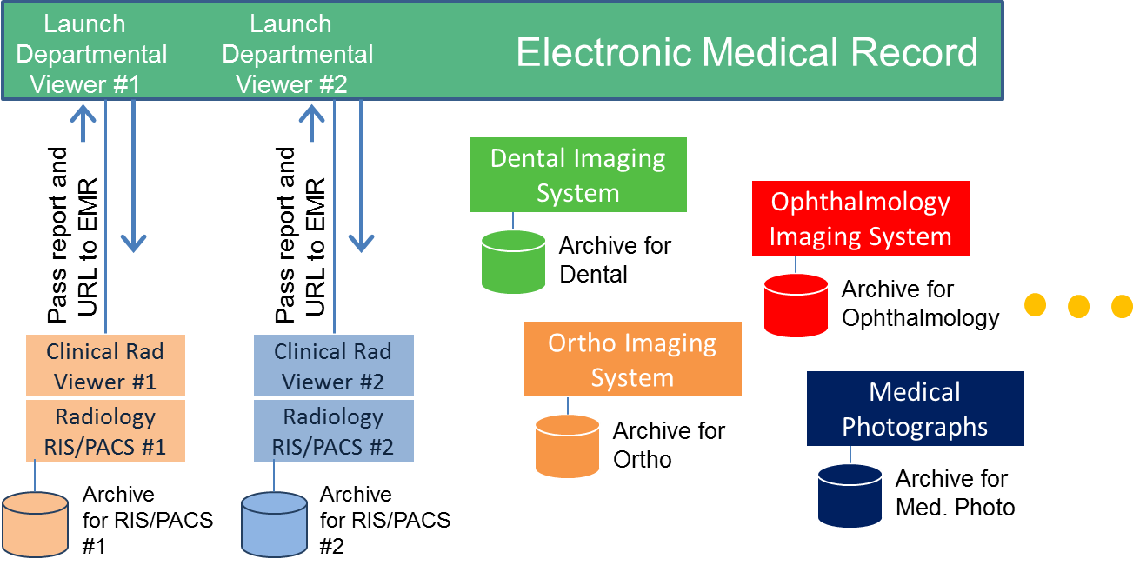
VNA ~ a brief history
Early Years of Digital Imaging
Most Imaging Systems were Proprietary
Interoperability was non-existent or required significant manual effort
Imaging Data was department-centric rather than patient-centric
Departments were responsible for archiving, maintaining and migrating the data
EMR was not aware of departmental images ‘or’ EMR launches departmental image viewer

Slide 7
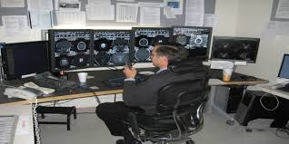
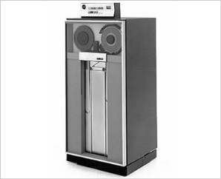
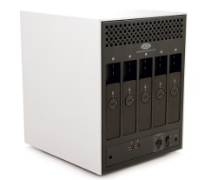
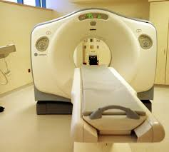
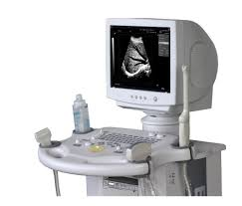
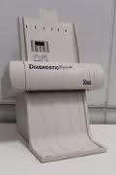
VNA ~ a brief history
Early Years of Digital Imaging
First Generation
Proprietary PACS
Diagnostic Viewer
Images Stored in Proprietary
Data Format
Database &
Short Term Store
Archive
Acquisition
Workstation
Acquisition
Workstation
Acquisition
Workstation
Proprietary
Interface
Modalities
CT
US
Film
Digitizer

Slide 8
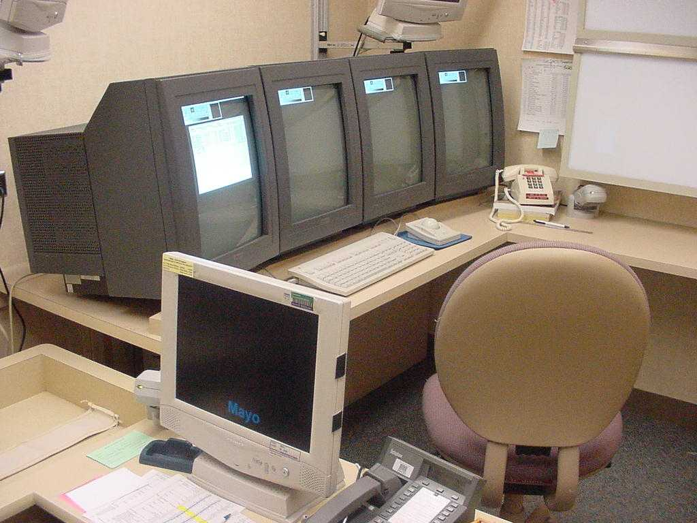
VNA ~ a brief history
Early Years of Digital Imaging
1997 - First PACS installed at Mayo – Proprietary Hardware, Software, Compression, Image Data

Slide 9
VNA ~ a brief history
What Has Changed
Advances in Technology
DICOM medical imaging standard mature and well established
Broad support for DICOM by imaging vendors has enabled interoperability
Well defined IHE medical image workflows (Integration Profiles) based on standards
Support for Enterprise Imaging
VNA’s, Enterprise Clinical Viewers, Encounters-based Imaging, all “ologies”
Standards
and
Industry
Desire for patient centric management of all institutional imaging data
Archival, Access Management, Viewing, Auditing, Exchange, Security
Integrated with the Electronic Medical Record
Orders-based, Encounters-based workflows with imaging results in the EMR
Desire for Imaging interoperability with other medical institutions and patients
Availability of imaging data for AI, Deep Learning, and Research initiatives
Medical
Institutions

Slide 10

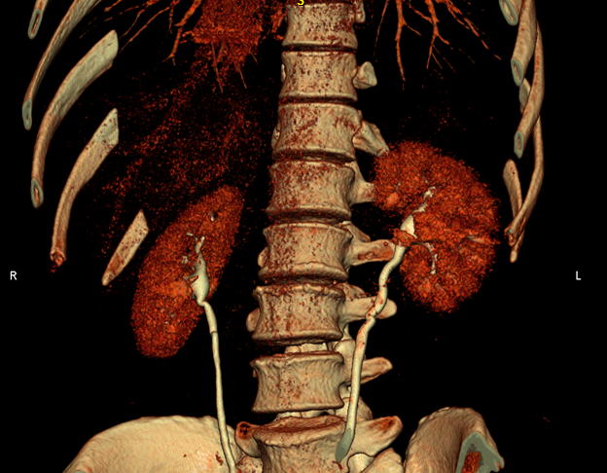
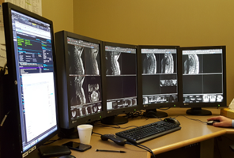



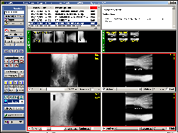
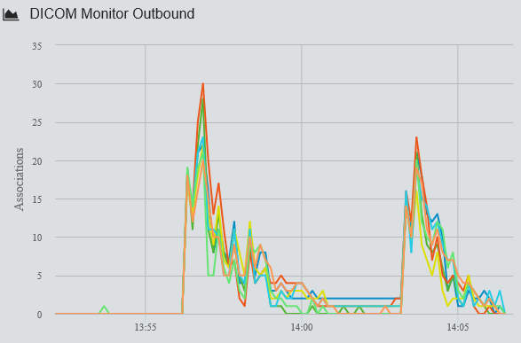

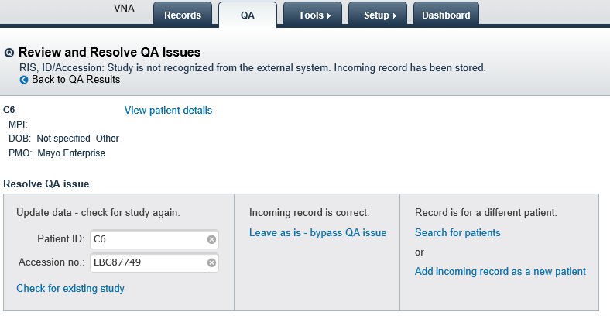
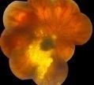

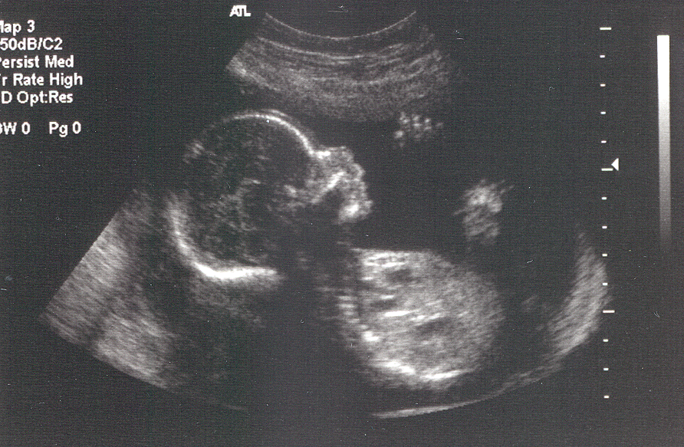

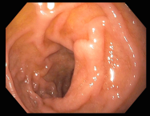
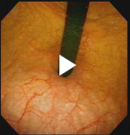
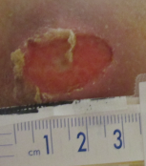
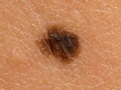


VNA
In an Imaging Ecosystem
Electronic Health Record
Inbound
Health Information
Exchange
AI/Deep
Learning
Analytics
Research
Post
Processing
Query
Retrieve
Viewing
Health Information
Exchange
Outbound
Imaging
Orders
Patient
Registration
DICOM, HL7 and Web Services
Interface Engine
Inbound
Admin,
Dashboard,
Auditing
Vendor Neutral Archive
Q/A
Image Exchange
Gateway
Business
Logic
DICOM and Web Services
Outbound
PACS
Radiology
PACS
Cardiology
Ophthalmology
Dental
Ob-Gyn
Point of Care US
Endoscopic Photos and Video
Medical Photos

Slide 11
VNA
Topics:
What is a VNA Anyway ?
History and Evolution of the VNA
Practical Considerations Before Implementing a VNA
Example: A Mature Enterprise Imaging VNA Implementation
Planning for A Successful Implementation

Slide 12
Practical Considerations
PACS Capabilities to work with a 3rd Party VNA Vary
DICOM, HL7 and Web Services
Admin,
Dashboard,
Auditing
3rd Party Vendor Neutral Archive
Q/A
Business
Logic
DICOM and Web Services
PACS
A
PACS
B
PACS
C
PACS
D
PACS
Archive
PACS
Archive
PACS
Archive
PACS
Archive
Relies on it’s own archive
Relies on it’s own archive
Can also store (export) a copy to a 3rd party VNA
May or may not include presentation states with exported copy.
Can rely on a 3rd party VNA or can use it’s own archive – either with good performance.
Includes presentation states with archived data.
Can rely on a 3rd party VNA or can use it’s own archive – either with good performance.
Includes presentation states with archived data.
Can also retrieve and display foreign exams without re-archiving them.

Slide 13

Practical Considerations
Determine Approach for non-DICOM images
Photos, Videos, Endoscopic, Microscopic Images
DICOM, HL7 and Web Services
Admin,
Dashboard,
Auditing
3rd Party Vendor Neutral Archive
Q/A
Business
Logic
DICOM and Web Services
VNA Capture/Import
Application/Services
DICOM
DICOM
Photo/Video Import
DICOM Wrap
Digital Capture System
DICOM Wrap
Medical Photos
Endoscopic Photos and Video
Medical Photos
Endoscopic Photos and Video
DICOM Wrapped JPEG, MPEG
Native Format (JPEG, MPEG)

Slide 14
Practical Considerations
Determine if/how the EMR will integrate with the VNA, and
what information will be used to uniquely referencing a study
Visit ID
Order #
Patient ID
Accession#
EMR
VNA
Patient ID,
Accession#
Study UID

Slide 15
VNA
Topics:
What is a VNA Anyway ?
History and Evolution of the VNA
Practical Considerations Before Implementing a VNA
Example: A Mature Enterprise Imaging VNA Implementation
IHE EBIW (Encounters-based Imaging Workflow) and a VNA Implementation
Planning for A Successful Implementation

Slide 16


Enterprise Imaging
Example: Mature VNA Implementation
Electronic Health Record
Registration
Master Data
Orders
Results Management
Worklist
Services
Acquire/Store
Photos/Videos
EHR
Desktop
EHR
Mobile
Patient
Portal
Integration
DICOM, HL7 and Web Services
Interface Engine Services
Patient Imaging Registry
Vendor Neutral Archive
Clinical Image Viewing
Image Routing Services
DICOM and Web Services
DICOM Digital
Capture Devices
DICOM Wrap
Import Services
Outside Images
Import
Service
Mayo
Images
Export
Service
Cardiology
OB/Gyn
Ophthalmology
Orthopedics
Radiation Oncology
Urology
Vascular Medicine
Neurology
PMR
Sports Medicine
Pain Medicine
Infusion Therapy
Radiology
Anesthesiology
Dental & Oral Surgery
Emergency Department
Pulmonary/Bronchoscopy
Critical Care
Hospital Internal Medicine
Video Clip Import
GI Scopes
Others….
Others….
Medical Photo Import
Operating Rooms
Import API
ENT Scopes
Mayo Photo App
Stress Echo Videos
Electronic Import
CD/DVD Import
Electronic Export
Burn CD/DVD
Orders-based
Encounters-based

Slide 17
Enterprise Imaging
Example VNA Implementation
Image Acquisition
VNA Provides:
Implementation Supports:
Long Term DICOM Image Archival Services
  Support for most DICOM Information Objects
  Q/A Validation and Resolution
  Image Availability Notifications to External Systems
  Logical Data Pools with Access Controls
DICOM Query/Retrieval Services with Auditing
  Multiple Patient ID Cross-Enterprise Management
  Managed Access to Data Pools
  Query/Retrieve with Current Information
Data Management Tools
  Patient Merges
  IHE IOCM (Image Object Change Management)
  Administrative Tools with Auditing
  Dashboard Monitoring
Orders-Based Image Acquisition Workflow
Encounters-Based Image Acquisition Workflow
Medical Photo Capture Workflow
Outside Digital Images Import Workflow
VNA Integrates with:
Electronic Medical Record
Enterprise Clinical Image Viewer
Radiology and Cardiology PACS (primary archive)
Image Routing Gateways
Many Image Producers and Consumers
Bi-directional Image Exchange Service
Photo Import and DICOM Wrapping Service

Slide 18
Enterprise Imaging
Example VNA Implementation
Image Acquisition
VNA Provides:
Implementation Supports:
Long Term DICOM Image Archival Services
  Support for most DICOM Information Objects
  Q/A Validation and Resolution
  Image Availability Notifications to External Systems
  Logical Data Pools with Access Controls
DICOM Query/Retrieval Services with Auditing
  Multiple Patient ID Cross-Enterprise Management
  Managed Access to Data Pools
  Query/Retrieve with Current Information
Data Management Tools
  Patient Merges
  IHE IOCM (Image Object Change Management)
  Administrative Tools with Auditing
  Dashboard Monitoring
Orders-Based Image Acquisition Workflow
Encounters-Based Image Acquisition Workflow
Medical Photo Capture Workflow
Outside Digital Images Import Workflow
VNA Integrates with:
Electronic Medical Record
Enterprise Clinical Image Viewer
Radiology and Cardiology PACS (primary archive)
Image Routing Gateways
Many Image Producers and Consumers
Bi-directional Image Exchange Service
Photo Import and DICOM Wrapping Service

Slide 19
Enterprise Imaging
Example: Mature VNA Implementation
Electronic Health Record
Registration
Master Data
Orders
Results Management
Worklist
Services
Acquire/Store
Photos/Videos
EHR
Desktop
EHR
Mobile
Patient
Portal
Integration
DICOM, HL7 and Web Services
Interface Engine Services
Patient Imaging Registry
Vendor Neutral Archive
Clinical Image Viewing
Image Routing Services
DICOM and Web Services
DICOM Digital
Capture Devices
DICOM Wrap
Import Services
Outside Images
Import
Service
Mayo
Images
Export
Service
Cardiology
OB/Gyn
Ophthalmology
Orthopedics
Radiation Oncology
Urology
Vascular Medicine
Neurology
PMR
Sports Medicine
Pain Medicine
Infusion Therapy
Radiology
Anesthesiology
Dental & Oral Surgery
Emergency Department
Pulmonary/Bronchoscopy
Critical Care
Hospital Internal Medicine
Video Clip Import
GI Scopes
Others….
Others….
Medical Photo Import
Operating Rooms
Import API
ENT Scopes
Mayo Photo App
Stress Echo Videos
Electronic Import
CD/DVD Import
Electronic Export
Burn CD/DVD
Orders-based
Encounters-based

Slide 20
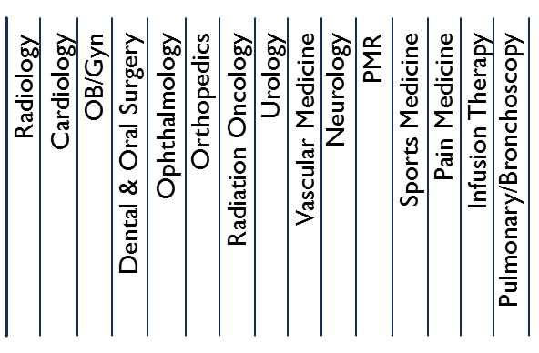
Example: Orders-based Image Acquisition Workflow/Data flow with a VNA
Electronic Health Record
EHR Modality Worklist
Server
Imaging Orders
EHR
Desktop
EHR
Mobile
Patient
Portal
1
6
6
6
Orders
View Images
Notify EHR
that images are available for this order
(ORU)
View Images
View Images
3rd Party Modality Worklist Server
Modality Worklist Query
2
2
2
2
2
Radiology
Modalities
Cardiology
Modalities
Ophthalmalogy
Modalities
OB/GYN
Modalities
Dental
Modalities
Enterprise Clinical Image Viewer Optimized Environments
3
1
Orders
DICOM
Images
DICOM
Images
DICOM
Images
DICOM
Images
Institutional Image Management System
(IIMS)
(Patient Imaging Registry)
5
DICOM
Images
3
3
3
3
3
Gateway
3
Retrieve
Prior
Images
1
Notify IIMS
that images are available
(ORU)
Orders
DICOM
Images
Vendor Neutral Archive
4
5
Validate Images Against Order
Logical Storage Pools

Slide 21

Example: Radiology Orders-based Image Acquisition Workflow/Data flow with a VNA
Radiology PACS using 3rd Party VNA it’s Archive
Electronic Health Record
Orders
1
2
2
2
RIS
Radiologist Worklist
Modality
Worklist
EHR Results
8
7
9
Order
Information
Radiologist and Technologist Worklist
View
4
6
PACS
Enterprise
Clinical Viewer
Order Information
DICOM Images
Images Available
DICOM Images
5
Gateway
5
5
5
DICOM Images
DICOM Images
6
5
6
IOCM
6
6
5
IOCM
DICOM
Images
5
Enterprise
Image
Management
System
(Patient Image Registry)
3
Vendor Neutral Archive (VNA)
5
5
Order Placed and Scheduled in EHR
Order Information Flows to Downstream Systems
Full Patient Jacket Parallel Prefetch (Mayo and Outside Studies)
Patient Arrives, Exam Begins, Modality Worklist Conveys Order Information
Images Acquired – Sent to 3 Destinations in Parallel (PACS, VNA, Clinical Viewer)
QA on PACS – IOCM used to keep VNA and Clinical Viewer in Sync – Technologist Indicates Exam Complete
Preliminary Images Available to View from EHR
Radiologist Worklist – Radiologist Interprets and Reports
Report Final – Results in EHR – Exam Status Final
1
2
3
4
5
6
7
8
9

Slide 22
Converging 9 Different Orders-based Radiology PACS to a Single Radiology PACS
Same VNA – No Data Migration
Electronic Health Record
RIS
Radiologist Worklist
Modality
Worklist
EHR Results
After
PACS
Enterprise
Clinical Viewer
Gateway
Vendor Neutral Archive (VNA)
PACS
PACS
PACS
PACS
PACS
PACS
PACS
PACS
PACS
Before
RIS
RIS
RIS
RIS
RIS
EMR#1 RIS Module
EMR #2
EMR #1
EMR #3

Slide 23
Enterprise Imaging
Example VNA Implementation
Image Acquisition
VNA Provides:
Implementation Supports:
Long Term DICOM Image Archival Services
  Support for most DICOM Information Objects
  Q/A Validation and Resolution
  Image Availability Notifications to External Systems
  Logical Data Pools with Access Controls
DICOM Query/Retrieval Services with Auditing
  Multiple Patient ID Cross-Enterprise Management
  Managed Access to Data Pools
  Query/Retrieve with Current Information
Data Management Tools
  Patient Merges
  IHE IOCM (Image Object Change Management)
  Administrative Tools with Auditing
  Dashboard Monitoring
Orders-Based Image Acquisition Workflow
Encounters-Based Image Acquisition Workflow
Medical Photo Capture Workflow
Outside Digital Images Import (and Export)
Orders-Based Image Acquisition Workflow
Encounters-Based Image Acquisition Workflow
VNA Integrates with:
Electronic Medical Record
Enterprise Clinical Image Viewer
Radiology and Cardiology PACS (primary archive)
Image Routing Gateways
Many Image Producers and Consumers
Bi-directional Image Exchange Service
Photo Import and DICOM Wrapping Service

Slide 24
Enterprise Imaging
Example: Mature VNA Implementation
Electronic Health Record
Registration
Master Data
Orders
Results Management
Worklist
Services
Acquire/Store
Photos/Videos
EHR
Desktop
EHR
Mobile
Patient
Portal
Bedside Ultrasound Devices
Integration
DICOM, HL7 and Web Services
Interface Engine Services
Patient Imaging Registry
Vendor Neutral Archive
Clinical Image Viewing
Image Routing Services
DICOM and Web Services
DICOM Digital
Capture Devices
DICOM Wrap
Import Services
Outside Images
Import
Service
Mayo
Images
Export
Service
Cardiology
OB/Gyn
Ophthalmology
Orthopedics
Radiation Oncology
Urology
Vascular Medicine
Neurology
PMR
Sports Medicine
Pain Medicine
Infusion Therapy
Radiology
Anesthesiology
Dental & Oral Surgery
Emergency Department
Pulmonary/Bronchoscopy
Critical Care
Hospital Internal Medicine
Video Clip Import
GI Scopes
Others….
Others….
Medical Photo Import
Operating Rooms
Import API
ENT Scopes
Mayo Photo App
Stress Echo Videos
Electronic Import
CD/DVD Import
Electronic Export
Burn CD/DVD
Orders-based
Encounters-based

Slide 25




Example: Encounters-based Image Acquisition Workflow/Data flow with a VNA
Bedside Ultrasound Devices (speak DICOM)
Electronic Health Record
Patient Registration
Master Data Management
EHR
Desktop
EHR
Mobile
Patient
Portal
1
7
7
7
Create
and Result
Order
For
Imaging
Using
Known
Accession #,
Department,
PHI,
etc.
Get Patient Demographic Information
View Images
View Images
View Images
3rd Party Modality Worklist Server
Modality Worklist Query
1
1
1
1
Anes.
Sports Medicine
Critical
Care
Pulmonary
Bronchoscopy
Enterprise Clinical Image Viewer Optimized Environments
barcode
PID
1
4
DICOM
Images
DICOM
Images
DICOM
Images
DICOM
Images
With
Acc #
Institutional Image Management System
(IIMS)
(Patient Imaging Registry)
6
Notify Exam In Progress →
(PHI, Dept., Modality, Study UID…)
← Get Accession #
2
2
2
2
3
Gateway
3
4
Retrieve
Prior
Images
Notify IIMS
that images are available
(ORU)
DICOM
Images
with Acc #
Vendor Neutral Archive
Validate Images Against Patient Registration
6
5
Logical Storage Pools

Slide 26
Enterprise Imaging
Example: Mature VNA Implementation
Electronic Health Record
Registration
Master Data
Orders
Results Management
Worklist
Services
Acquire/Store
Photos/Videos
EHR
Desktop
EHR
Mobile
Patient
Portal
Surgical and Endoscopic
Integration
DICOM, HL7 and Web Services
Interface Engine Services
Patient Imaging Registry
Vendor Neutral Archive
Clinical Image Viewing
Image Routing Services
DICOM and Web Services
DICOM Digital
Capture Devices
DICOM Wrap
Import Services
Outside Images
Import
Service
Mayo
Images
Export
Service
Cardiology
OB/Gyn
Ophthalmology
Orthopedics
Radiation Oncology
Urology
Vascular Medicine
Neurology
PMR
Sports Medicine
Pain Medicine
Infusion Therapy
Radiology
Anesthesiology
Dental & Oral Surgery
Emergency Department
Pulmonary/Bronchoscopy
Critical Care
Hospital Internal Medicine
Video Clip Import
GI Scopes
Others….
Others….
Medical Photo Import
Operating Rooms
Import API
ENT Scopes
Mayo Photo App
Stress Echo Videos
Electronic Import
CD/DVD Import
Electronic Export
Burn CD/DVD
Orders-based
Encounters-based

Slide 27


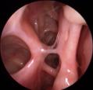

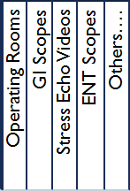
Example: Encounters-based Image Acquisition Workflow/Data flow with a VNA
Surgical and Endoscopic Images and Video Clips
Electronic Health Record
Registration
Master Data Management
EHR
Desktop
EHR
Mobile
Patient
Portal
1
7
7
7
Get Patient Demographic Information
View Images
Create
Order
For
Imaging
Using
Known
Accession #,
Department,
PHI,
etc.
View Images
View Images
3rd Party Modality Worklist Server
Modality
Worklist
Query
1
Digital
Capture System
Enterprise Clinical Image Viewer Optimized Environments
barcode
PID
4
DICOM Images
and video clips
with Acc #
Institutional Image Management System
(IIMS)
(Patient Imaging Registry)
DICOM
Images and
video clips
6
Video
Notify Exam In Progress →
(PHI, Dept., Modality, Study UID…)
← Get Accession #
Video Management System (editing)
Edited
DICOM
Video
Clips
2
Gateway
3
3
Notify IIMS
that images are available
(ORU)
DICOM Images
and video clips
with Acc #
Retrieve
Prior
Images
4
Vendor Neutral Archive
Validate Images Against Patient Registration
6
5
Logical Storage Pools

Slide 28
Enterprise Imaging
Example: Mature VNA Implementation
Electronic Health Record
Registration
Master Data
Orders
Results Management
Worklist
Services
Acquire/Store
Photos/Videos
EHR
Desktop
EHR
Mobile
Patient
Portal
Photography and Video Clips
Integration
DICOM, HL7 and Web Services
Interface Engine Services
Patient Imaging Registry
Vendor Neutral Archive
Clinical Image Viewing
Image Routing Services
DICOM and Web Services
DICOM Digital
Capture Devices
DICOM Wrap
Import Services
Outside Images
Import
Service
Mayo
Images
Export
Service
Cardiology
OB/Gyn
Ophthalmology
Orthopedics
Radiation Oncology
Urology
Vascular Medicine
Neurology
PMR
Sports Medicine
Pain Medicine
Infusion Therapy
Radiology
Anesthesiology
Dental & Oral Surgery
Emergency Department
Pulmonary/Bronchoscopy
Critical Care
Hospital Internal Medicine
Video Clip Import
GI Scopes
Others….
Others….
Medical Photo Import
Operating Rooms
Import API
ENT Scopes
Mayo Photo App
Stress Echo Videos
Electronic Import
CD/DVD Import
Electronic Export
Burn CD/DVD
Orders-based
Encounters-based

Slide 29


Example: Encounters-based Image Acquisition Workflow/Data flow with a VNA
Photography and Video Clip Acquisition and Import Services
Electronic Health Record
Registration
Master Data Management
EHR
Desktop
EHR
Mobile
Patient
Portal
1
1
7
7
7
Launch
To Patient
Context
Patient Lookup
Web Service
Import EHR Photos
Web Service
(future)
View Images
Create
Order
For
Imaging
Using
Known
Accession #,
Department,
PHI,
etc.
View Images
View Images
C
1
2
A
Medical
Photo/Video Import
Application
2
B
Enterprise Clinical Image Viewer Optimized Environments
2
4
Mobile
Photo/Video App
DICOM Images
and Video Clips
with Acc #
Institutional Image Management System
(IIMS)
(Patient Imaging Registry)
6
DICOM Encapsulate Web Service
Notify Photo Exam Info. →
(PHI, Dept., Photo Classification, …)
← Get Accession #
DICOM Encapsulation and Routing
3
4
Retrieve
Prior
Images
3
Notify IIMS
that images are available
(ORU)
DICOM Images
and Video Clips
with Acc #
Vendor Neutral Archive
Validate Images Against Patient Registration
6
5
Logical Storage Pools
Three Methods:
Medical Photos
Mobile Photo/Video App
Restricted Photos
A
B
Photo/Video Import Application
C
API – Import Web Service

Slide 30
Enterprise Imaging
Example: Mature VNA Implementation
Electronic Health Record
Registration
Master Data
Orders
Results Management
Worklist
Services
Acquire/Store
Photos/Videos
EHR
Desktop
EHR
Mobile
Patient
Portal
Bi-directional Image Exchange
Integration
DICOM, HL7 and Web Services
Interface Engine Services
Patient Imaging Registry
Vendor Neutral Archive
Clinical Image Viewing
Image Routing Services
DICOM and Web Services
DICOM Digital
Capture Devices
DICOM Wrap
Import Services
Outside Images
Import
Service
Mayo
Images
Export
Service
Cardiology
OB/Gyn
Ophthalmology
Orthopedics
Radiation Oncology
Urology
Vascular Medicine
Neurology
PMR
Sports Medicine
Pain Medicine
Infusion Therapy
Radiology
Anesthesiology
Dental & Oral Surgery
Emergency Department
Pulmonary/Bronchoscopy
Critical Care
Hospital Internal Medicine
Video Clip Import
GI Scopes
Others….
Others….
Medical Photo Import
Operating Rooms
Import API
ENT Scopes
Mayo Photo App
Stress Echo Videos
Electronic Import
CD/DVD Import
Electronic Export
Burn CD/DVD
Orders-based
Encounters-based

Slide 31
VNA
Topics:
What is a VNA Anyway ?
History and Evolution of the VNA
Practical Considerations Before Implementing a VNA
Example: A Mature Enterprise Imaging VNA Implementation
Planning for A Successful Implementation

Slide 32
VNA and Enterprise Imaging
Foundations for Success
Define an Enterprise Imaging Strategy, Including the Core Services to Provide
  Image Archival, Image Viewing, Image Exchange, EMR Integration, Data Maintenance
  Outside Image Management, Privacy and Security Management, Image Access Controls and Auditing
Put in Place Effective Governance Responsible for the Implementation of that Strategy
  Policies, Prioritization, Planning, Approval, and Oversight
Create an Enterprise Imaging Platform to Provide the Core Services
  The Platform Itself, Excellent Support for Implementation, Maintenance, and Problems
Work With Departments to Integrate their Imaging Devices and Applications
  Orders-Based Workflows, Encounters-Based Workflows Outside Images Medical & Surgical Photos, etc.
Recommended Reading
  A Foundation for Enterprise Imaging: HIMSS-SIIM Collaborative White Paper, Journal of Digital Imaging, October 2016, Vol29, Issue 5, pp 530-538 https://link.springer.com/article/10.1007/s10278-016-9882-0

Slide 33
Presenter’s contact information
Thank you –
You are welcome to contact me if you have questions or want to discuss any of these topics further.
  Kenneth Persons
  krpersons@mayo.edu
  Mayo Clinic,
  200 First St. SW Pb 2-58
  Rochester, MN, USA 55902

