Slide 1
DICOM Educational Conference
Bangkok, Thailand
3-4 October 2019
DICOM 3D Printing
rady Children’s Hospital-San Diego
Justin Ryan, PhD
Copyright DICOM® 2019 www.dicomstandard.org #DICOMConference2019 #DICOM @DICOMstandard

Slide 2
About Us
Justin Ryan, PhD
  Research Scientist and Director of the 3D Innovations Lab
  10 years in medical anatomical modeling (3D printing)
  Co-chair (User), DICOM WG-17 – 3D Printing (and Extended Reality)
  PhD and MSE Biomedical Engineering, Arizona State University; BA Digital Art Arizona State University
Allan Noordvyk (in absentia)
  Executive Director of Research, Enterprise Imaging Solutions, Change Healthcare
  Co-chair (Technical), DICOM WG-17 – 3D Printing (and Extended Reality)

Slide 3
Overview
Motivation
  3D Printing
  “Anatomical Modeling”
Challenges
Current Workflow and Formats
2018b DICOM Update
Proposed Supplement 208
Updated Mandate
Call to Action

Slide 4
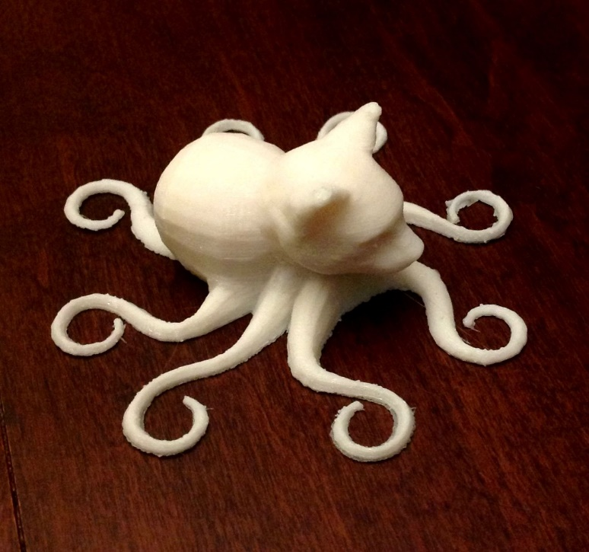
3D Printing
Many are familiar with home 3D printing
Octocat, Image credit: Allan Noordvyk

Slide 5
Uses of 3D Printing and Medical Imaging
- Education
Patient
  Illustrate condition, diagnosis, or procedure
  Often as part of obtaining informed consent
Image credit: J. Morris, Mayo Clinic

Slide 6
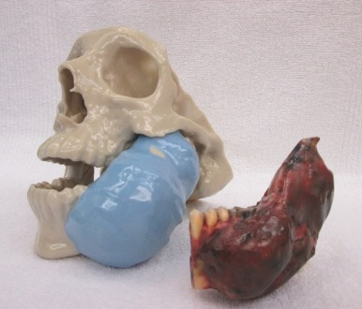
Uses of 3D Printing and Medical Imaging
- Education
Patient
  Illustrate condition, diagnosis, or procedure
  Often as part of obtaining informed consent
Practitioner
  Notable/Teaching cases
  (General education better handled through other means)
Image credit: A. Alexander, Mayo Clinic

Slide 7
Uses of 3D Printing and Medical Imaging
- Diagnosis & Planning
Diagnosis
Image credit: J. Morris, Mayo Clinic

Slide 8
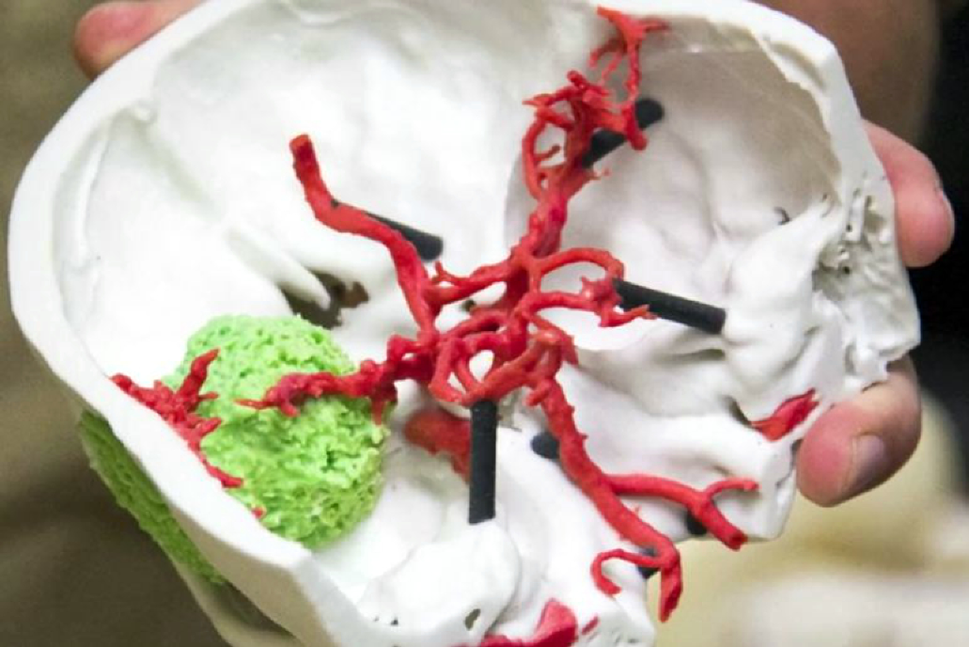
Uses of 3D Printing and Medical Imaging
- Diagnosis & Planning
Diagnosis
Planning
  Surgical approach
  Implant sizing and insertion
  Surgical tool selection
Image credit: Stars and Stripes

Slide 9
Uses of 3D Printing and Medical Imaging
- Diagnosis & Planning
Diagnosis
Planning
  Surgical approach
  Implant sizing and insertion
  Surgical tool selection
Fitting
  E.g., pre-bending plates
Image credit: J. Morris, Mayo Clinic

Slide 10
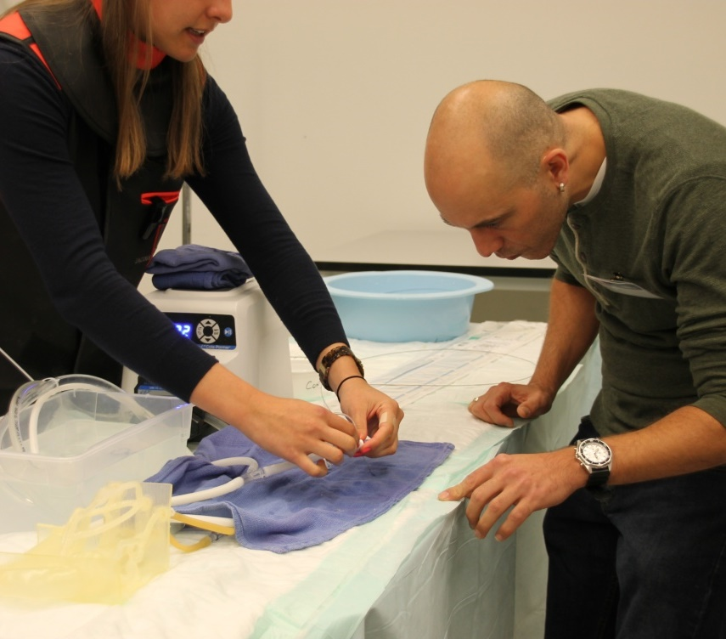
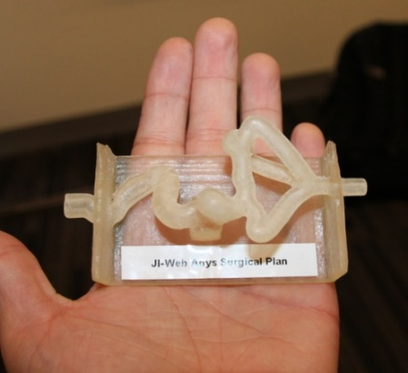
Uses of 3D Printing and Medical Imaging
- Simulation
Surgery practice
  E.g., Insertion of stent in a tortuous vessel
“Dry run” of complicated cases
Image credit: Change Healthcare

Slide 11
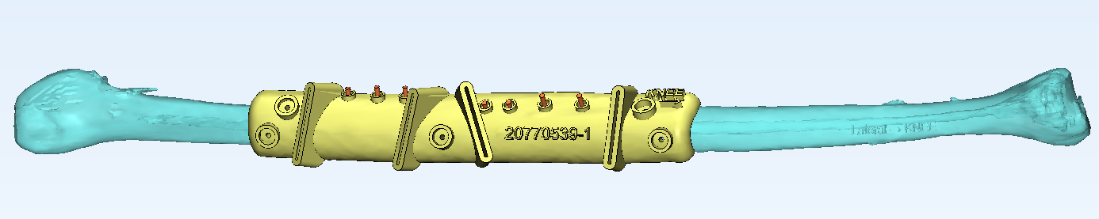
Uses of 3D Printing and Medical Imaging
- Implants/Prosthetics
Instruments
Guides
  Needle, e.g., biopsy
  Cutting
  Drilling
Image credits: J. Morris (right), A. Alexander (below), Mayo Clinic

Slide 12
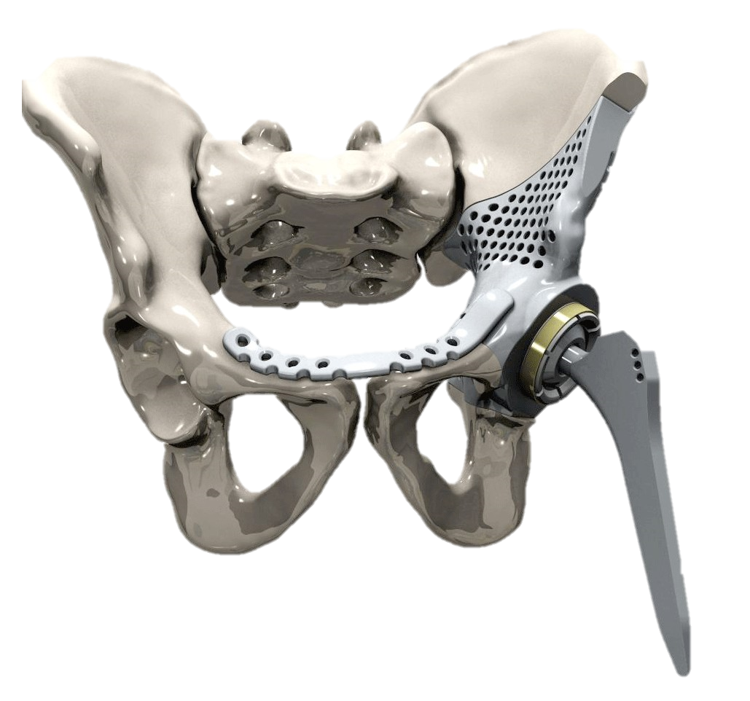
Uses of 3D Printing and Medical Imaging
- Implants/Prosthetics
Image credit: Alphaform Instrumentaria
Image credit: J. Morris, Mayo Clinic

Slide 13
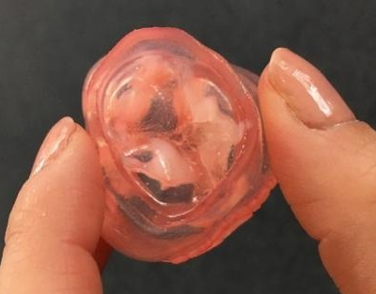

Uses of 3D Printing and Medical Imaging
- Implants/Prosthetics
Image credit: Yael Maxwell
Image credit: Yong Dawson

Slide 14
3D Printing
3D-printed titanium parts could save Boeing up to $3 million per plane
– The Verge, 11 April 2017
Many are familiar with home 3D printing
Other fields are seeing benefits of 3D printed components
  Low volume components
  Mass customization
  Tooling & Prototyping
The first common 3D-printed buildings might be army barracks
– Fast Company, 14 September 2018
Volkswagen will use 3D printers to mass produce parts
– CNN, 11 September 2018
How 3D printing could help save us from trade wars
– CNN, 13 August 2018
https://www.theverge.com/2017/4/11/15256008/3d-printed-titanium-parts-boeing-dreamliner-787
https://www.fastcompany.com/90235902/the-first-common-3d-printed-buildings-might-be-army-barracks
https://money.cnn.com/2018/09/11/technology/volkswagen-3d-printing-parts/index.html
https://www.cnn.com/2018/08/31/opinions/3d-printing-trade-wars-opinion-daveni/index.html

Slide 15
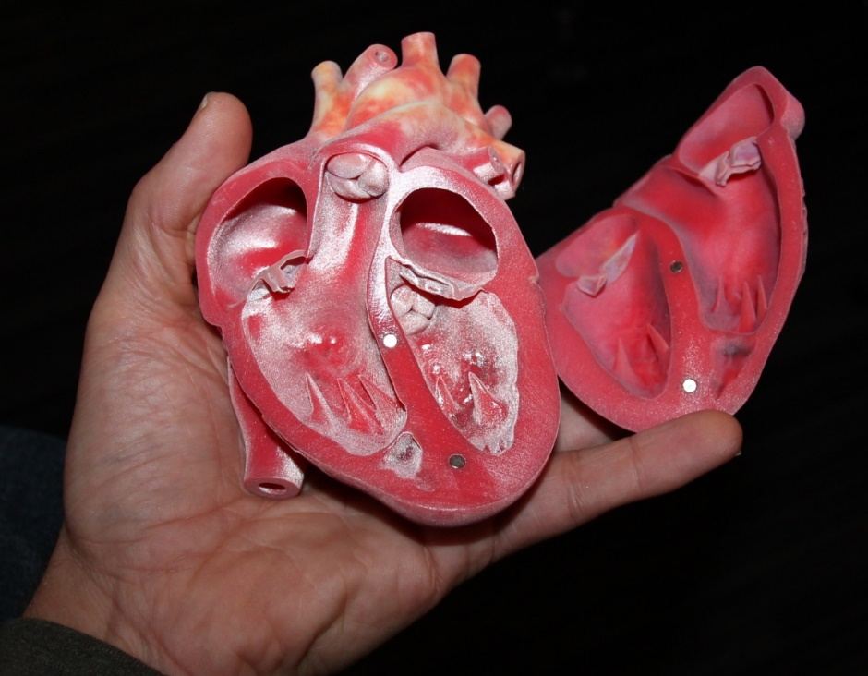
3D Printing in Medicine
“Off-the-shelf” low-volume items
Custom lab equipment
Patient-matched devices
  Medical imaging used in design of custom devices
Patient-matched anatomical replicas from medical images (“anatomical models”)
Image credit: Change Healthcare

Slide 16
3D Printing
Request | Practitioner, e.g. surgeon, determines need for a 3D printed model
Image | Relevant, suitable, imaging located or acquired
Consult | Technician* discusses model requirements and presentation
Segment and model | Create model from imaging Addition of functional features (separations, sockets) Addition of orientation markings and patient identifiers
Review and Refine | Virtual model sent for review Model improved based on feedback Add printing supports, determine manufacturing orientation
Print | Select materials and colors
Clean-up and QA | Remove printing supports, add magnets, etc. Sterilization Validation

Slide 17
Challenges with traditional 3D print workflow
Patient safety
  Wrong Patient, Wrong Imaging, Laterality errors
  Model version issues
  Scale errors
Complicated workflow
File handling
  Model file naming conventions
  Model file storage requirements
  Management of source images
Protection of patient information

Slide 18
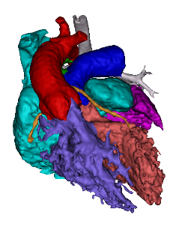
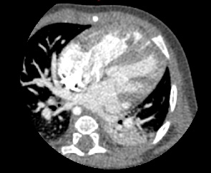

What Happens Now*
What Happens When?
The clinical care team wants to review a 3D model?
A user wants to review a model without “modeler” software?
A user doesn’t have the patient identifier?
A user doesn’t have access to the networked drive?
Patient Link
Patient Metadata
Software
PACS*
Modeler
File Database (Networked)
Data
Source Images
3D Model
3D Model, 3DPDF, Other Files
Gcode
STL
PLY
OBJ
VRML
AMF
3MF
…
Format
DICOM
Not DICOM
Not DICOM
* Or VNA, DICOM image exchange, etc.

Slide 19
DICOM Encapsulated STL SOP Class (2018)
STL is a common 3D model file format
Modeling software can store models in PACS alongside patient imaging
  Reduces wrong patient, wrong imaging errors
  Simplifies workflow by eliminating manual movement of images and models
  Eliminates need for model file naming, file storage conventions, separate storage
Source images; frame of reference
Relationship to patient anatomy (e.g. mirrored, modified)
Scale
Intended use (education, implant, etc.)
Previous model, and reason for refinement
Thumbnail image for quick view
Burned In Annotation (0028,0301) now covers embossed/engraved PHI
Recognizable Visual Features (0028,0302) now covers identifying person from model

Slide 20

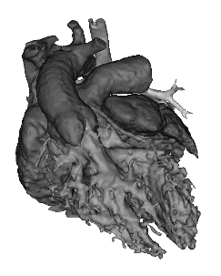

Added in DICOM 2018b
X,Y,Z
Patient Metadata
Patient Metadata
Preview Image
Software
PACS*
Modeler
PACS*
Data
Source Images
3D Model
3D Model
Format
DICOM
STL in DICOM
DICOM
* Or VNA, DICOM image exchange, etc.

Slide 21
Other DICOM 3D Manufacturing activity
Education & promoting use of DICOM Encapsulated STL
  Exhibit at SIIM 2019
Investigating encapsulation of additional model file types (E.G. OBJ, X3D, 3MF)
  For benefits over STL like identifying materials, vertex color information, etc.
Grouping of models
Default color of object
Overlap between 3D Printing and Augmented Reality/Virtual reality

Slide 22


New in Supplement 208
X,Y,Z
Patient Metadata
Patient Metadata
Preview Image
Software
PACS*
Modeler
PACS*
Data
Source Images
3D Model
3D Model
Format
DICOM
OBJ in DICOM
DICOM
Including Textures/Material Files
* Or VNA, DICOM image exchange, etc.

Slide 23
DICOM Encapsulated OBJ SOP Class
+ other STL & OBJ improvements
OBJ is a common 3D model file format
  Both for printing and XR
DICOM Encapsulated OBJ
  Same benefits as Encapsulated STL, but also supports:
    Vertex colors
    Texture maps
Adding to both DICOM STL & OBJ
  Model Group
    Group 3D objects that meant to be assembled together
  Recommended Display CIELab Value
    Assign color to whole 3D objects, to differentiate
  Recommended Presentation Opacity
    Make whole objects transparent or semi-transparent

Slide 24
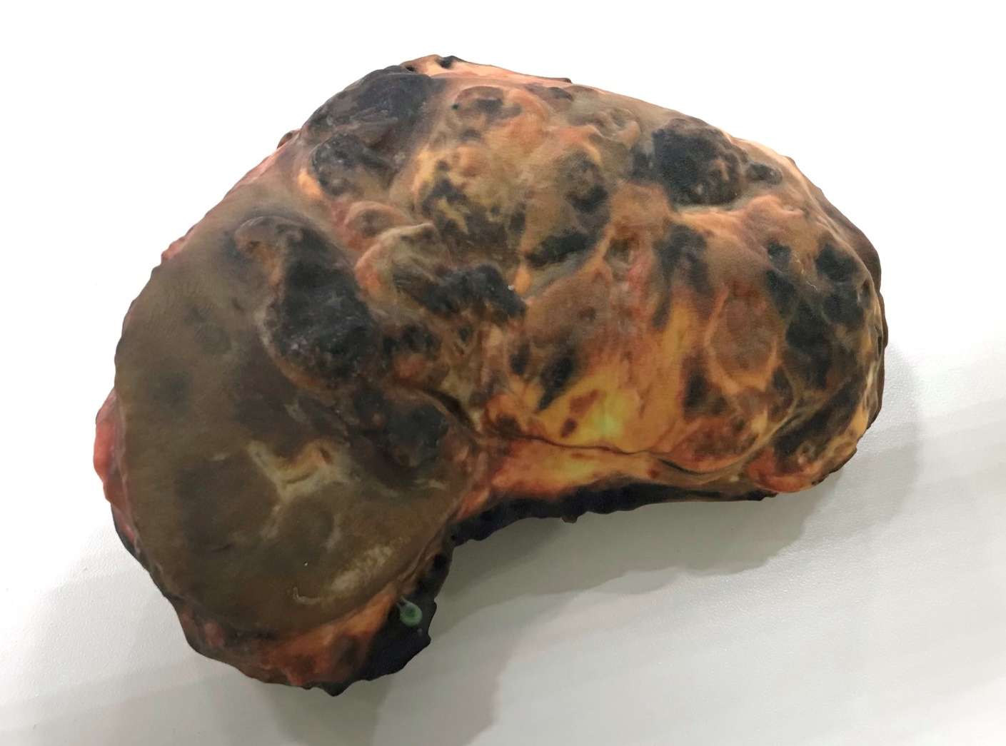
Example use of new capabilities:
Texture Map
3D printed model of tumor, identical in appearance at time of surgical removal
Model credit: Mayo Clinic
Image credit: Change Healthcare

Slide 25
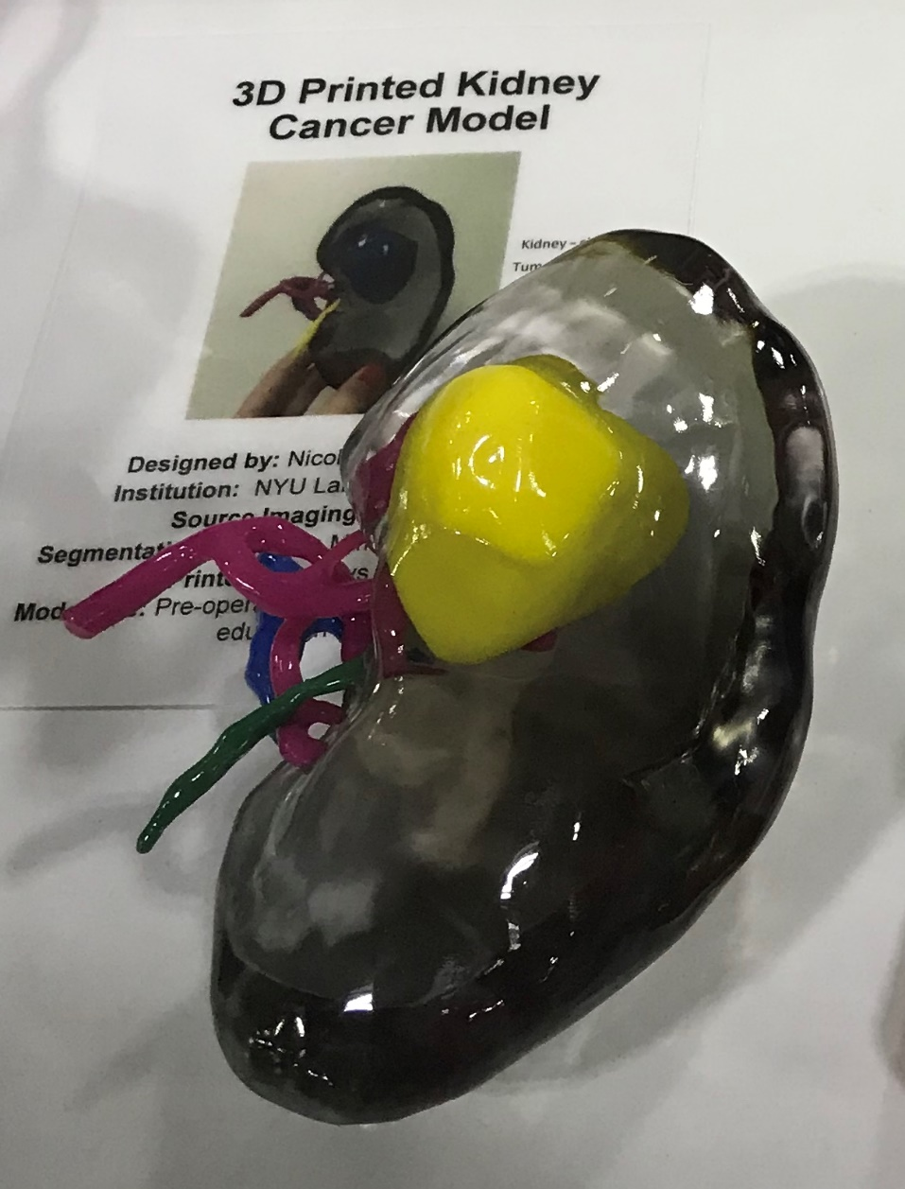
Examples use of new capabilities:
Object Color
Transparency
Grouping
Multiple 3D printed models:
kidney tumor, color-coded vessels, and transparent surrounding kidney tissue
Model credit: NYU Langone Medical Center
Image credit: Change Healthcare

Slide 26
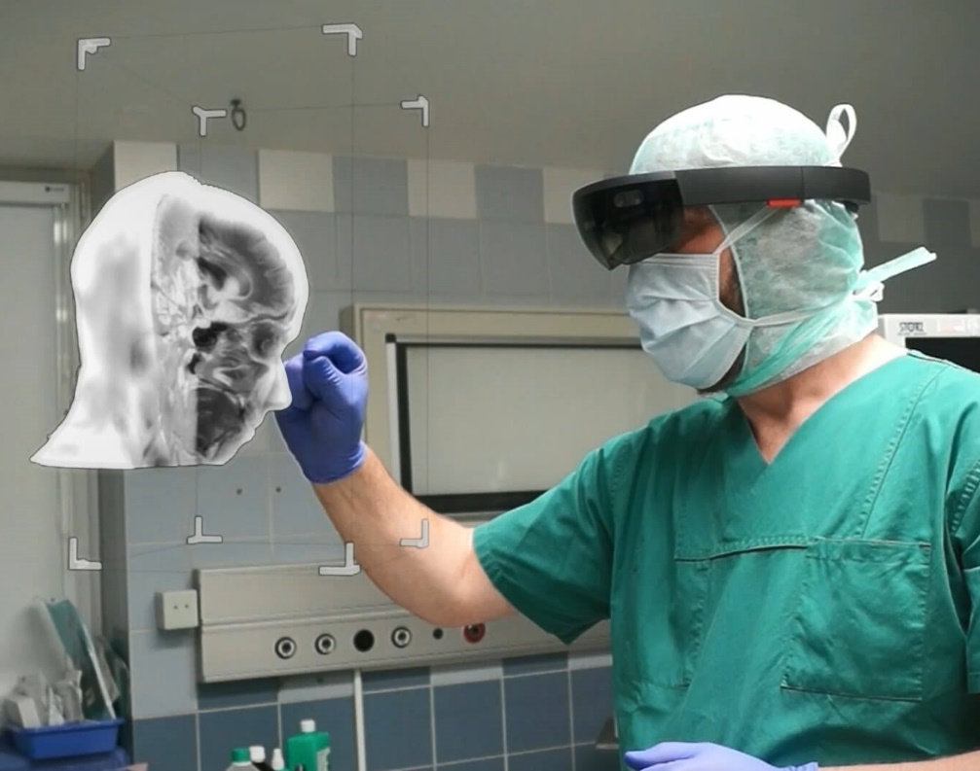
Extended Mandate
Extended Reality (XR) (inclusive of Virtual Reality, Augmented Reality, and Mixed Reality) has increased use
WG17 updated Mandate to address XR needs
  Existing strong overlap with Encapsulated STL/OBJ and other work items

Slide 27
How Can You Help?
Hassle your software vendors about supporting DICOM Encapsulated STL (and OBJ)
  Why? They only add features for which they hear lots of requests
3D Modeling Software
  Should be able to create and store the objects
PACS / VNA / Image Exchange Software
  Should be able to receive, store and return the objects

Slide 28
What’s Next?
Further extend the DICOM standard
  Supplement 208 is current in public comment
    Candidate for inclusion in 2020 edition of DICOM standard
  https://www.dicomstandard.org/participate/
    Say you are interested in joining WG17
Keep an eye on 3MF or AMF adoption (future 3D printing file formats)
Look for new use cases from medical Virtual Reality (VR) and Augmented Reality (AR) community

Slide 29
Thank You
Justin Ryan (User Co-Chair)
  jryan2@rchsd.org
  Rady Children’s Hospital-San Diego
Allan Noordvyk (Technical Co-Chair)
  allan.noordvyk@changehealthcare.com
  Change Healthcare
Significant slide assistance by Elliot Silver, Change Healthcare

