Slide 1
DICOM Educational Conference Bangkok, Thailand
OCTOBER 3-4, 2019
DICOM RESULT reporting
Structured Reports, JSON, AI
David A. Clunie
PixelMed Publishing, LLC

Slide 2
Disclosures
Editor of the DICOM Standard (NEMA Contract)
Owner of PixelMed Publishing, LLC
Author of book on DICOM Structured Reporting
Consulting for BKMedical, Canfield, Carestream, Imago, MDDX (Bioclinica)
Supported by NIH U24CA180918 QIICR, NCI Leidos BOA 29XS219 Task Order #05

Slide 3
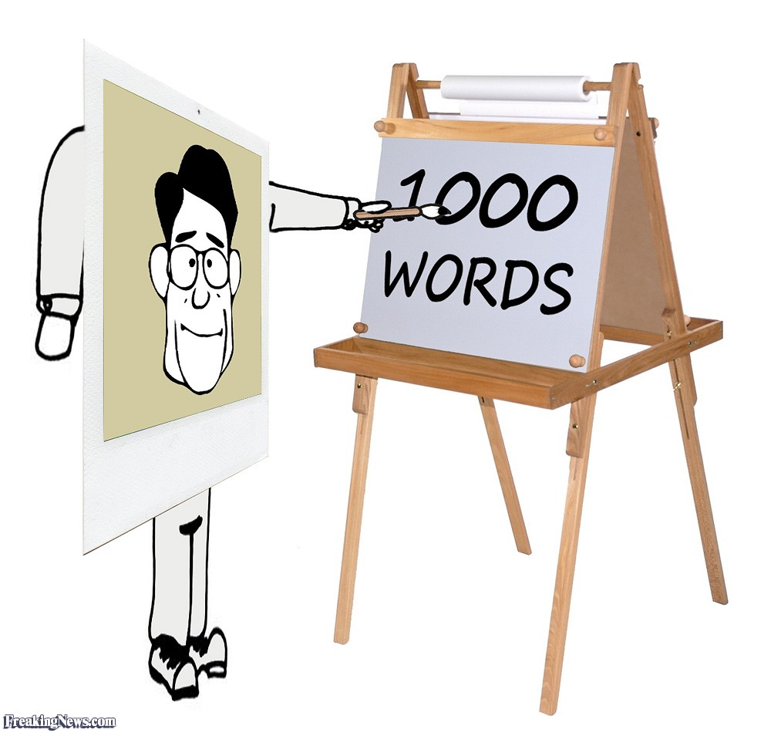
Notes:
http://www.freakingnews.com/A-Picture-Paints-a-Thousand-Words-Pics-65426.asp

Slide 4
Notes:
http://www.freakingnews.com/A-Picture-Paints-a-Thousand-Words-Pics-65426.asp

Slide 5
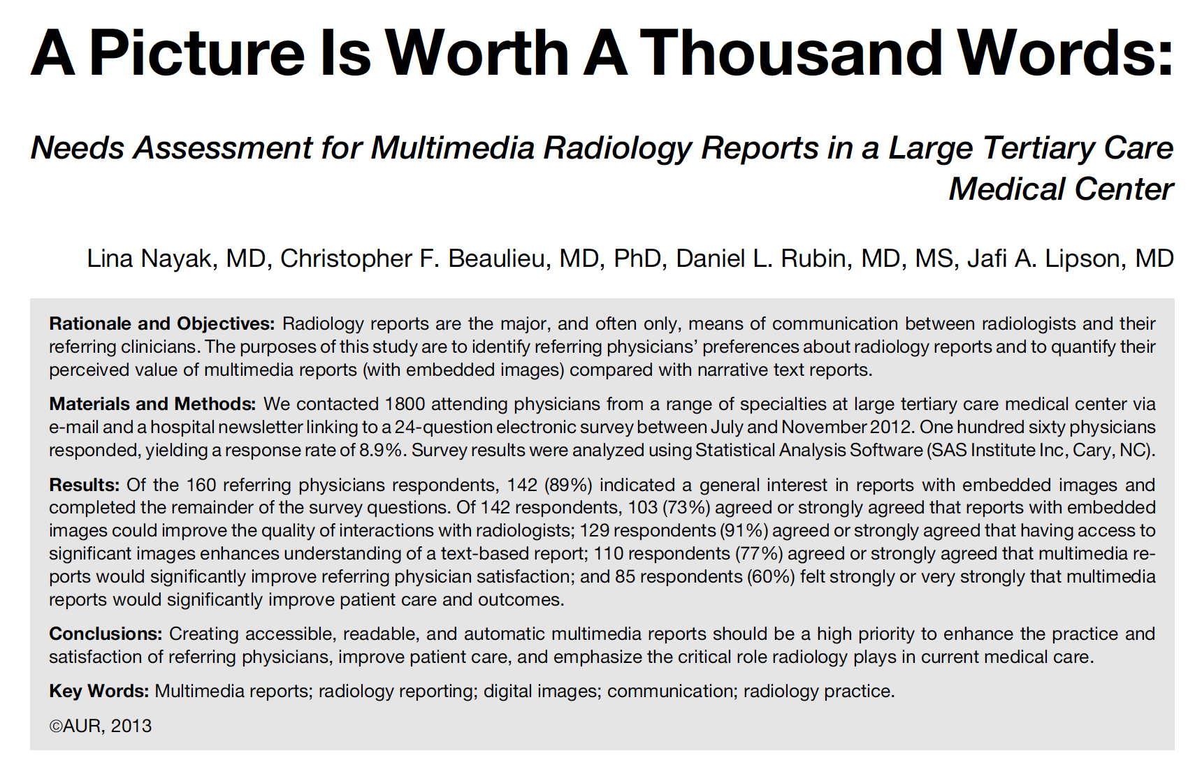
Notes:
http://www.freakingnews.com/A-Picture-Paints-a-Thousand-Words-Pics-65426.asp

Slide 6
Notes:
http://www.freakingnews.com/A-Picture-Paints-a-Thousand-Words-Pics-65426.asp

Slide 7
What is a “Structured Report”?
Human perspective (radiologist, cardiologist, pathologist, referring physician …)
not a massive blob of prose (narrative)
organized
hierarchical
sections and sub-sections
bulleted lists
question and answer rather then single sentence
Machine perspective
coded section headings
coded questions with answers:
coded answer
text answer
numeric answer (with coded units)
links to images, regions of interest, coordinates (spatial & temporal)

Slide 8
Machine Readable Reports

Slide 10
Annotation – Granularity
Patient/Case
Imaging Study
Series/Acquisition
Image
Frame (pixel data array at one place in space/time/…)
Region (“of interest” – ROI)
Single point (label each/every voxel/pixel)
All supported DICOM Structured Report (SR) or SEG

Slide 11
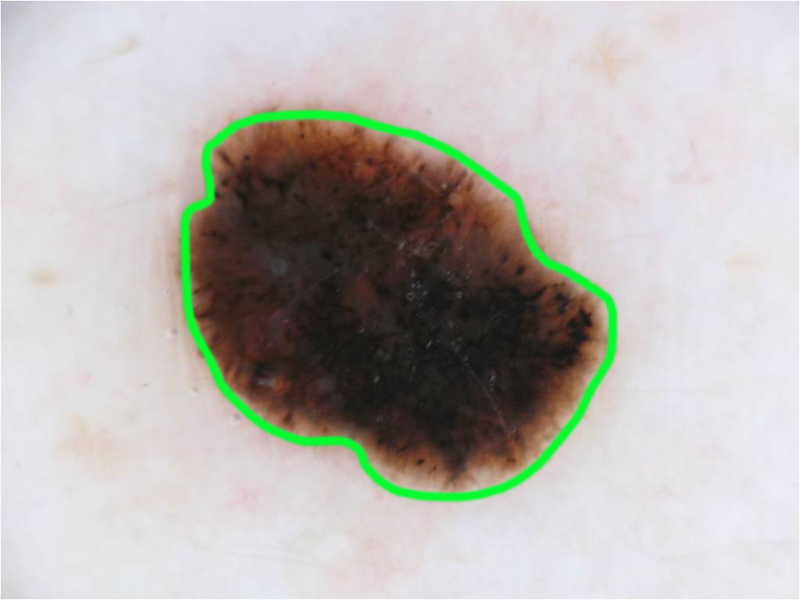
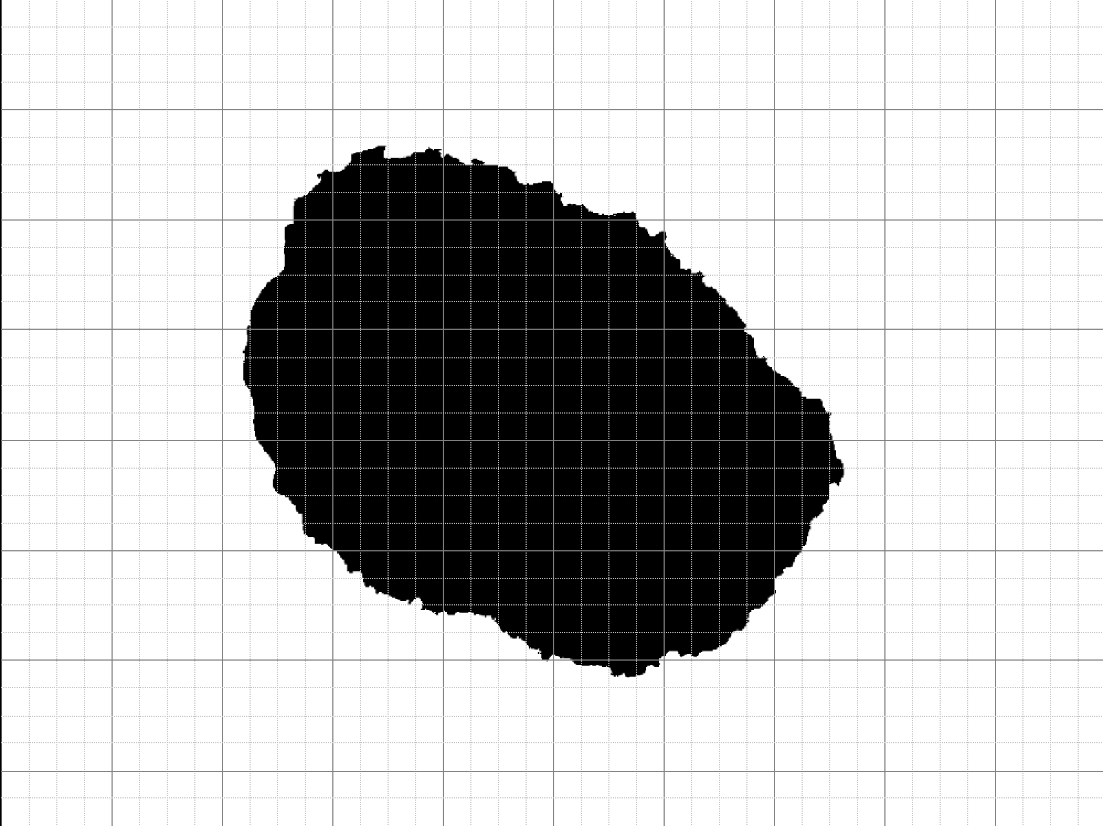
Annotation Representation
Contour – 2D Coordinates (SR)
Rasterized Bitmap (SEG)

Slide 12
Presentation States relatively useless
DICOM Presentation States are great for capturing state of rendering to human
zoom/pan, window center/width, …
but limited text and graphic annotations
no semantics
not even linkage of graphics and text
can be referenced from SR to set appropriate viewing conditions for referenced images
Unfortunately are very popular with PACS due to their simplicity
better than no DICOM capture of annotations at all of course
means product managers not motivated to add SR support
Ideally, all PACS viewers would support displaying any kind of SR
not just tabulating/rendering hierarchical content as text
not just jumping to reference image
but also displaying all coordinates/SEG references overlaid on images
preferably with local context from the tree such as finding, measurements and units

Slide 13
DICOM Structured Reports
A machine-readable structured report that satisfies humans too
Added to DICOM circa 2000
Primary use-cases circa 2018
Ultrasound cart output – echocardiography, obstetric measurements
Mammography CAD output
Radiation Dose from CT and projection X-Ray devices (RDSR)
Key Object Selection (KOS)
limited use for human-generated narrative reports with section structuring
Major new use-cases in the quantitative/machine learning era
tumor/lesion region of interest encoding
quantitative measurements and categorical classification
created by humans or machines
consumed by humans or machines

Slide 14
DICOM Non-Image Objects
DICOM Segmentation
Previous DICOM SR etc
DICOM Registration
Current DICOM Images from Modality
Analysis Workstation
DICOM SR
PACS Store, Distribute and Review
DICOM Real World Value
Previous DICOM Images from PACS
DICOM Parametric Map Images

Slide 15
DICOM SR organizes them …
DICOM Segmentation
Previous DICOM SR etc
DICOM Registration
Current DICOM Images from Modality
Analysis Workstation
DICOM SR
PACS Store, Distribute and Review
DICOM Real World Value
Previous DICOM Images from PACS
DICOM Parametric Map Images

Slide 16
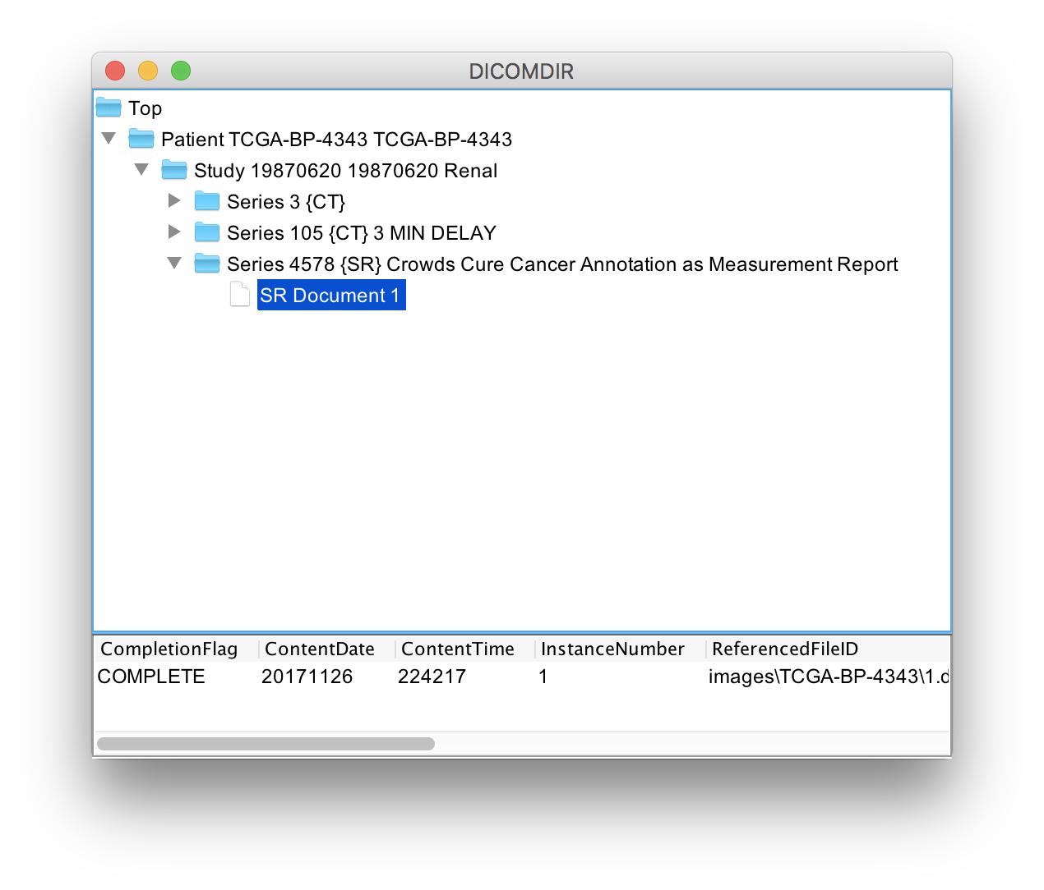
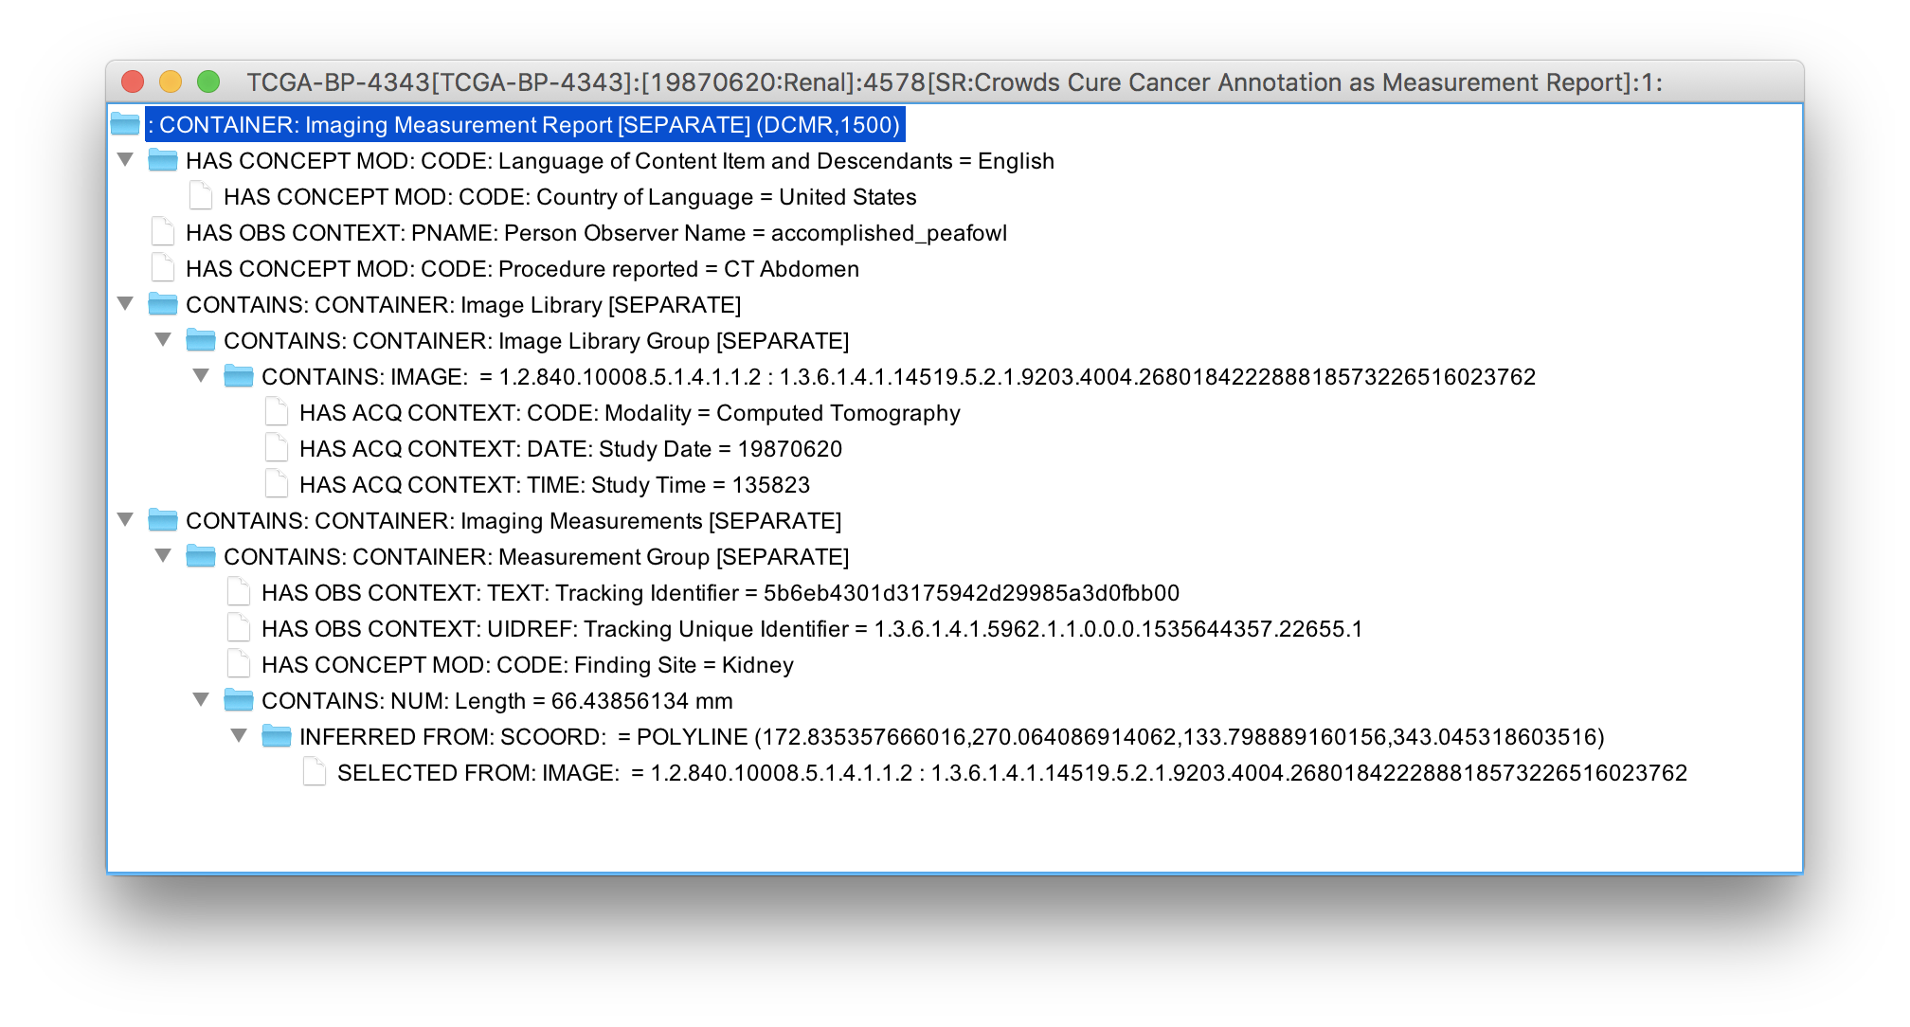
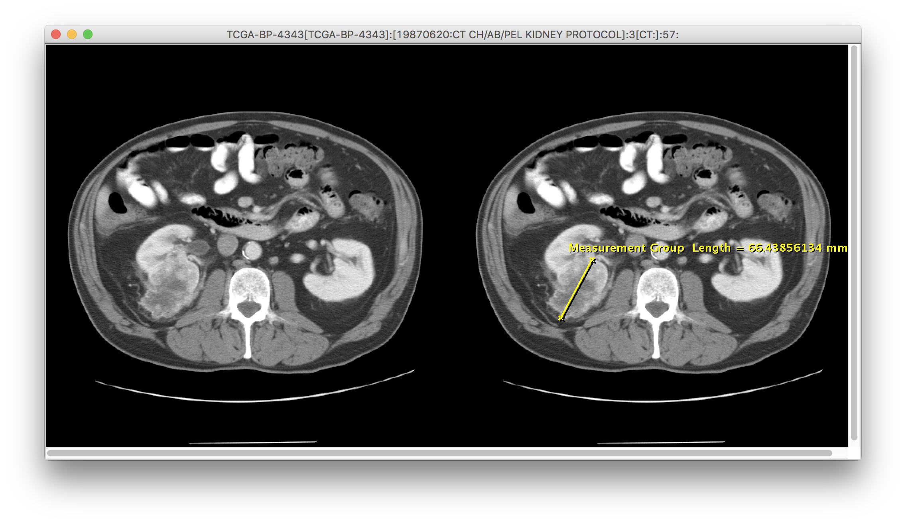

Slide 20
SR Content is a Tree
Root Node
1
Child Nodes
1
.
1
1
.2

Slide 21
Each Node (Content Item)
Is a “name-value” pair
e.g. “finding” = “mass”
Concept “name” is always coded
e.g. (121071, DCM, “Finding”)
“Value” may be one of several “value types”
“Value” may be coded too
e.g. (M-37000, SRT, “Hemorrhage”)
e.g. 37.2 (mm2, UCUM, “square millimeters”)

Slide 22
Value Types
TEXT
CODE
NUM
PNAME
DATE
TIME
DATETIME
CONTAINER
UIDREF
COMPOSITE
IMAGE
WAVEFORM
SCOORD(3D)
TCOORD

Slide 23
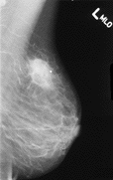
NUM: Distance = 37.6 mm
INFERRED FROM
SCCORD: Path = POLYLINE (32,77),(210,93)
SELECTED FROM
IMAGE: 1.2.840.276453….

Slide 24
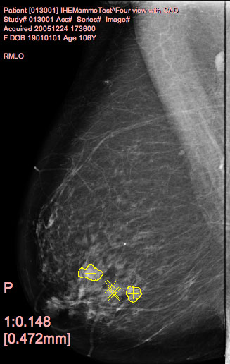
CONTAINER: “Mammo CAD Report”
CODE: “Summary” = “Succeeded with Findings”
…
CONTAINER: "Individual Impression/ Recommendation"
"Individual Impression/ Recommendation"
CONTAINS
CODE: "Single Image Finding" = "Mammography breast density"
HAS PROPERTIES
SCOORD: "Center" = POINT {2505,2168}
SCOORD: "Outline" = POLYLINE {2531,2114,2537, 2114,..,2525,2114,2531,2114}
SELECTED FROM
IMAGE: 1.2.840.276453….

Slide 25
Spatial Coordinates
POINT
MULTIPOINT
POLYLINE
CIRCLE
ELLIPSE

Slide 26
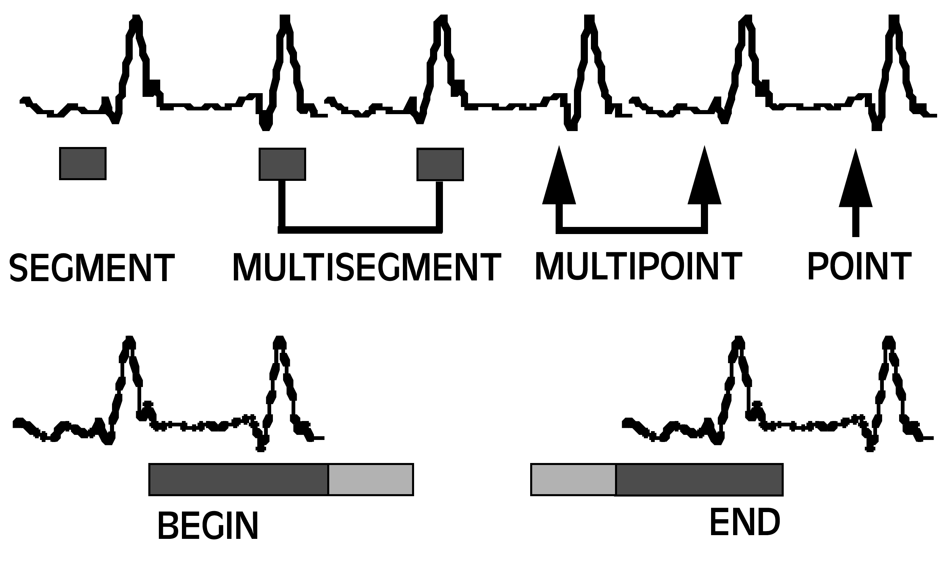
Temporal Coordinates

Slide 27
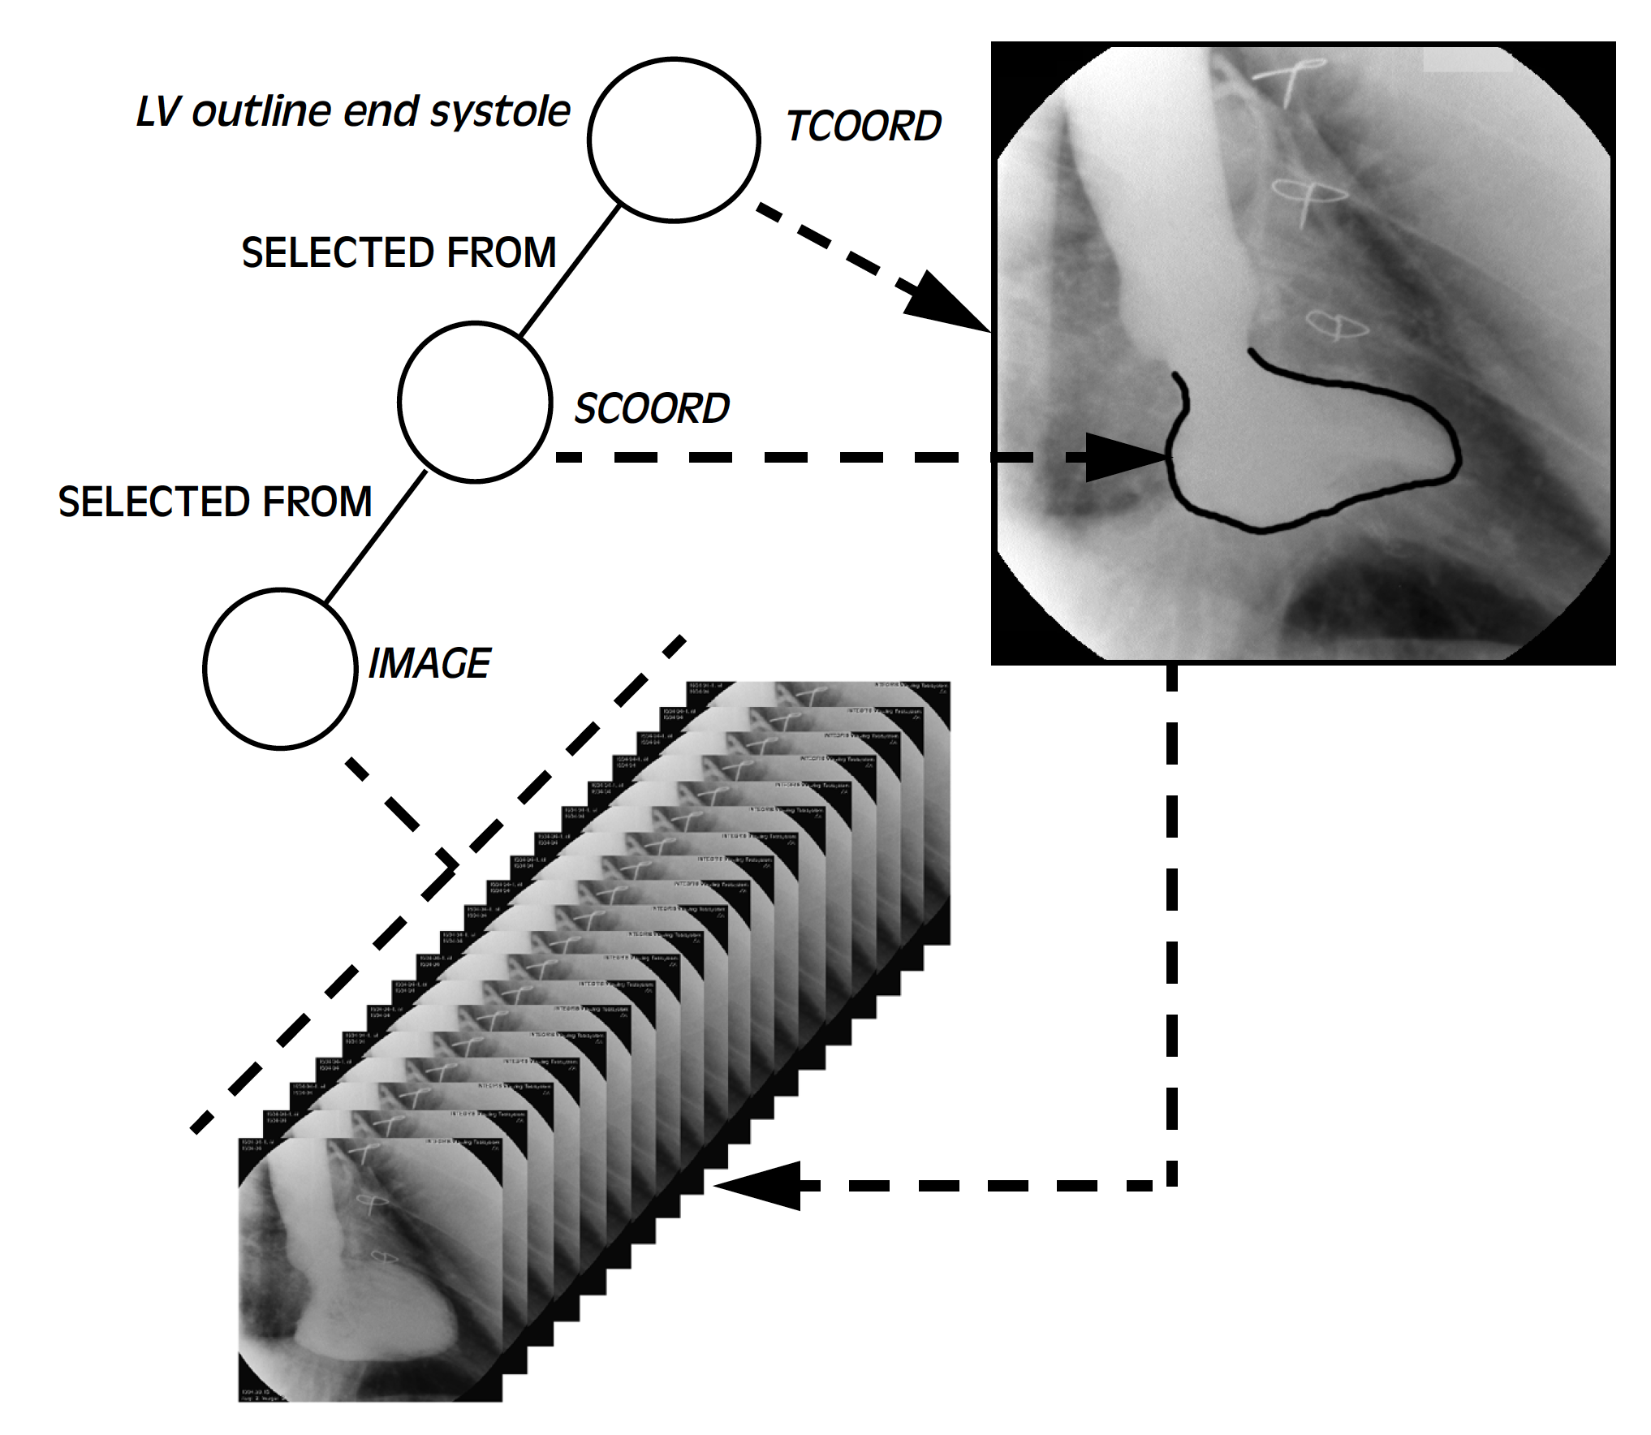
Image Temporal and Spatial Coordinates

Slide 28
Temporal Coordinates applied to both Images and Waveforms

Slide 29
What about Codes?
DICOM uses external lexicons
SNOMED
LOINC
RADLEX
defines DCM codes & definitions if no other good scheme
EHR push towards more reliable codes
e.g., EHR interoperability and common data elements
RIS, modalities and PACS implementations could do better
institutions need to standardize internal procedure codes
harmonize/bridge imaging/EHR codes

Slide 30
Codes for Structured Reports
Codes needed for
entities, e.g., lesions, tumors, tissue types
location, e.g., anatomic site
characteristics, e.g., edges, enhancement
measurements, e.g., volume, sum of areas, mean
units, e.g., HU, mm
Availability
many already - SNOMED, LOINC, RADLEX, DCM, NCI, UCUM
more being defined every day
vendors also use private codes
need to anticipate code evolution (configurable producer/consumer)

Slide 31
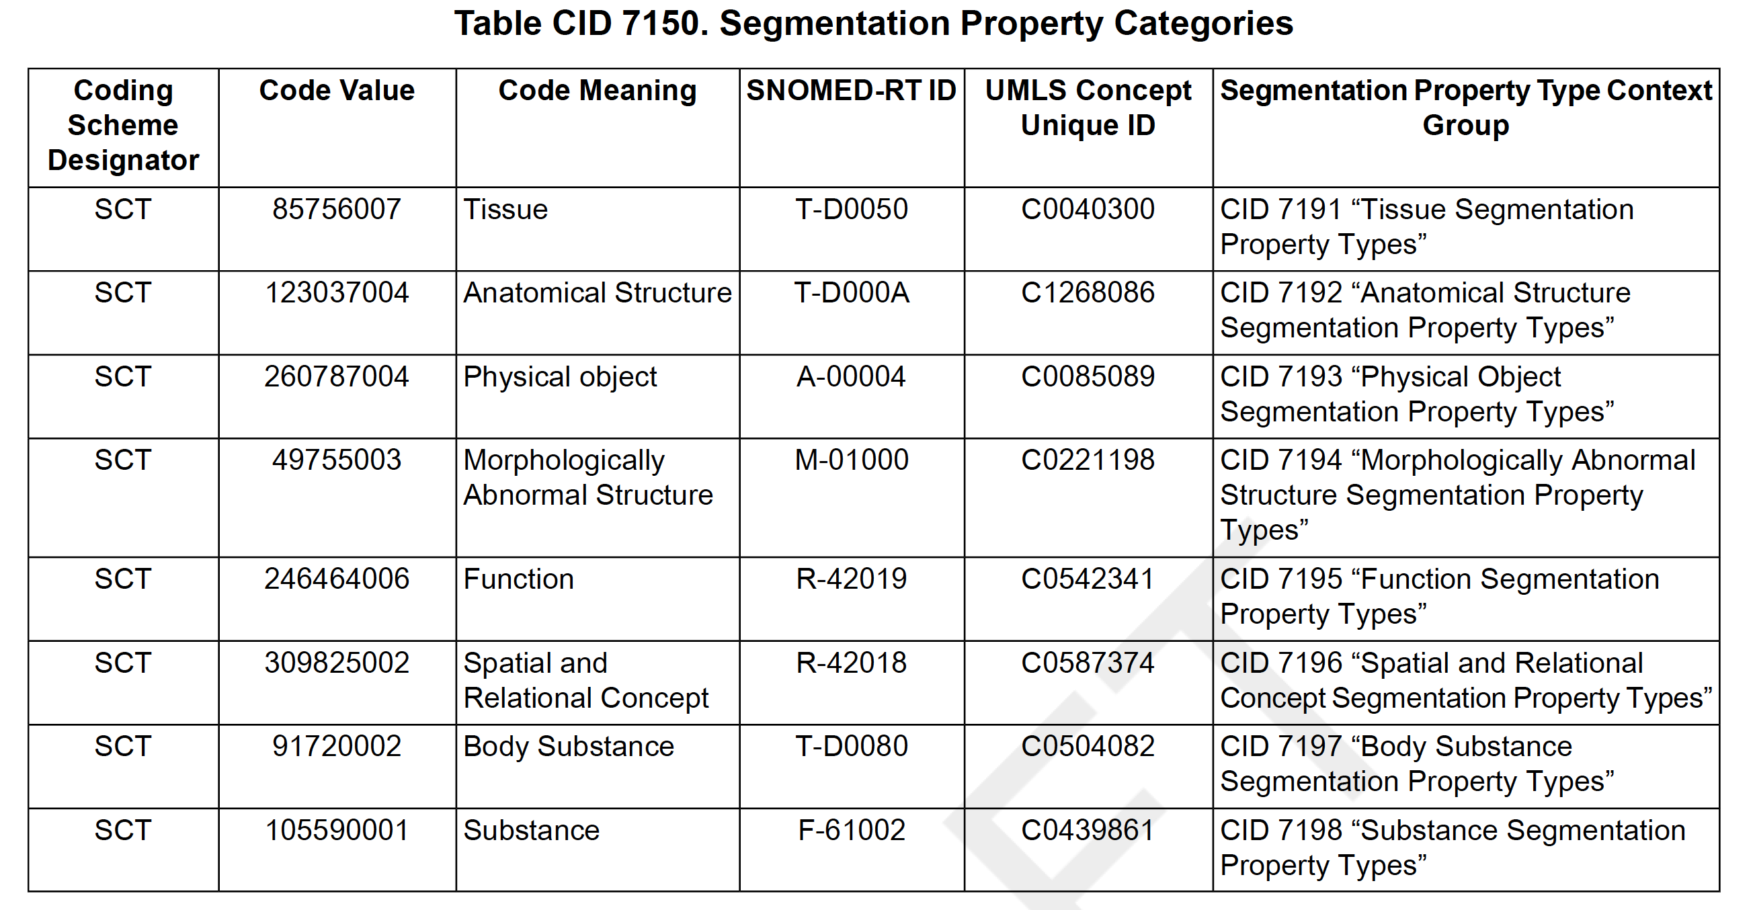
ROI and Segmentation Codes

Slide 32
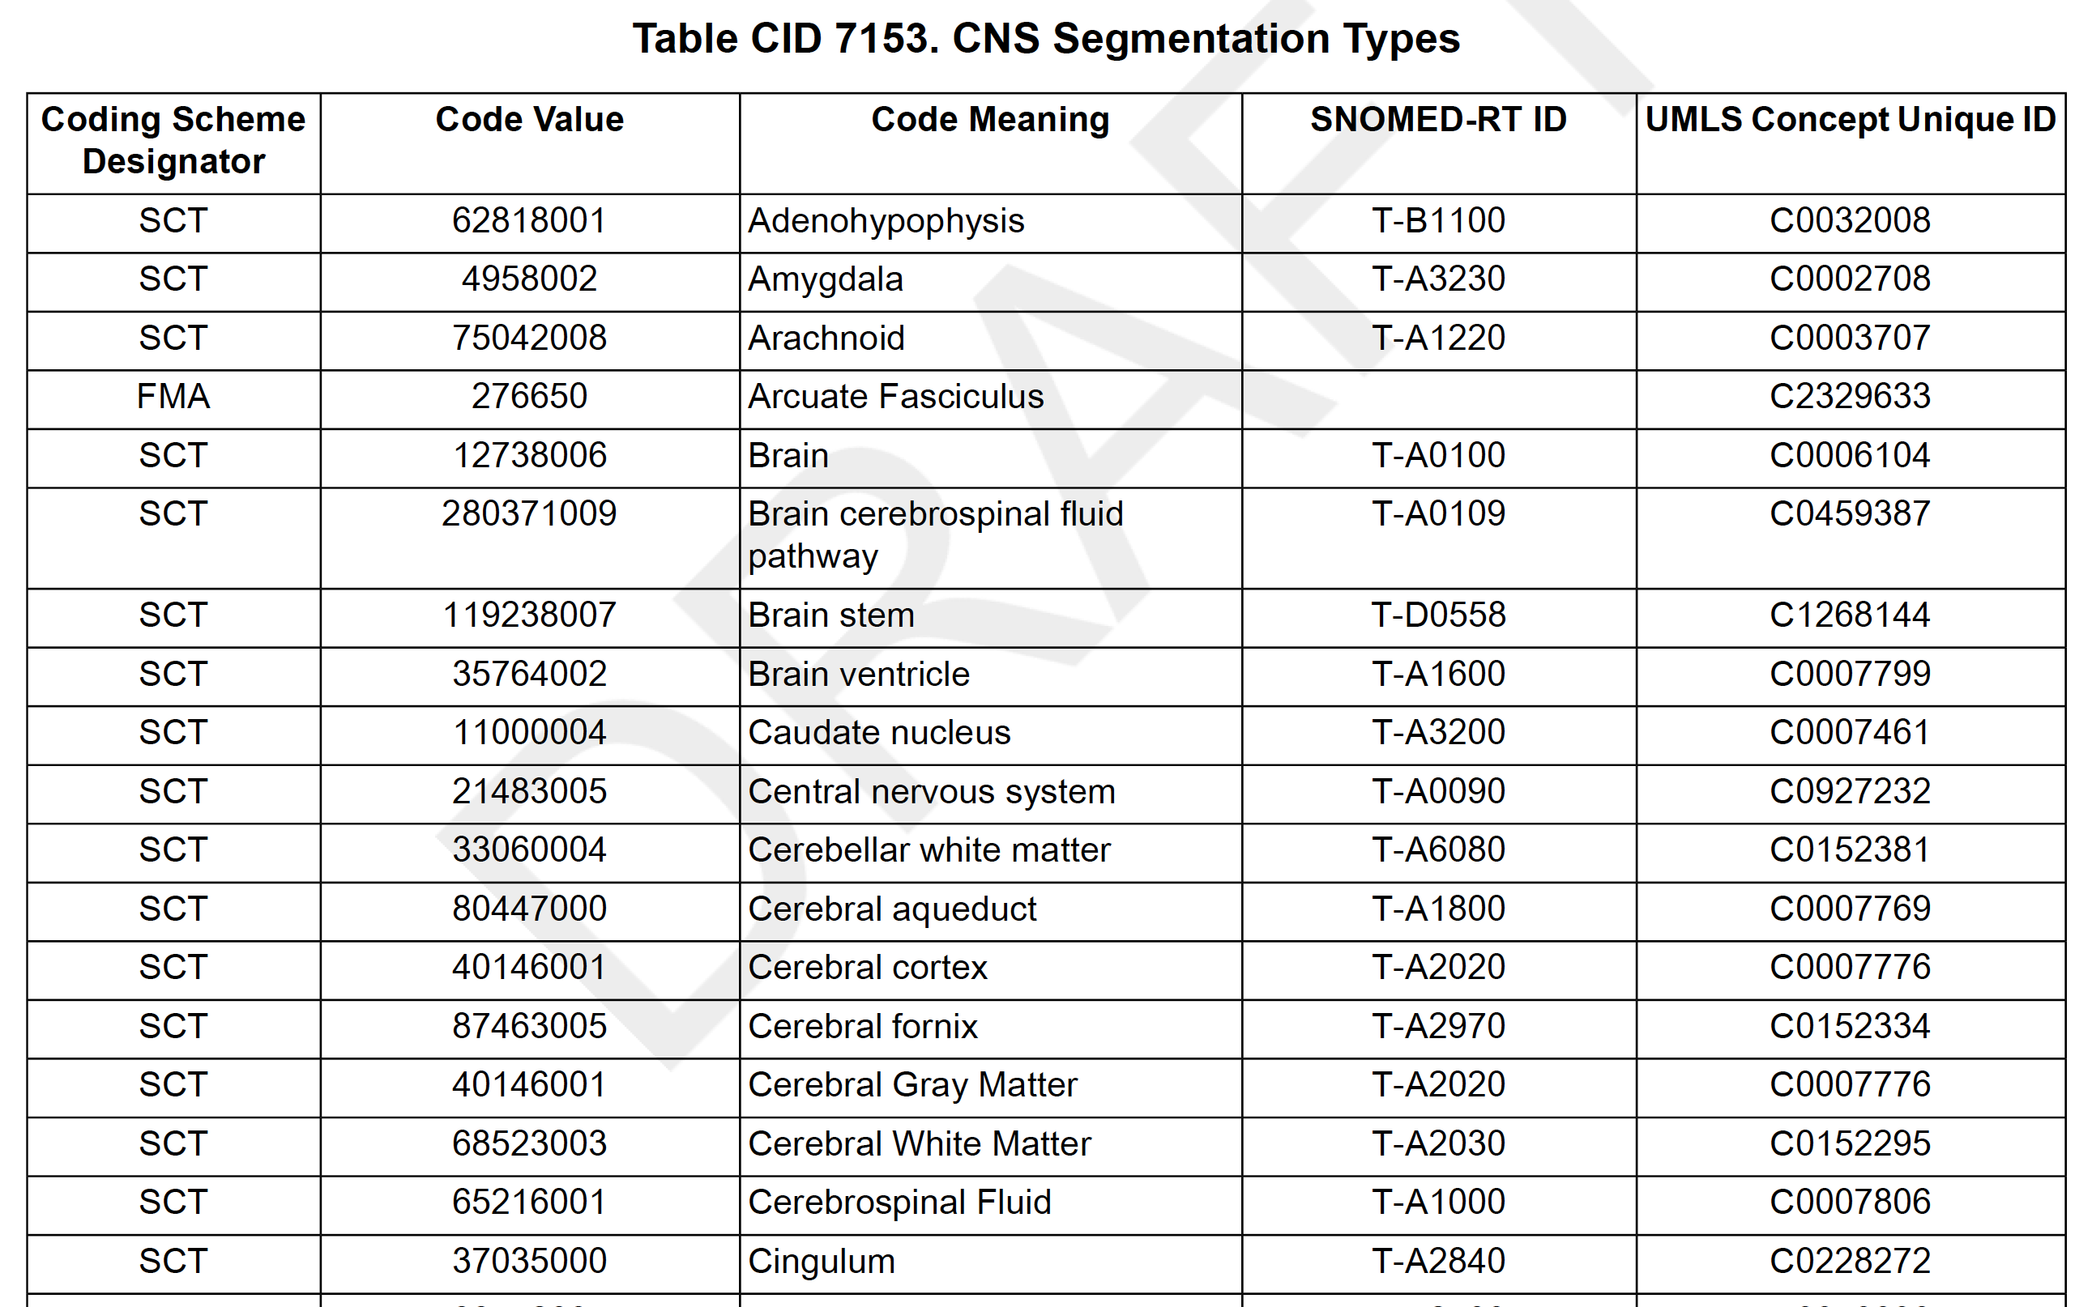
ROI and Segmentation Codes

Slide 33
Constrained by Templates
Generic tree of content items has unbounded complexity, so need constraints
Templates for interoperability for specific use cases
e.g., Mammography CAD
Templates for entire structure
“root level”
Templates for parts of structure – re-usable
e.g., Volumetric ROI Measurements
Defined in PS3.16, follow pattern similar to Module tables in PS3.3
(coded) name of content item
requirement type
multiplicity
conditions
value set for coded values
coded units for numeric values

Slide 34
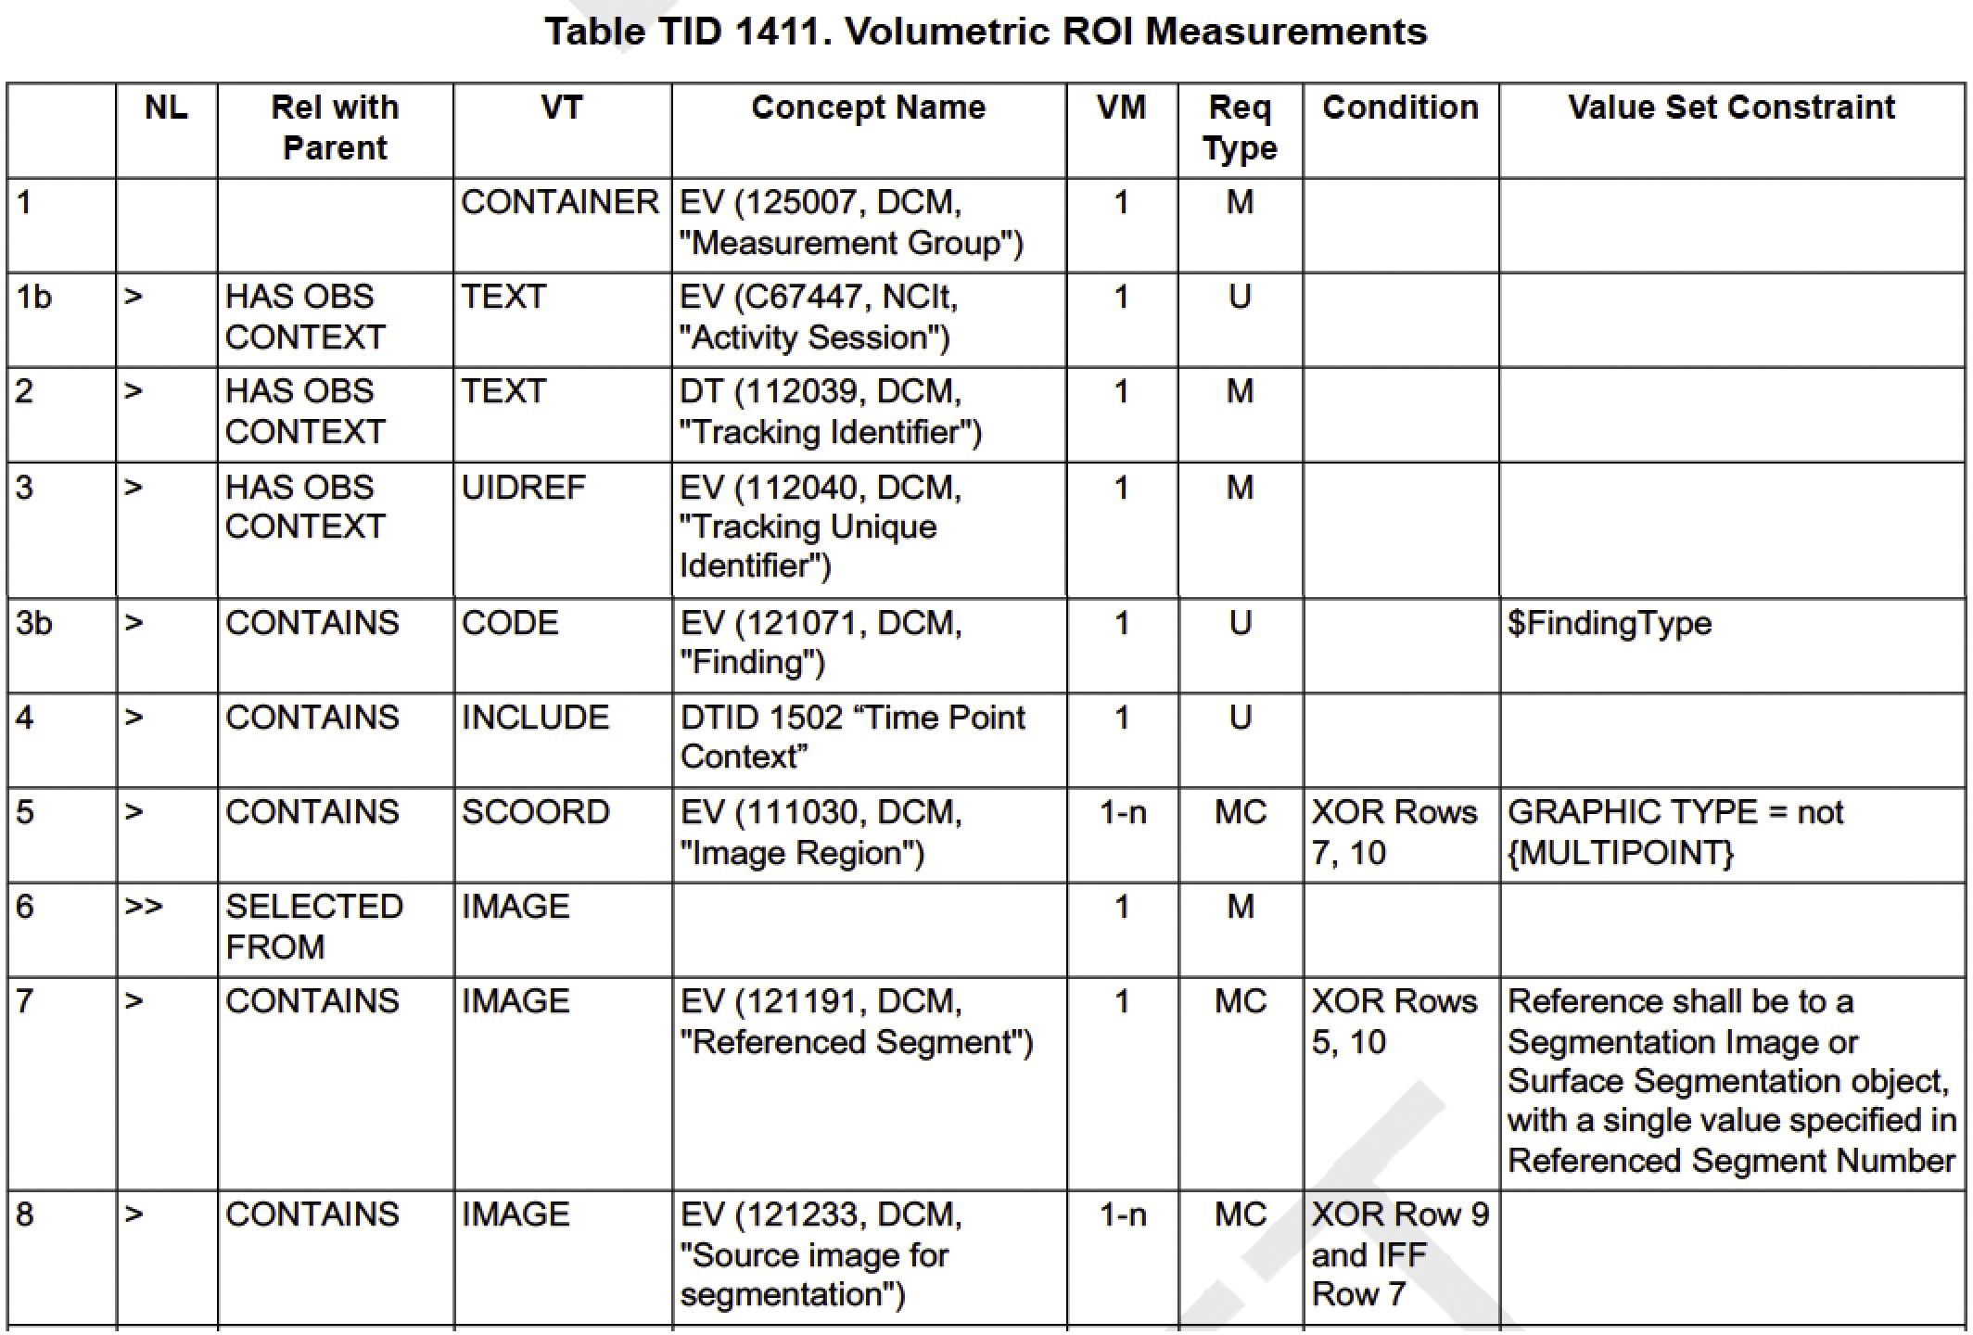

Slide 35
Key Object Selection Document
Specialized form of DICOM Structured Report
SOP Class constrains to specific template
Essentially
list of images and other DICOM objects (“manifest”)
coded Document Title, e.g., “For Clinical Trial Export”
text description
Used in IHE as
Key Image Note profile
manifest for XDS-I profile

Slide 36
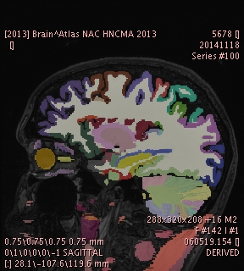
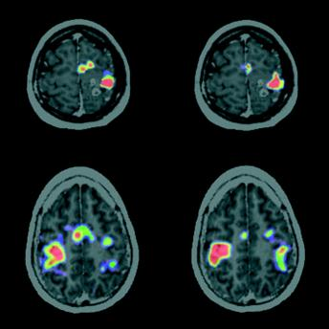
Segmentations and Parametric Maps
Per-voxel encoding of numeric or label values
“Images”, but not just “pretty pictures”
modality-specific or secondary capture; single or multi-frame
Segmentations
binary, probability, fractional occupancy
multiple segments (multiple labels)
Parametric maps
pixel value “means something” – real world value map (RWVM)
integers +/- (linear) rescaling to floats (usable by any viewer)
“derived” images of modality-specific SOP Class
recently added floating point voxels and SOP Class (Sup 172)
Leave “fusion” (superimposition) to application
e.g., PET SUV on top of CT
can use Blending Presentation State to specify what to fuse
Harvard Brain Atlas NRRD Label Map converted to DICOM Segmentation
Meyer P T et al. J Neurol Neurosurg Psychiatry 2003;74:471-478

Slide 37
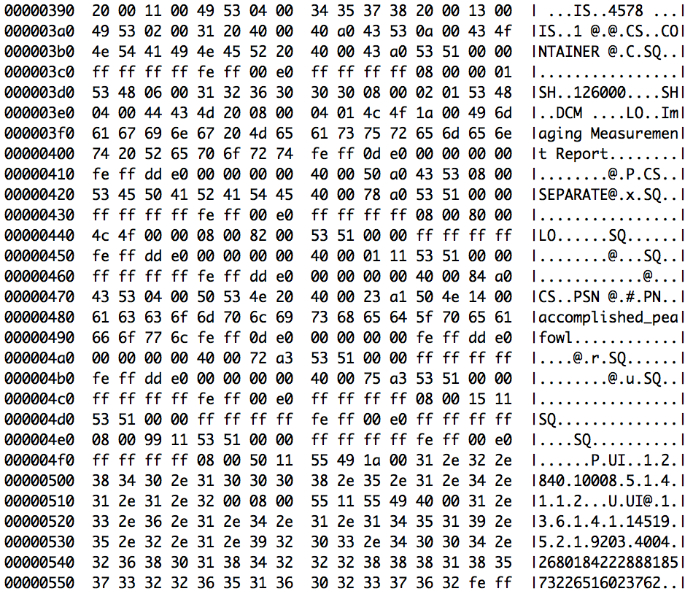
Traditional Binary DICOM SR

Slide 38
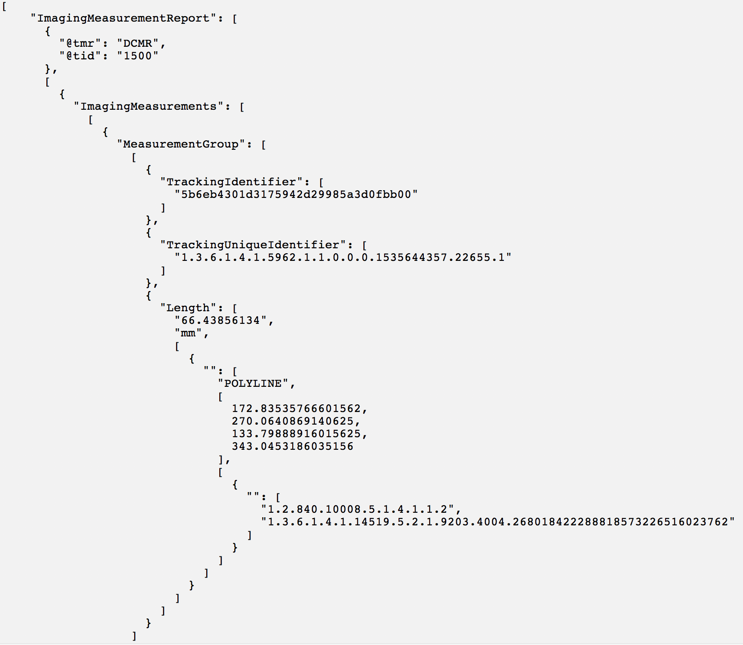

Slide 39
Goals for Simplified DICOM SR in JSON
Full-fidelity round trip with actual DICOM SR for all constructs (any template)
Simple (enough to hand write or copy from examples)
Compact (even terse)
Understandable (relatively)
Unambiguous (easily parsable)
Leverage any existing actual or de facto JSON or evolving AI standards
Platform independent
Capable of encoding extracts separated from composite context (such as without “header” rather than content tree, image library, etc., which could be added by separate tool/pass)

Slide 40
Pipeline to add missing stuff to JSON
Just Number, Coordinates and Image Reference
+ Lesion Identifiers
+ Image Library and Evidence Sequences
+ Composite Context
AI Algorithm
Lesion Manager
DICOM Image Aware System
Patient-Study Aware System
PACS

Slide 41
Conclusions
DICOM has extensive result reporting encoding capability
Getting human’s to use it is challenging, beyond well established applications like ultrasound measurements
Machines can produce and consume DICOM results; e.g., mammography CAD results are always encoded as DICOM SR
Scope of ML/AI use cases for results are adequately covered
All results can be encoded as DICOM SRs, segmentations or parametric map images
Templates and codes are already defined for many applications (e.g., TID 1500 for measurements and categorical assessments)
Modern developer-friendly approaches (JSON representation of SR) are being addressed
Novel annotation mechanisms (e.g., vast numbers of nuclei in WSI) may require extensions to DICOM (à la MR tractography)

