Slide 1
DICOM Educational Conference Bangkok, Thailand
3-4 October 2019
DICOM News
Siemens healthineers
Björn Nolte
COMPANY’S LOGO
Copyright DICOM® 2019 www.dicomstandard.org #DICOMConference2019 #DICOM @@The_DICOM_STD

Slide 2
DICOM News – How to keep up with the latest updates to the standard
DICOM News
How can I easily get a brief overview of the latest progress of the DICOM standard?
DICOM Progress (last five years)
Which functionality has been added over the last five years?
DICOM Added functionality over the years
During which year was a particular feature introduced in the DICOM standard?
Which parts of the standard were affected?
What was the final version of the feature before being added into the standard?

Slide 3
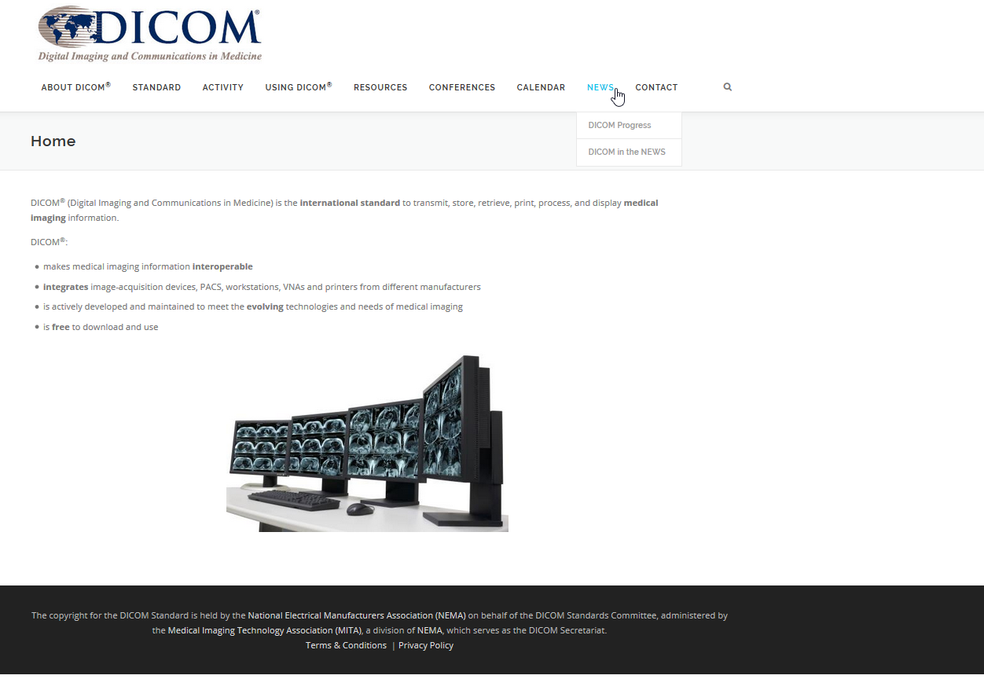
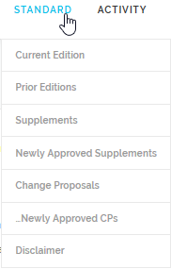

Slide 4
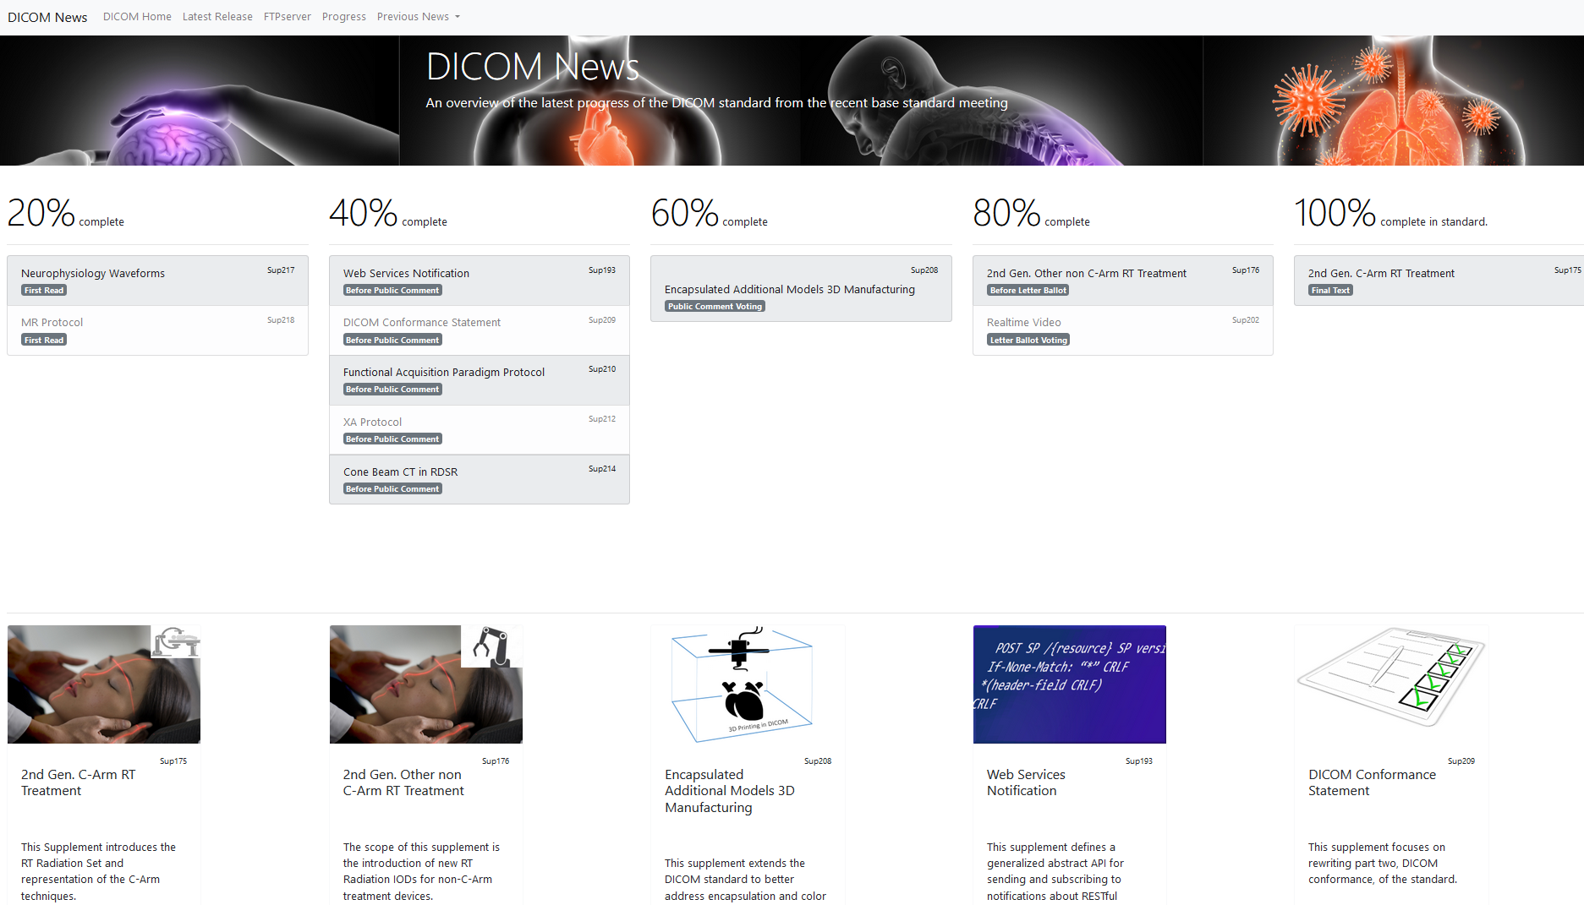
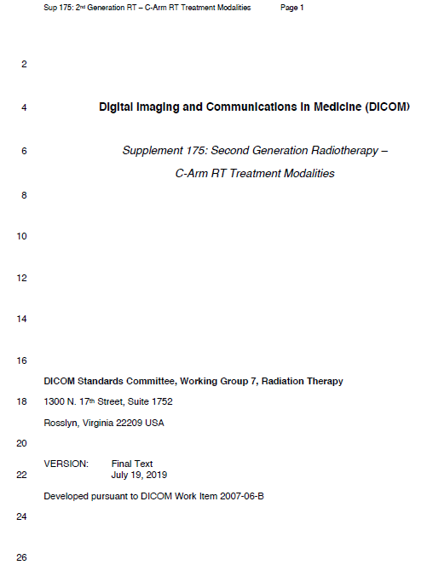
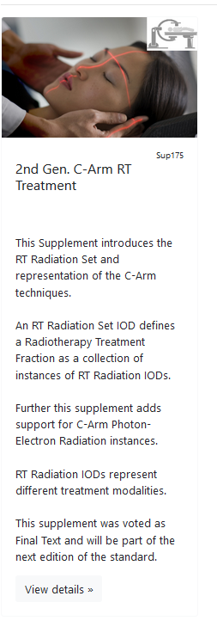

Slide 5
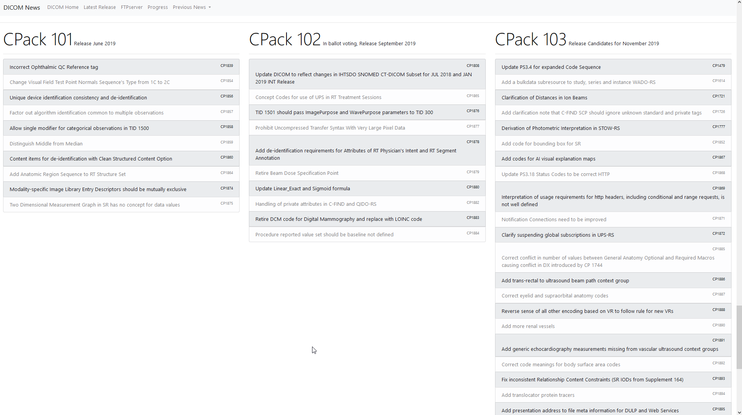

Slide 7
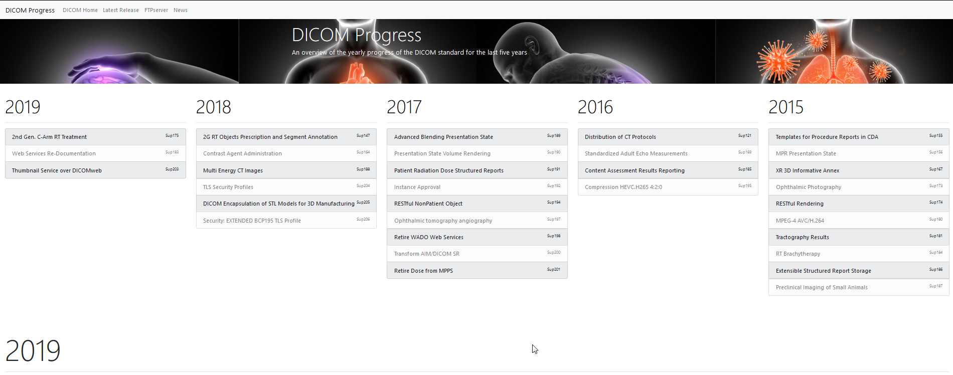

Slide 8
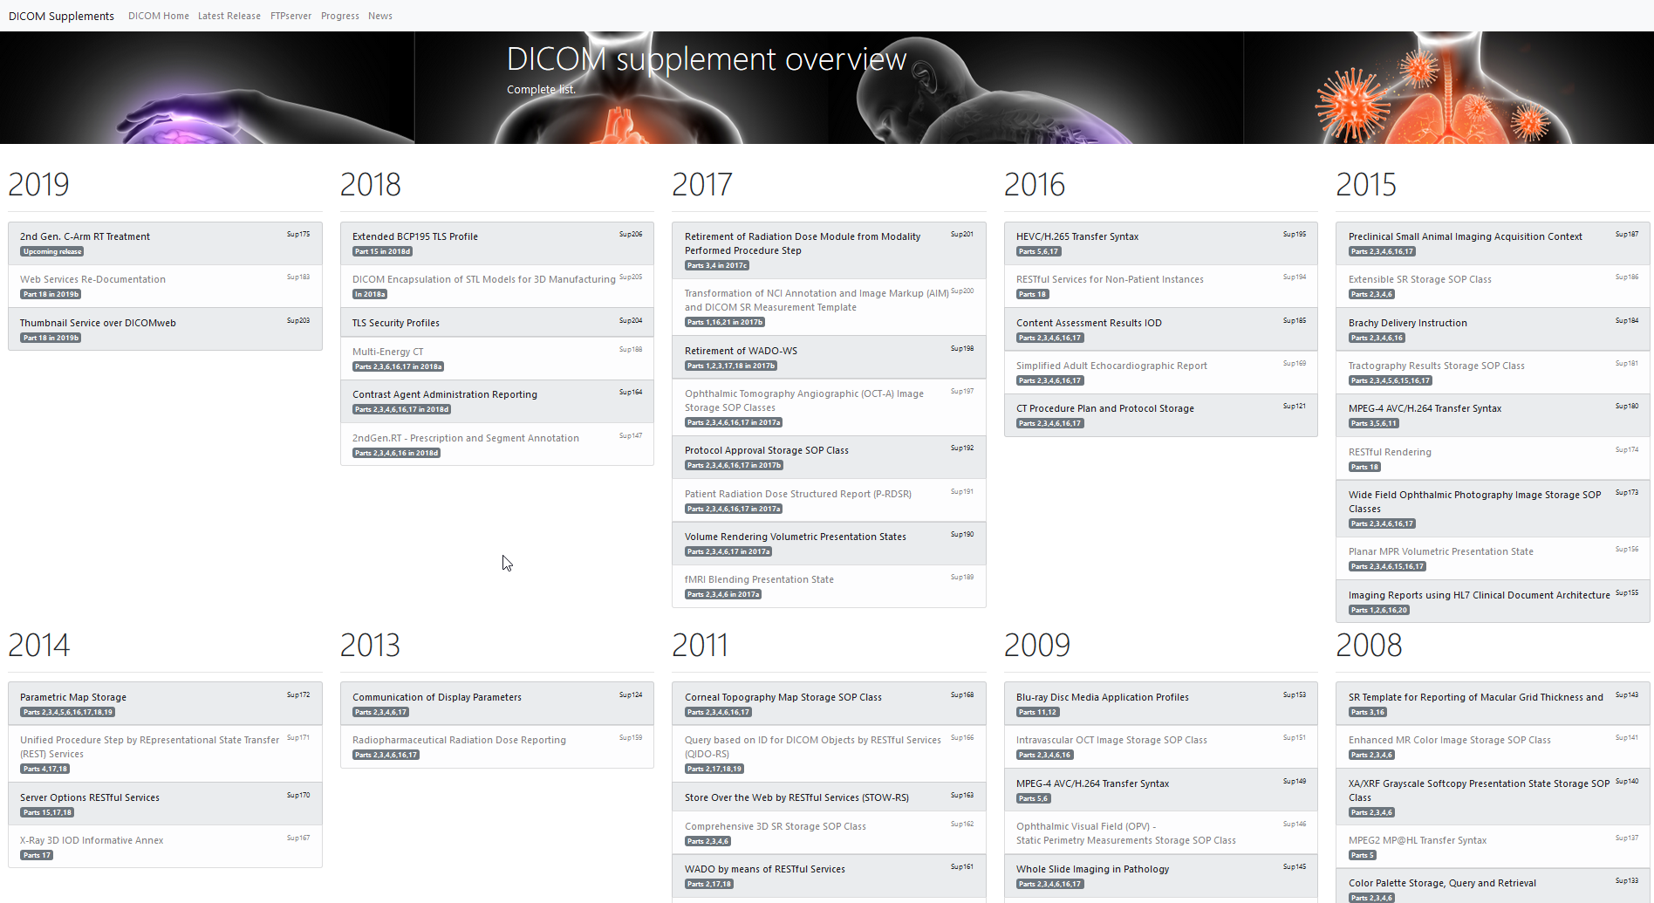
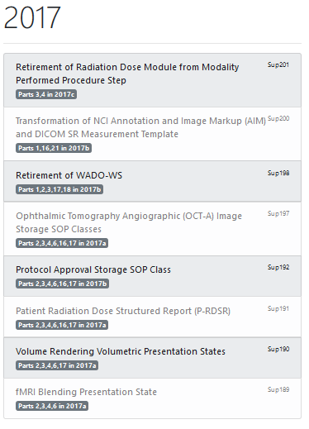

Slide 9
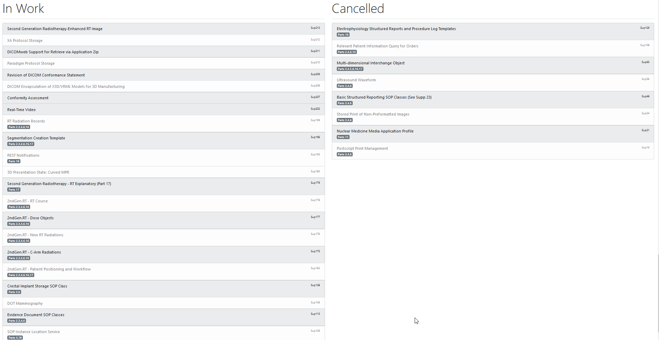

Slide 10
Presenter’s contact information
Björn Nolte
Bjoern.nolte@siemens-healthineers.com
Siemens Strasse 3, 91301 Forchheim, Germany
Thank you !

