Slide 1
WG34: Photoacoustic Imaging
Supplement 229
WG-06 November 2022 Meeting
Public Comment – IOD Summary
WG34 Secretary: Amanda Kalkwarf, SPIE WG34 Chairs: Brian Bialecki, ACR Stefan Morscher, iThera Medical
Contributing members:
Allison Bertrand, SENO Medical
Bryan Clingman, SENO Medical
Ben Cox, UCL
Patricia Smole, iThera Medical
Patrick Leisching, iThera Medical

Slide 2
Introduction to Photoacoustic Imaging

Slide 3
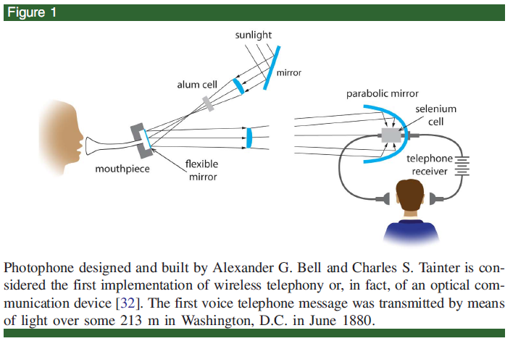
Overview – Photoacoustic (PA) Imaging
Photo-
Narrowband laser pulses (nanosecond duration at milli-joule energies))
Acoustic
Broadband response
kHz-MHz range
Photophone, 1880
Ntziachristos, Vasilis, and Daniel Razansky. ‘Molecular Imaging by Means of Multispectral Optoacoustic Tomography (MSOT)’. Chemical Reviews 110 (2010): 2783–94.
Manohar, Srirang, and Daniel Razansky. ‘Photoacoustics: A Historical Review’. Advances in Optics and Photonics 8, no. 4 (31 December 2016): 586–617.

Slide 4
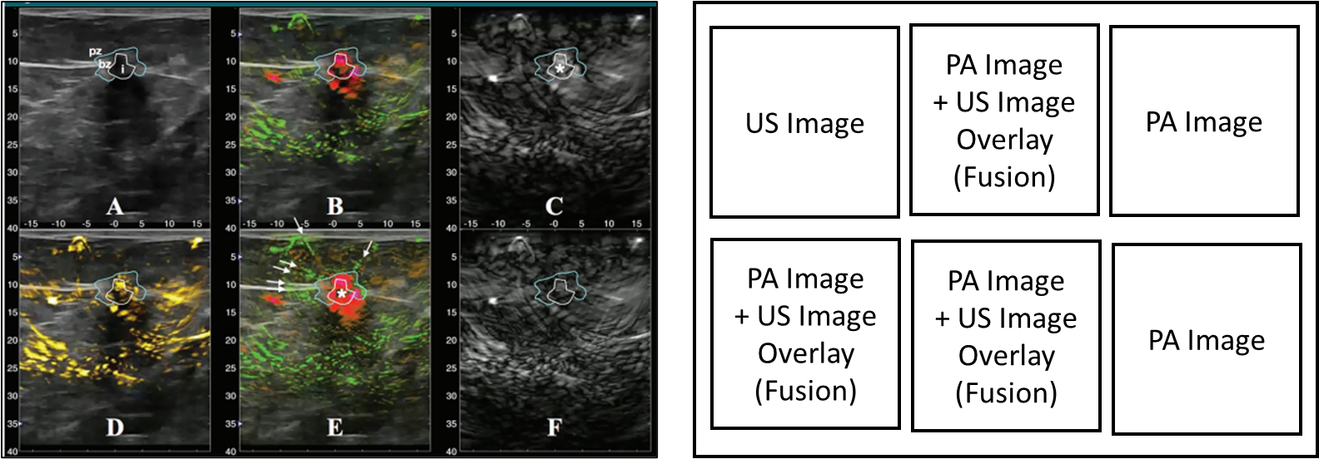
PA Display Examples in Literature Illustrates some of the potential use cases
https://doi.org/10.1148/radiol.2017172228
PA acquisition with two input wavelengths and ultrasound (US), displayed in six different panels with PA Images (C, F), US images (A), and three overlay (fusion) images with PA and US (B, D, E) generated from three algorithms for processing the PA wavelengths and fusing with ultrasound..

Slide 5
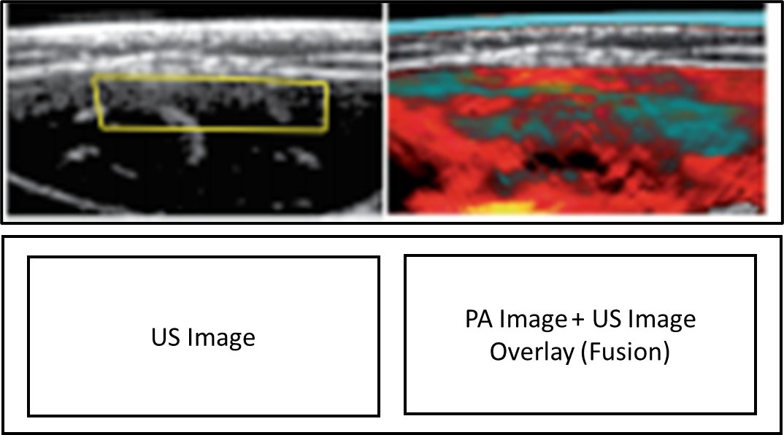
PA Display Examples in Literature Illustrates some of the potential use cases
https://doi.org/10.1038/s41551-017-0068
PA acquisition with two ranges of multispectral input wavelengths and ultrasound (US), displayed in two different panels with the US image (left) and the PA image (right) generated from two algorithms for processing of the PA wavelength in a “cyan” and a “hot” colormap and fusing with ultrasound.

Slide 6
PA Display Examples in Literature Illustrates some of the potential use cases
https://doi.org/10.1038/s41551-017-0068
PA acquisition with one input wavelength displayed as a PA image in three planes (left) and a PA image (right) processed with an algorithm to show frequency separation in three planes.

Slide 7
Photoacoustic Imaging IOD Overview
Imaging data
PA Images
Imaging metadata
Derived from IPASC* Metadata, tailored more towards clinical use
PA IOD Attribute Modules
Photoacoustic Image Module
Photoacoustic Transducer Module
Photoacoustic Reconstruction Module
Per-Frame Photoacoustic Excitation Characteristics Macro
Per-Frame PA Image Frame Type Macro
Other standard DICOM modules (Patient, Study, Series, Image)
*IPASC = International Photoacoustic Standardisation Consortium

Slide 8
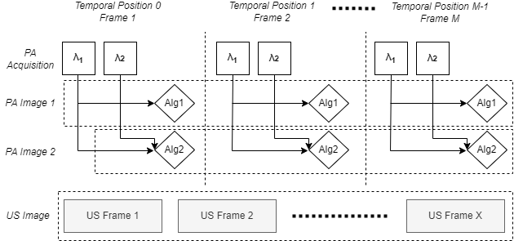
PA Example with Complementary Images
PA Images – one or more wavelengths processed with vendor-defined algorithms
Optional: Complementary Images (outside of the scope of the PA IOD)

Slide 9
Photoacoustic Imaging IOD vs Ultrasound
The Photoacoustic (PA) IOD is a stand alone as a modality separate from ultrasound
Some implementations might have only PA (optical wavelength data), which others might have complementary data from another modality.
Because many implementations do use standard pulse/echo ultrasound systems for data acquisition, the PA IOD was modeled loosely on the Enhanced US Volume IOD
For ease of compatibility where presentation might include side-by-side synchronized display or overlay (fusion) of PA images on the display of US images.
Fusion details are outside the scope of this IOD, but it is suggested that the Advanced Blending Presentation State (ABPS) could be used.

Slide 10
PA Dimension Indexing and Image Type
Dimension Indexing attributes:
Image Position (Volume) (0020,9301)
Temporal Position Time Offset (0020,930d)
PA Dimension Index Id (gggg,ee93)
Uniquely relates the combination of the Algorithm Name (0066,0036) and the Excitation Wavelength Sequence (gggg,ee94) to describe how an acquisition modality creates a PA image with one or more wavelengths and a vendor-defined algorithm.

Slide 11
CID/TID Tables
Extension to Table CID 12033. Ultrasound Transducer Geometry
Added two transducer geometries
Reviewed with WG-12 (April 2022), concurrence on keeping change in Supp 229
TID YYYYY Skin Type Acquisition Context
References DCID 4401 “Fitzpatrick Skin Type”, usage in the PA IOD is related to optical absorption; separate from Dermoscopy usage related to skin cancer

Slide 12
Context Identifier (CID) Tables
CID XXYYY Illumination Type
Description of the arrangement of optical illumination sources
CID XXYYZ Acoustic Coupling Medium
Acoustic coupling medium that was used to allow sound propagation from the imaged subject to the transducer
CID XXYYB Ultrasound Transducer Technology
Technology employed by the receiving transducer (piezo, MEMS, interferometric)
CID XXYYC Speed of Sound Correction Mechanism
Speed of sound correction mechanism used in image reconstruction

Slide 13
Part 17 – Explanatory Information
AXXX.1 Introduction
AXXX.2 Use Cases
AXXX.3 Acquisition Examples
AXXX.4 Real World Display Examples

Slide 14
Part 17 – Acquisition Examples
Example 1: PA Standalone Image
Example 1a: PA Single Wavelength Standalone Image
Example 2: PA/US Coupled Acquisition
Example 3: Stationary Tomographic 3D PA/US Coupled Acquisition

