Slide 1
Supplement 222: Whole Slide Microscopy Bulk Annotations Storage
Working Group 26: Pathology
2021/01 WG 6 Public Comment

Slide 2
Overview
Whole Slide Images (WSI) pyramidal, tiled
Annotations needed for case, slide, location
Codes, test, measurements and scores
Human or machine generated
Few or millions of objects
SR suitable for few (human)
SR doesn't scale to millions (machine)
SEG may not be desirable (want shapes)

Slide 3
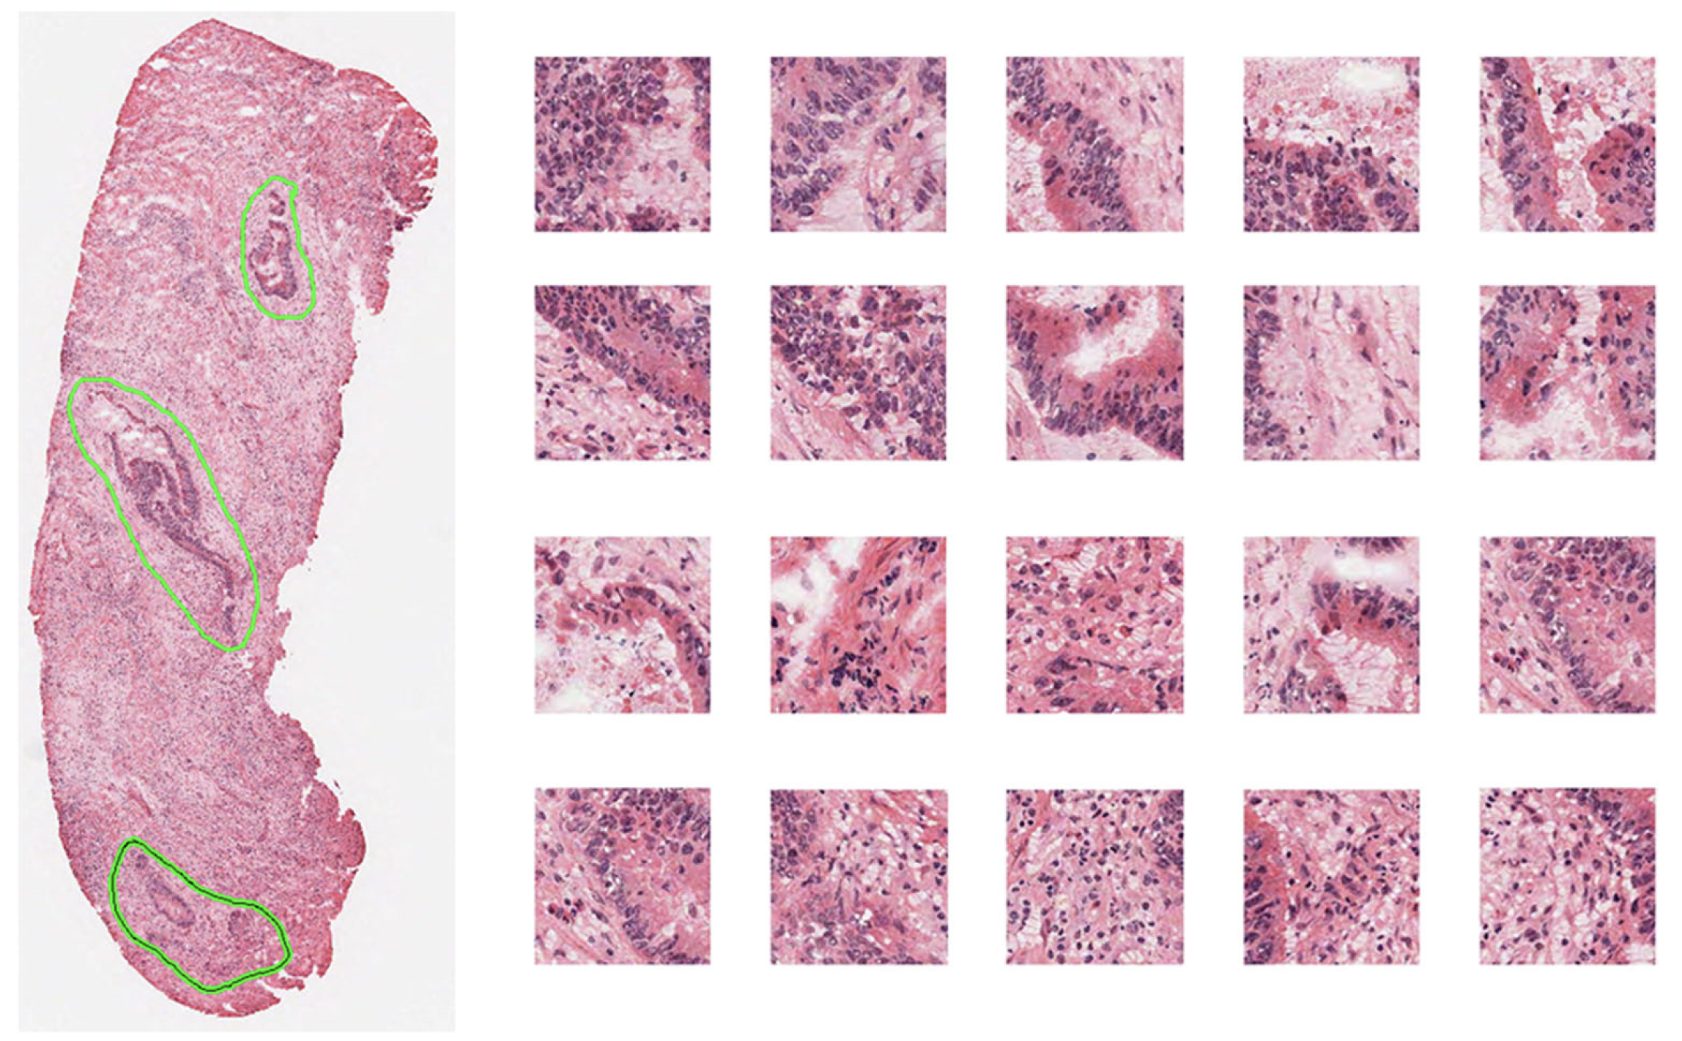
Yoon et al. Tumor Identification in Colorectal Histology Images
Using a Convolutional Neural Network. J Digit Imaging. 2018 Jul 31;1–10.

Slide 4
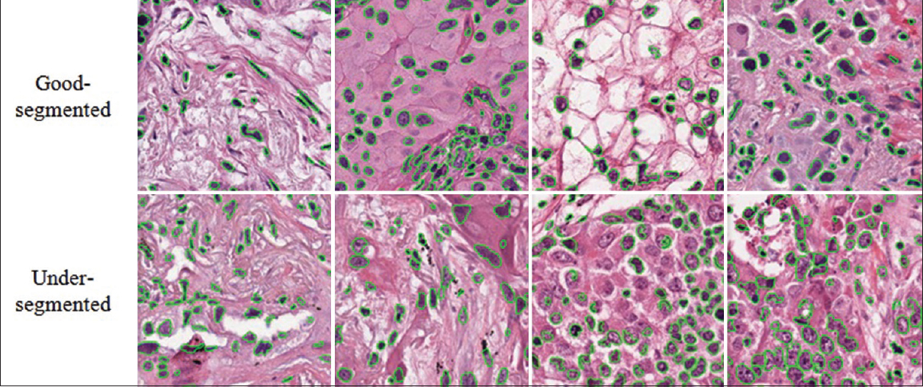
Wen et al. A methodology for texture feature-based quality assessment
in nucleus segmentation of histopathology image. JPI. 2017.

Slide 5
Requirements
Need connected point-based objects
closed polygons
open polylines
rectangles
individual points (e.g., center)
Need parameterized shapes
circles and ellipses
Usually all of same type for same purpose
group by common form and purpose

Slide 6
Design Choices
Can transcode to similar structures in SR
3D rather than 2D coordinates (? - Open Issue)
same as SR SCOORD3D (slide relative)
independent of pyramid layer or tile (boundaries)
Factor out unchanging dimensions
Z coordinate
optical path
Array of coordinates indexed by object
re-use vertex encoding of surface segmentation

Slide 7
Annotation Group Sequence Item (1-n)
Long Primitive Point Index List
Point Coordinates Data
0
14
24
34
…
0.66675001 | 0.032000002
0.66649997 | 0.032249998
0.66649997 | …
0.7829001 | 0.163000002
… | …
Graphic Type = POLYGON
Common Z Coordinate Value
Annotation Group Number
Annotation Group Label
Annotation Property Type Code Sequence

