Slide 1
Supplement 226
Confocal microscopy
DICOM Working group-19 Dermatology
Public comment
Editor: Liam cafferY
October 2022

Slide 2
Confocal microscopy
Non-invasive imaging technique
Can be done in-vivo or ex-vivo
Used for the diagnosis of range of skin disease with an emphasis on melanoma
Precise diagnosis in difficult lesions

Slide 3
In-vivo confocal microscopy
Allows examination of the skin at resolutions comparable to histology without performing a biopsy
Virtual biopsy
Adjunct to dermoscopy (or clinical imaging) as provides cyto-architectural architecture of different dermoscopic pattern
Acquisition in reflectance mode

Slide 4
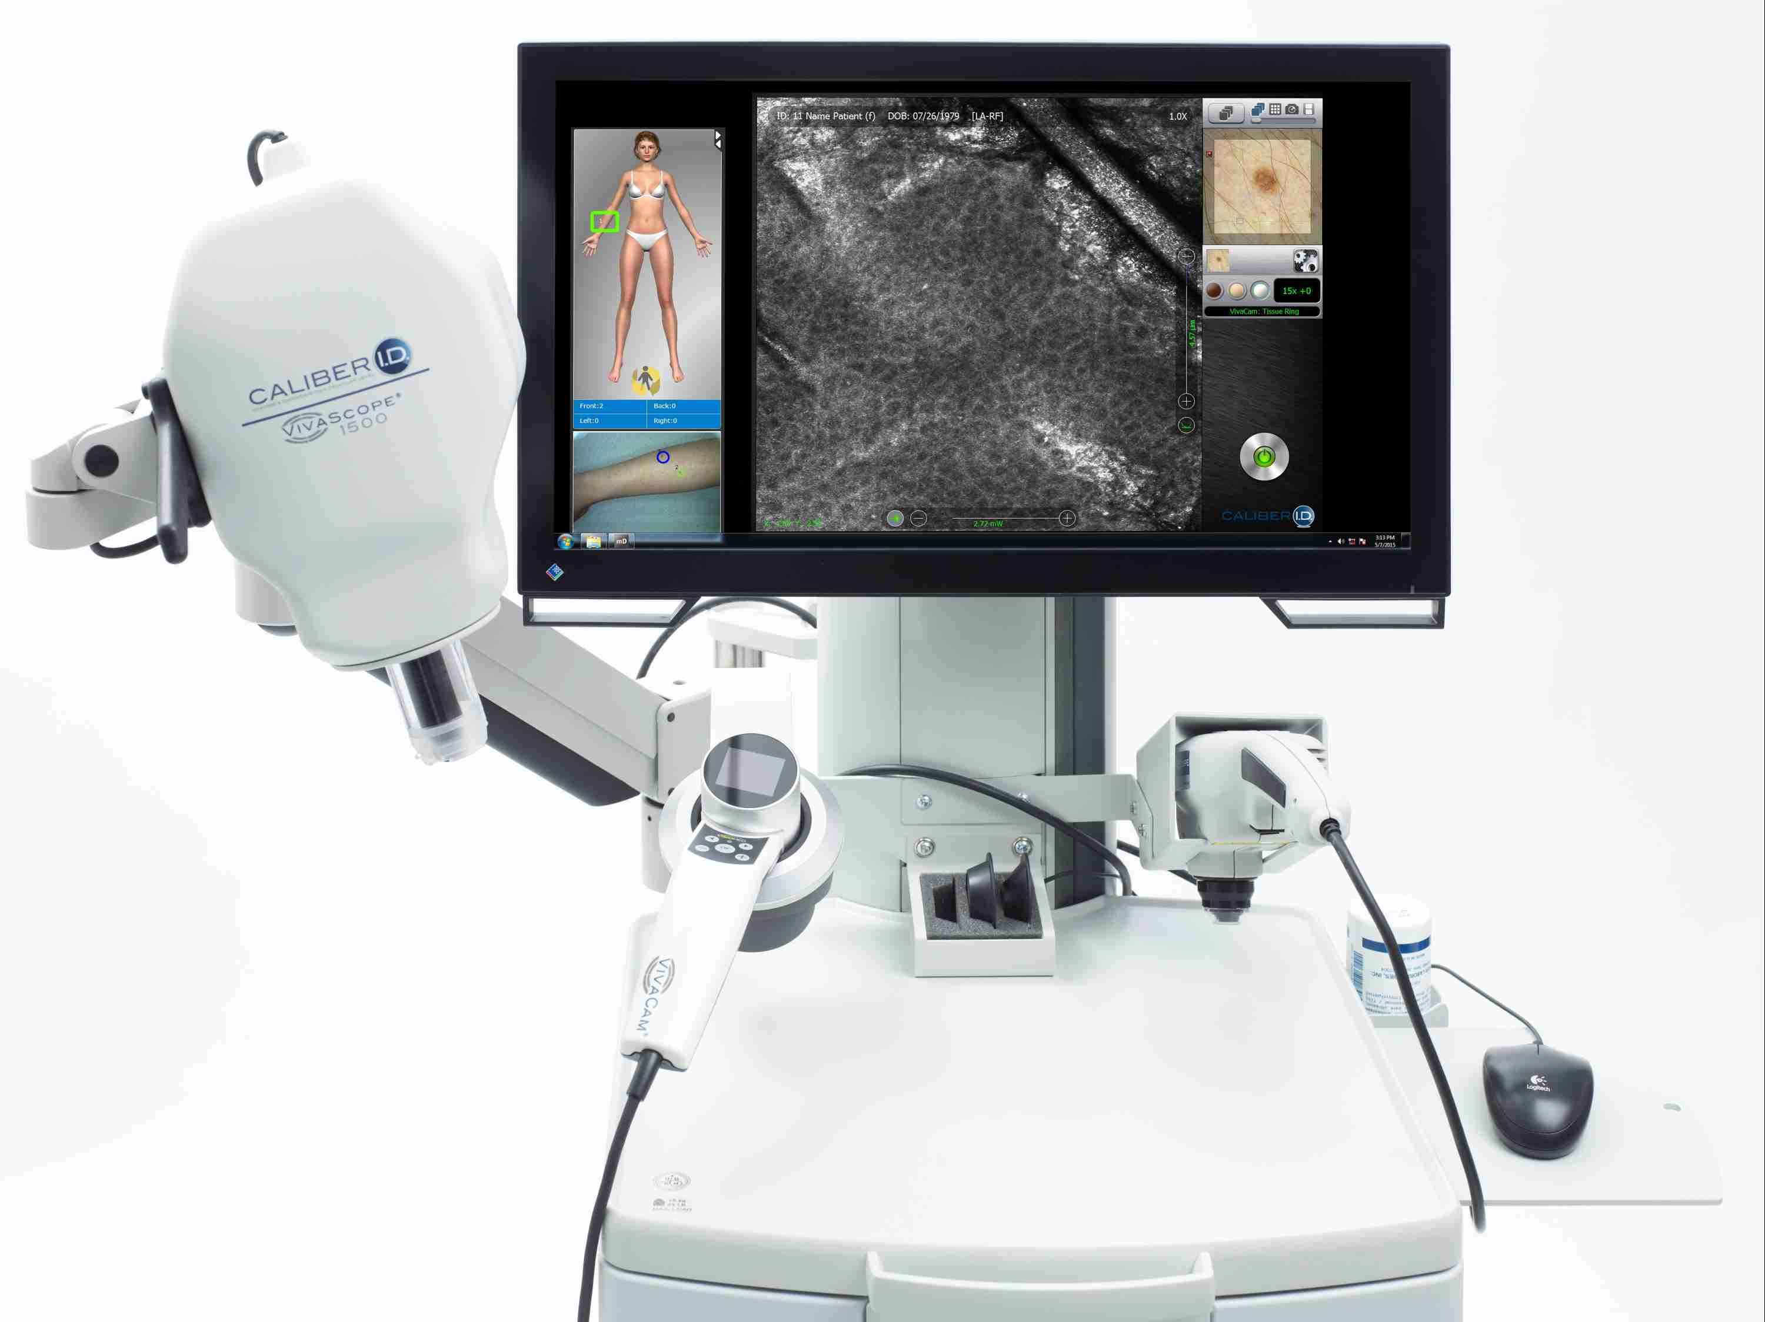
MICROSCOPE
MICROSCOPE
Dermoscope

Slide 5
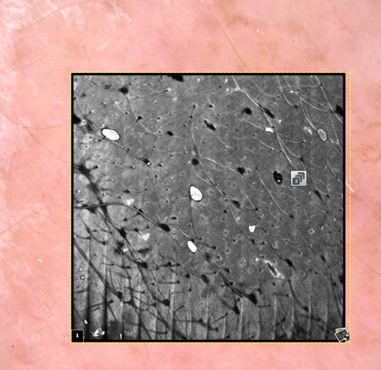
In-vivo confocal microscopy acquisition
Window attached to skin
Dermoscopic image acquired
Confocal microscope placed in window
User interface: Acquisition area drawn on dermoscopic image
Stage co-ordinate are transmitted to confocal microscope (up to 8mm x 8mm)

Slide 6
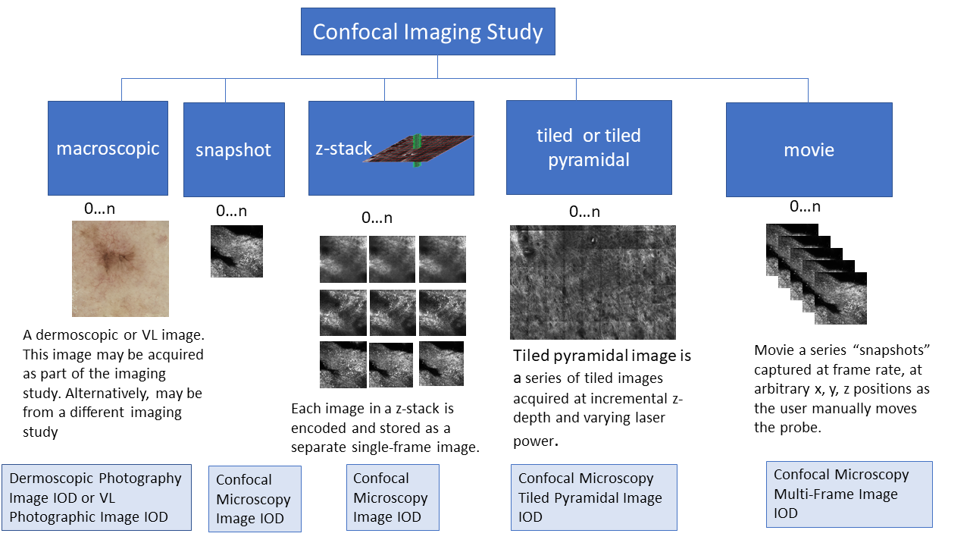
In-vivo confocal microscopy acquisition types

Slide 7
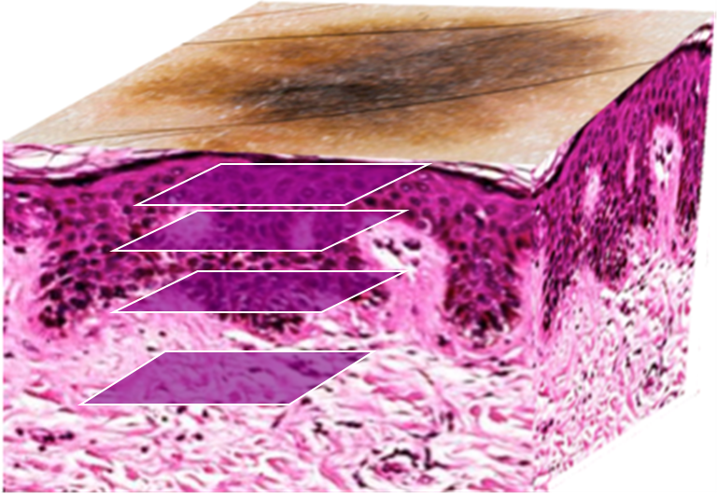
Tiled pyramidal or Mosaic Stacks

Slide 8
Ex-vivo confocal microscopy
Freshly excised tissue
Fluorescent stain
Reflectance or Fluorescence modes

Slide 9
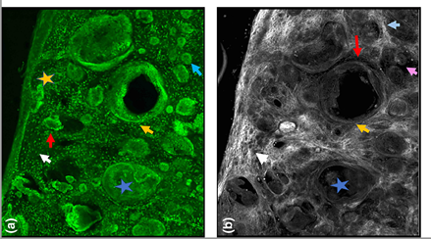
Ex-vivo RCM of BCC Specimen with acridine orange stain
Fluorescence
Reflectance
Image source https://onlinelibrary.wiley.com/doi/full/10.1111/bjd.18239

Slide 10
Progress
Major changes
Originally 1 IOD now 3 IODs
Additional IODs Confocal Microscopy Tiled Pyramidal Image IOD and Confocal Microscopy Multi-Frame Image IOD
Skin Cancer Acquisition Context > Skin Imaging Acquisition Context
Add CID Specimen stains for CM (do not use existing CID)
Added Acquisition IE and Multi-Resolution Pyramid IE, Slide Pyramidal Tile Organisation module, Removed ICC Profile module
Moved some content to PS3.17
Added explanatory diagrams
Re-used attributes (power, wavelength) from OCT
Minor changes
Formatting and organisation
Value representations
Added microscope to Optical Magnification Factor

